Slide 1
Weekly Report
Adri Priadana
October 24, 2023

Slide 2
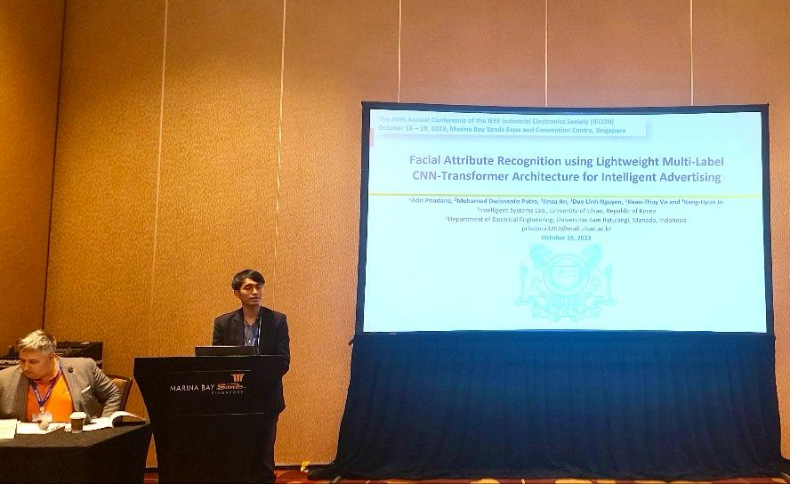
Last Week Activities
Attended and presented at IECON 2023 in Singapore
Course (Korean Conversation Language)
Learning the material (two meeting) and filled the workbook that I missed when I went to IECON 2023
Face Recognition for TII
Status: Awaiting Review Scores

Slide 3
This Week Activities
Course (Korean Conversation Language)
Doing the course
Continue to learn the material (two meeting) that I missed when I went to IECON 2023
Prepare for the midterm exam (Tuesday, October 31, 2023)
TII Journal → Human Action Recognition
Continue to learn the code of the framework, MMCV, and the model for skeleton based human action recognition
Continue to fine tune the model and look for new ideas
Try to apply Spatial Temporal MHSA

Slide 4
Thank You

Slide 5
Last Week Activities
Human Action Recognition → TII Journal
Use different number of frame
Regarding the paper, the uniform sample $n$ frames took from a video by dividing the video into $n$ segments of equal length and randomly select one frame from each segment.
Model | Number of Frames | Param (M) | GFLOPs | Original NTU60 dataset (40K to Train) | NTU60 dataset (5K to Train)
Paper | 48 | 2.0 | 15.9 | 93.70
Our Train | 48 | 2.0 | 15.9 | 93.06 | 86.03
 | 32 | 2.0 | 10.56 | 93.10 | 86.60
 | 24 | 2.0 | 7.92 |  | 86.16
 | 36 | 2.0 | 11.88 |  | 86.43

Slide 6
Last Week Activities
TII Journal → Human Action Recognition
Continue to fine tune the model and look for new ideas
Baseline
Stem | $$1×7^{2},32$$
Stg1 | $$\left[\begin{matrix}1×1^{2},32 \\ 1×3^{2},32 \\ 1×1^{2},\text{128} \end{matrix}\right]×4$$
Stg2 | $$\left[\begin{matrix}3×1^{2},\text{64} \\ 1×3^{2},\text{64} \\ 1×1^{2},\text{256} \end{matrix}\right]×6$$
Stg3 | $$\left[\begin{matrix}3×1^{2},\text{128} \\ 1×3^{2},\text{128} \\ 1×1^{2},\text{512} \end{matrix}\right]×3$$
GA, FC
Model | Param (M) | GFLOPs | Original NTU60 (40K to Train) | NTU60 (5K to Train)
Paper | 2.0 | 15.9 | 93.70
Paper (Our Train) | 2.0 | 15.9 | 93.06 | 86.03
Add TA (Effi) >> Base1 | 2.0 | 15.9 | 93.15 | 86.83
Add TA (Effi) 2nd Try | 2.0 | 15.9 |  | 86.27
Base1 + C1 Sp3&5 (Stg 2&3) >> Base2 | 1.8 | 14.9 |  | 86.23
Base2 + C2 Sp3&5 (Stg 2&3) >> Base3 | 1.8 | 14.8 | 93.01 | 86.85
Base2 + C2 Sp3&5 Stg2 + C2 Sp3&5&Tf&Iden (0.5,0.25,0.125,0.125) Stg3 | 1.63 | 14.6 | 93.10 | 86.77
Base2 + C2 Sp3&5 Stg2 + C2 MHSA (B*TxCxH*W) & FFN Stg3 | 1.67 | 14.67 |  | 84.20
F32 - Paper (Our Train) | 2.0 | 10.56 | 93.10 | 86.60
F32 - Base2 + C2 Sp3&5 on Stg2 + C2 Sp 3&5&MHSA (B*TxCxH*W) FFN&Iden (0.5,0.25,0.125,0,125) on Stg3 | 1.638 | 9.76 | 92.71 | 87.18
F32 - Base2 + C2 Sp3&5 on Stg2 + C2 Sp 3&5&MHSA (BxCxT*H*W) FFN&Iden (0.5,0.25,0.125,0,125) on Stg3 | 1.638 | 9.76 | 92.89 | 87.07
F32 - Base2 + C2 Sp3&5 on Stg2 + C2 Sp 3&MHSA (BxCxT*H*W) FFN&Iden (0.75,0.125,0,125) on Stg3 | 16.79 | 9.789 | 92.78 | 87.27

Slide 7
Last Week Activities
Human Action Recognition → TII Journal
Try to fine-tune the model based on Spatial-Temporal data
TA : $1×T×1×1$, Effi : only GA and Sigmoid, placed after every ResNet block
Model | Param (M) | GFLOPs | Original NTU60 (40K to Train) | NTU60 (5K to Train)
Paper | 2.0 | 15.9 | 93.70
Paper (Our Train) | 2.0 | 15.9 | 93.06 | 86.03
Add TA (Effi) >> Base1 | 2.0 | 15.9 | 93.15 | 86.83
Add TA (Effi) 2nd Try | 2.0 | 15.9 |  | 86.27
Base1 + MHSA(H8) last of Stg 2&3 | 3.3 | 19.5 |  | OEM
Base1 + MHSA(H8) last of Stg 2 | 2.3 | 18.3 |  | OEM
Base1 + MHSA(H8) last of Stg 3 | 3.1 | 17.1 |  | OEM
Base1 + C1 Sp3&5 (Stg 2&3) >> Base2 | 1.8 | 14.9 |  | 86.23
Base2 + C2 Sp3&5 (Stg 2&3) >> Base3 | 1.8 | 14.8 | 93.01 | 86.85
Base2 + C2 Sp3&5 Stg2 + C2 Sp3&5&Tf&Iden (0.5,0.25,0.125,0.125) Stg3 | 1.63 | 14.6 | 93.10 | 86.77
Base2 + C2 Sp3&5 Stg2 + C2 MHSA (B*TxCxH*W) & FFN Stg3 | 1.67 | 14.67 |  | 84.20
Baseline
Stem | $$1×7^{2},32$$
Stg1 | $$\left[\begin{matrix}1×1^{2},32 \\ 1×3^{2},32 \\ 1×1^{2},\text{128} \end{matrix}\right]×4$$
Stg2 | $$\left[\begin{matrix}3×1^{2},\text{64} \\ 1×3^{2},\text{64} \\ 1×1^{2},\text{256} \end{matrix}\right]×6$$
Stg3 | $$\left[\begin{matrix}3×1^{2},\text{128} \\ 1×3^{2},\text{128} \\ 1×1^{2},\text{512} \end{matrix}\right]×3$$
GA, FC

Slide 8
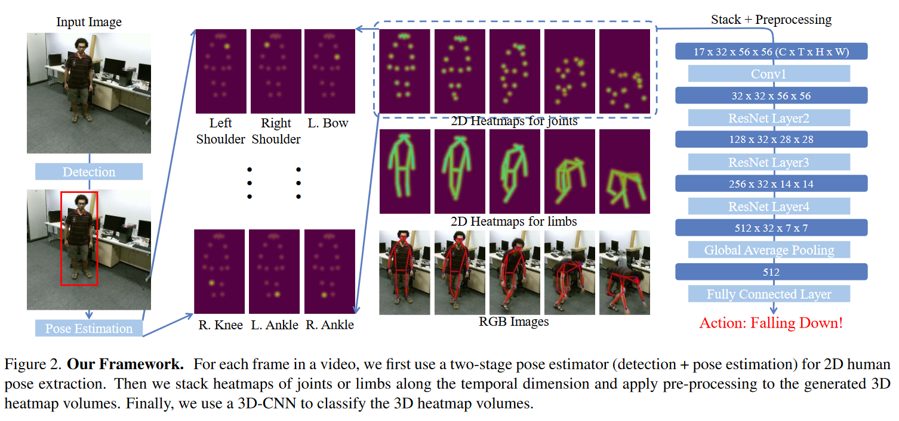
Human Action Recognition
References: Revisiting Skeleton-Based Action Recognition

Slide 9
Human Action Recognition
Model | Original NTU60 dataset (40K to Train) | NTU60 dataset (20K to Train) | NTU60 dataset (10K to Train) | NTU60 dataset (5K to Train)
Paper | 93.70
Paper (Our Train) | 93.06 | 92.04 | 89.99 | 86.03
Add SE |  |  |  | 85.52
Add SA |  |  |  | 85.61
Add TA |  |  |  | 86.07
Add TA (Effi) >> Base1 | 93.15 |  |  | 86.83
Add TA (Effi) 2nd Try |  |  |  | 86.27
Base1 + Using SiLU |  |  |  | 85.73

