Slide 1
AirCamRTM: Enhancing Vehicle Detection for Efficient Aerial Camera-based Road Traffic Monitoring
Rafael Makrigiorgis, Nicolas Hadjittoouli, Christos Kyrkou, Theocharis Theocharides
KIOS Research and Innovation Center of Excellence, Department of Electrical and Computer Engineering, University of Cyprus
Presenter: Jehwan Choi
choijh1897@gmail.com
2023.3.4

Slide 2
Introduction
RTM
Road traffic monitoring
Intelligent transportation system
Traffic data analysis
Camera-equipped UAV
Affordability
Easy to data capturing
2
Notes:
2

Slide 3
Introduction
Main works in other papers
Detecting vehicles in aerial images
Use generic detector and re-train
Do not consider other algorithms that could be useful
Pre-processing (Before main work)
Post-processing (After main work)
Challenges
Focus on the vehicles on the road
Matter to the traffic monitoring process
Reduction of the computational complexity
When monitoring hundreds of vehicles
3
Notes:
3

Slide 4
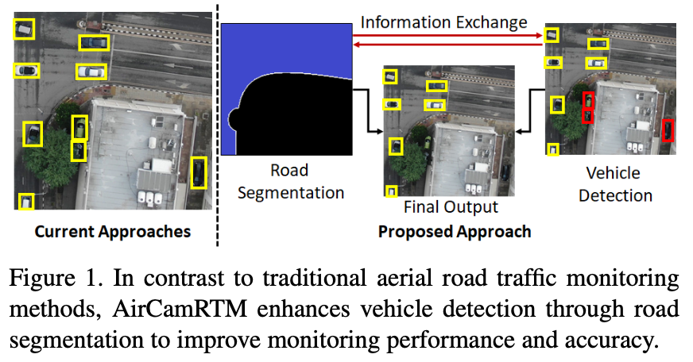
Introduction
AirCamRTM(Proposed)
Integration of road segmentation with vehicle detection
4
Notes:
4

Slide 5
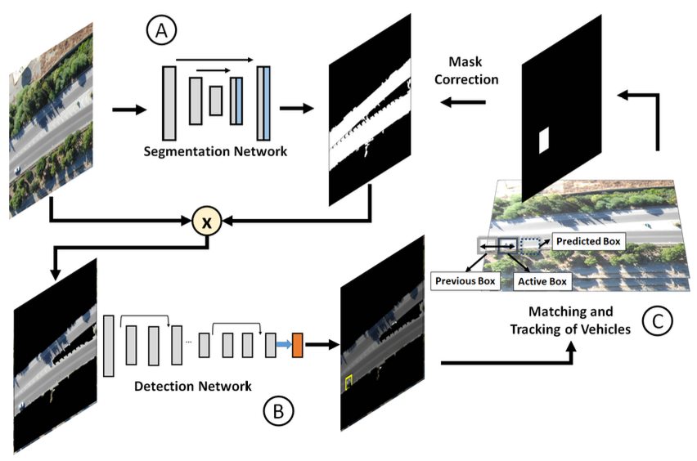
Proposed AirCamRTM
Main framework
A: Road segmentation prediction
B: Predict the vehicles in the segmented road
C: Mask correction using the detected BBox
5
Notes:
5

Slide 6
Road segmentation
Combination of encoder and decoder
Encoder
EfficientNet
MobileNetV2
ResNet18
Decoder
UNet
FPN
PAN
DeepLabV3
6
Notes:
6

Slide 7
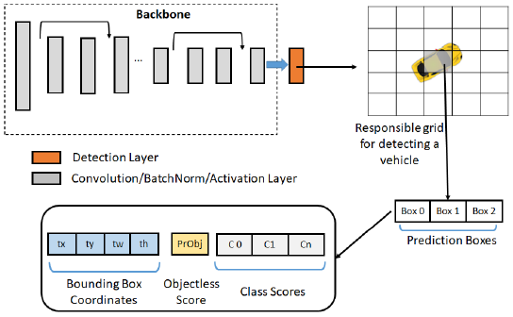
Vehicle Detection and Classification(1/3)
YOLO family (Accuracy & Speed)
YOLOv2
Dividing an image into grid units (detection speed)
Detecting multiple objects with a single inference
7
Notes:
7

Slide 8
Vehicle Detection and Classification(2/3)
YOLO family (Accuracy & Speed)
YOLOv3
Skip connection
To solve the vanishing gradient problem
Up-sampling and concatenation
Preserve fine-grained features for small object detection
Detection at three different scales
Various sizes object
Combined and Non-Maximum Suppression
8
Notes:
8

Slide 9
Vehicle Detection and Classification(3/3)
YOLO family (Accuracy & Speed)
YOLOv4
BoF (Bag of Freebies)
No increase inference cost
Data augmentation
Loss function
BoS (Bag of Specials)
Increase inference cost
Enhance receptive field
feature integration
Activation function
9
Notes:
9

Slide 10
Vehicle Detections post processing
A set of bounding box(vehicle) after road segmentation
Independent between frames
Not matched before and current frames
To track the same vehicles
Matching approach
To associate bounding boxes of the same vehicle
Always
Missing bounding box
Not detected by the model
10
Notes:
10

Slide 11
Vehicle Detections post processing
Vehicles Temporal Association and Consistency
Hungarian algorithm
Cost minimization
Kalman filter
Error minimization
11
Notes:
11

Slide 12
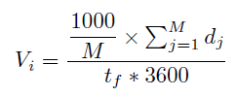
Vehicle Detections post processing
Direction and velocity calculation
Direction
Subtracting the current coordinates with the previous detection
Velocity
Converting pixels to actual distance ($km/pixels$)
Current average velocity ($km/h$)
12
Notes:
12

Slide 13
Vehicle Detections post processing
Velocity
GSD (Ground Sample Distance)
h: UAV altitude
f: focal length
$C_{h}×C_{w}$: camera sensor dimensions
$W×H$: image dimensions in pixels
Average velocity
M: the number of value of moving distances
13
Notes:
13

Slide 14
Mask Correction Using Detections
To improve road segmentation
In missing segmentation regions
Created 1.5X scale bounding box
Move and reach missing regions
Expanding and continuing
14
Notes:
14

Slide 15
Datasets
Detection
UAV flights [~5k images]
UAVTD [ ~5k images]
Aerial KITTI [~1.5k images]
Custom UAV Videos
Segmentation
OpenStreetMap(OSM) Dataset [~6.6k images]
Aerial KITTI [~1.5k images]
15
Notes:
15

Slide 16
Result
Original Tiny YOLOv4
2 detection layers
16
Notes:
16

Slide 17
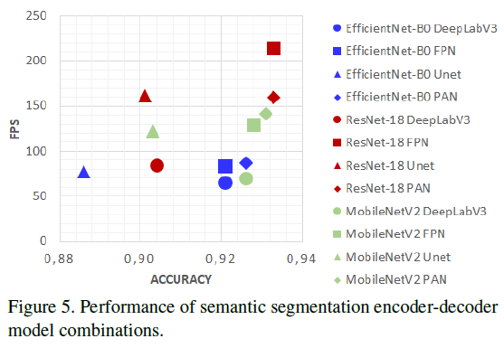
Result
Performance of encoder-decoder combinations
17
Notes:
17

Slide 18
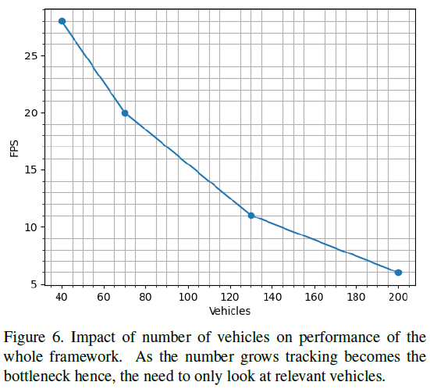
Result
FPS according to the number of vehicles
18
Notes:
18

Slide 19
Result
Result images
Result video
https://www.youtube.com/watch?v=JqnMPviwhDM
19
Notes:
19

Slide 20
Conclusion
Proposed AirCamRTM
Deep learning based traffic monitoring using aerial images
Integration of detection and segmentation
Improved performance
Working
Integrated network
Expanding the dataset
20
Notes:
20

Slide 21
Thank you for your attention!
21

Slide 22
APPENDIX
22

Slide 23
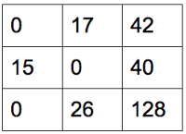
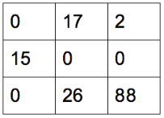
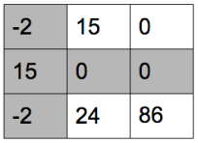
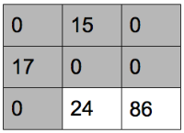
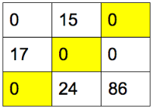
Hungarian algorithm
Cost minimization
-108
-108
-108
-135
-135
-135
-122
-122
-122
-40
-40
-40
23
Notes:
23

Slide 24
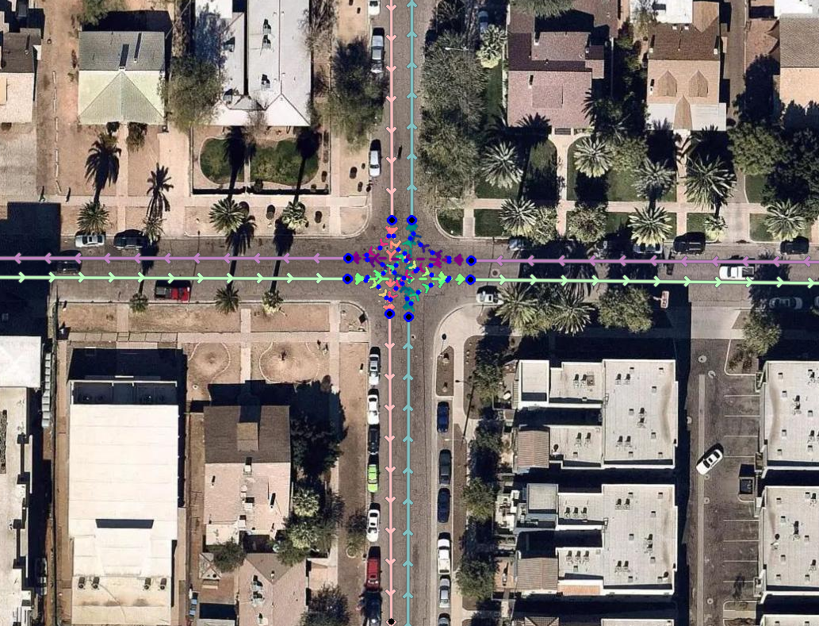
Turning Lane Extraction
D
: terminal node
24
Notes:
24

Slide 25
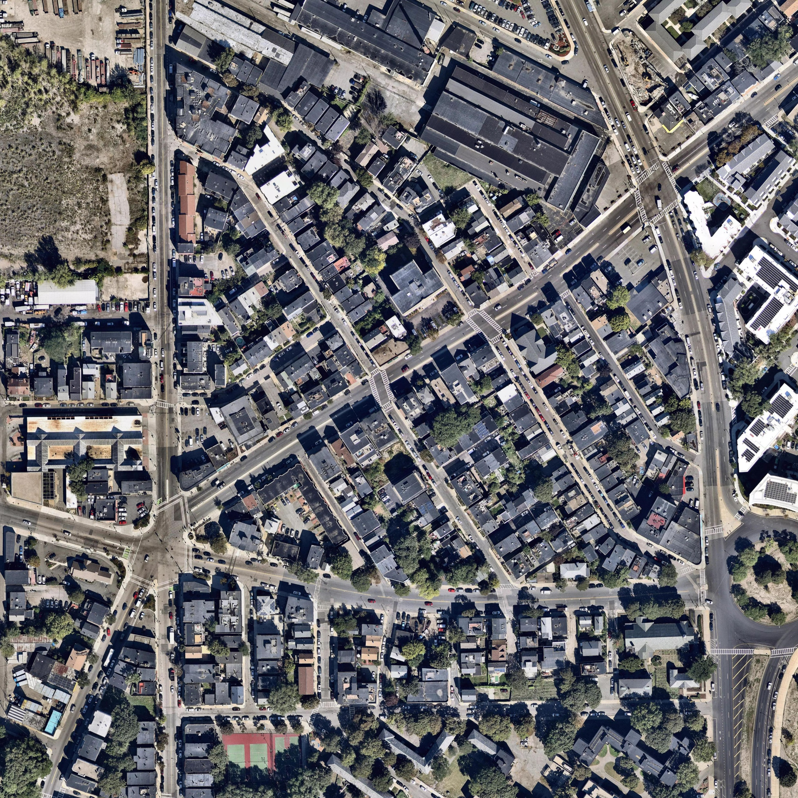
Inference
Input image: 4096 x 4096
Window size: 640 x 640
Move sliding wind by 256 pixels
25
Notes:
25

Slide 26
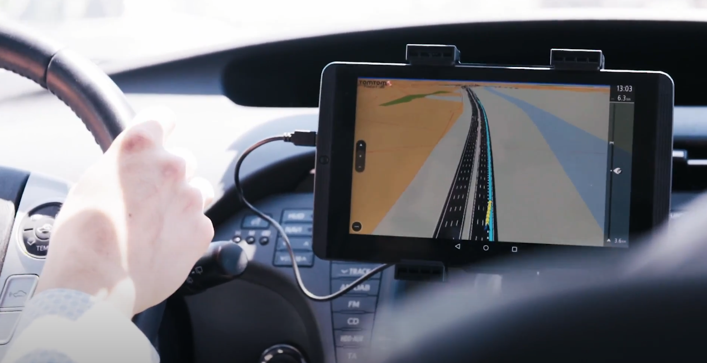
Lane-to-Lane Navigation
https://www.youtube.com/watch?v=0tCetjD-cKk
26
Notes:
26

Slide 27
U-Net
정리하자
27
Notes:
27

Slide 28
L2 Norm
L2 Norm(Euclidean Norm)
Displacement
If x = [2, 3], L2 norm = $\sqrt{13}$
Equation: ∥x∥2=$\sqrt{2^{2}+3^{2}}=\sqrt{13}$
3
2
28
Notes:
28

Slide 29
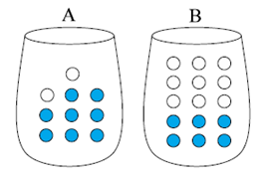
Cross Entropy Loss
Entropy: Measure of uncertainty
Cross Entropy: Dissimilarity of real and predict
H(A) = -[0.8log(0.8)+0.2log(0.2) = 0.217
Ha(B) = -[0.8log(0.2)+0.2log(0.8)] = 0.579
A: Real B: Predict
29
Notes:
29

Slide 30
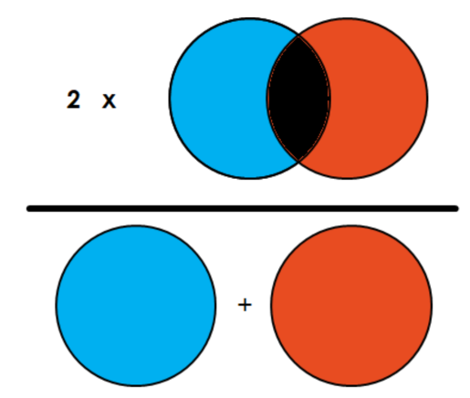
Dice loss
Dice Coefficient(Score)
Similar with IoU
Similarity ↑ = Score ↑
Similarity ↓ = Score ↓
Dice loss = 1 – dice score
30
Notes:
30

Slide 31
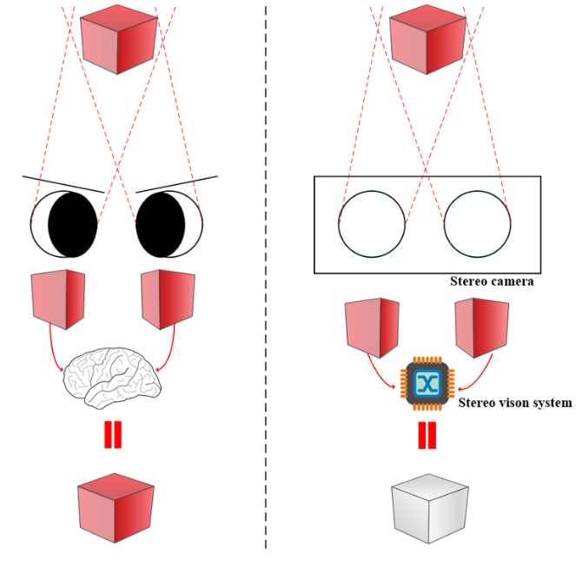
Stereo Vision
Using 2 cameras, calculate 3D distance information
31
Notes:
31

Slide 32
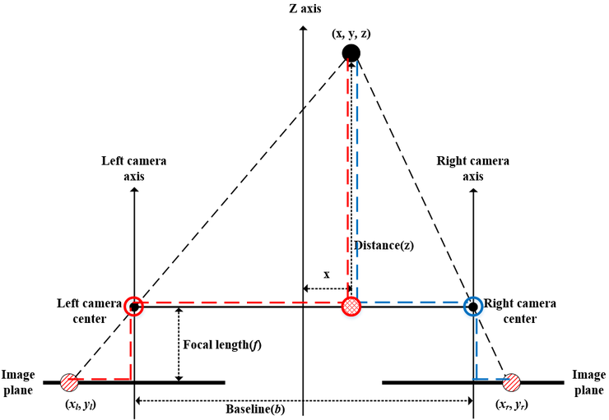
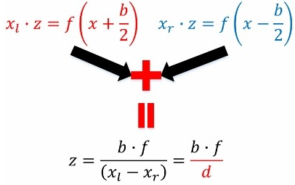
How to calculate 3D depth?
3D distance
Disparity
d↑ → z↓
d↓ → z↑
32
Notes:
32

Slide 33
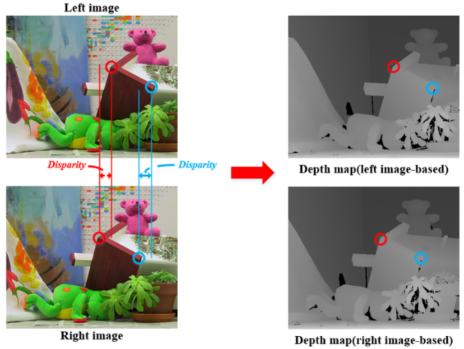
Disparity Map
33
Notes:
33

Slide 34
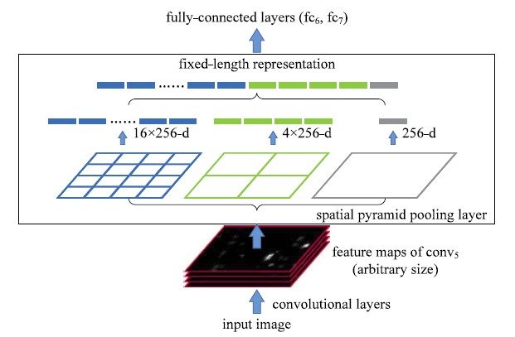
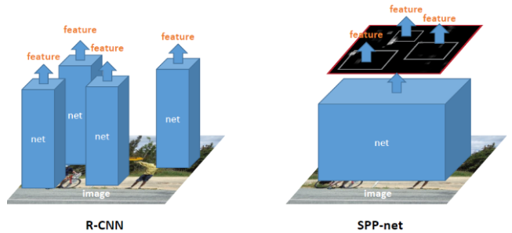
SPPNet
Better than R-CNN
34
Notes:
34

Slide 35
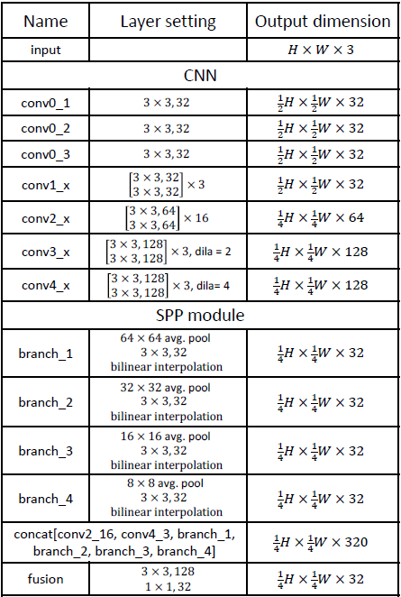
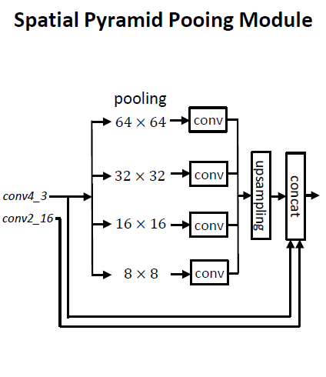
SPP Module
35
Notes:
35

Slide 36
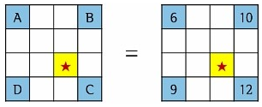
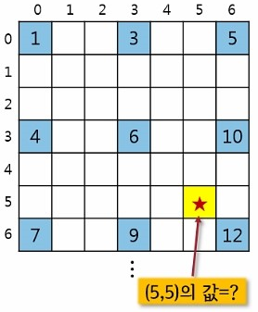
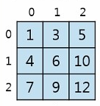
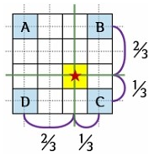
Bilinear Interpolation
Using to make big size image
Example
What value?
$$\left(6×\frac{1}{3}+10×\frac{2}{3}\right)×\frac{1}{3}+\left(9×\frac{1}{3}+12×\frac{2}{3}\right)×\frac{2}{3}=10.22$$
36
Notes:
36

Slide 37
KITTI Difficulty Level
37
Notes:
37

Slide 38
Forward Warping
find corresponding pixels
38
Notes:
38

Slide 39
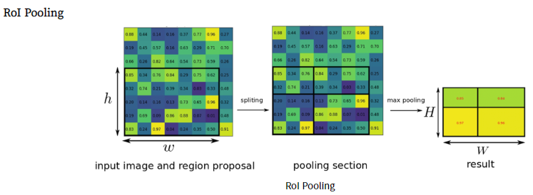
ROI pooling
To make feature map with fixed size, using max pooling
39
Notes:
39

Slide 40
Cross Entropy Loss
Entropy: Measure of uncertainty
Cross Entropy: Dissimilarity of real and predict
H(A) = -[0.8log(0.8)+0.2log(0.2) = 0.217
Ha(B) = -[0.8log(0.2)+0.2log(0.8)] = 0.579
A: Real B: Predict
40
Notes:
40

Slide 41
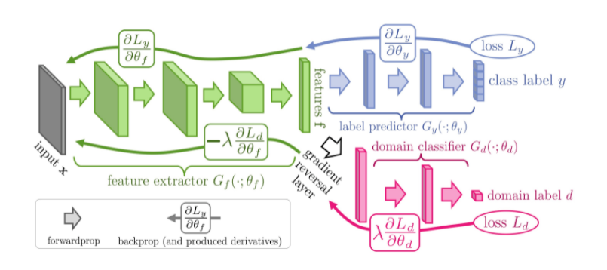
Gradient Reversal Layer(GRL)
Flips the sign of the gradients during pack propagation
41
Notes:
41

Slide 42
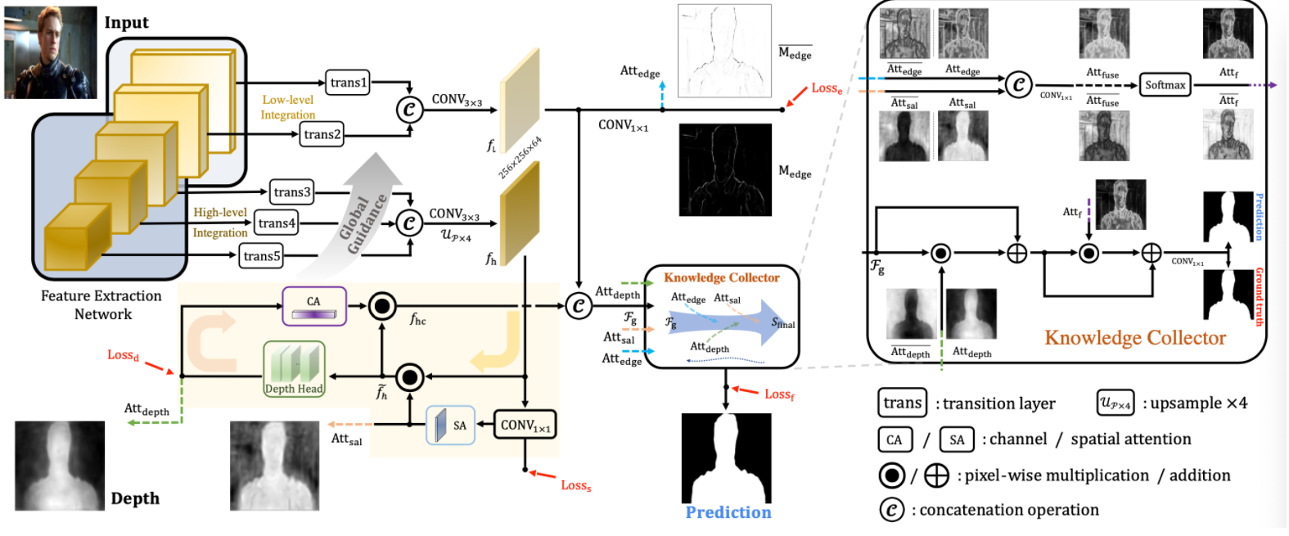
CoNet
Accurate RGB-D salient object detection via collaborative learning
Same author, previously used method
42
Notes:
42

Slide 43
Global Average Pooling
(H, W, C) -> (1, 1, C)
43
Notes:
43

Slide 44
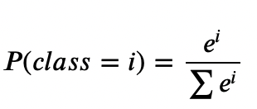
Softmax
Why use?
Used to represent probabilities for all classes
Formular
Example
4
0.894
4
0.844
2
0.568
2
0.114
1
0.194
1
0.042
Sigmoid
Softmax
44
Notes:
44

Slide 45
Gumbel-Softmax
Using softmax with random noise
Formular
π : class probability
g : Gumbel noise sample
τ : temperature
45
Notes:
45

Slide 46
Gumbel-Softmax
Example
Difference by τ
Player(Layer) | Speed(Output) | Luck(Gumbel) | $$\log{π_{i}+ g_{i}}$$ | Winner(One-hot)
1 | 10 | 0 | 10 | 1
2 | 7 | +1 | 8 | 0
3 | 4 | -1 | 3 | 0
4 | 1 | 0 | 1 | 0
τ Player | 0.1 | 0.5 | 1 | 5
1 | 1 | 0.982 | 0.88 | 0.4803
2 | 0 | 0.018 | 0.1191 | 0.3219
3 | 0 | 0 | 0.0008 | 0.1184
4 | 0 | 0 | 0.0001 | 0.0794
46
Notes:
46

Slide 47
Binary Gumbel-Softmax
Assume class : 2, i : 1
Class probability ->
Substitute ->
Finally ->
47
Notes:
47

Slide 48
Depth Estimator
https://github.com/jiwei0921/DCF/blob/70113b89e8ef59f05662e1baf841a0665db835b3/DCF_code/model/depth_calibration_models.py#L176
48
Notes:
48

Slide 49
Evaluation Metrics
${ F}_{β}$: F-measure
${ E}_{ε}$: E-measure
${ F}_{β}^{ω}$: weighed F-measure
MAE: Mean Absolute Error
$$\frac{2∗P∗R}{P+R}$$
1 - ${ F}_{β}$
$$\frac{1}{n}\sum_{i=1}^{n}{\left|x_{i}−x\right|}$$
49
Notes:
49

Slide 50
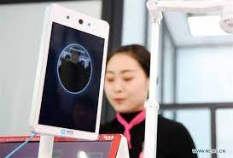
end-to-end
Relocate one neural network
Example
Building access permission
Face Detection
Compare Dataset
50
Notes:
50

Slide 51
end-to-end
Relocate one neural network
Example

Slide 52
Gumbel-Softmax
Using softmax with random noise
Formular
τ is temperature
It makes gumbel max differentiable
52
Notes:
52

Slide 53
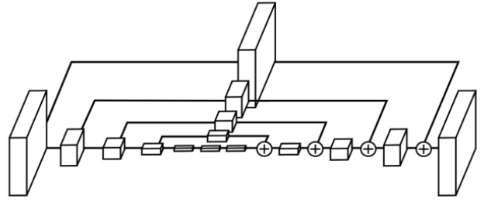
Stacked hourglass network
Architecture(looks like hourglass)
Only use 3x3 and 1x1 layers
Each block is bottleneck
53
Notes:
Feature의 추출과 저차원으로의 downsampling을 위해 Convlutional layer와 maxpooling layer를 사용한다.
매 max pooling 단계에서의 입력을 또한 별도의 branch로 내보내고 이에 convolution 연산을 적용한다. 이를 통해 scale 마다의 feature가 추출된다.
가장 낮은 resolution에 도달한 후, upsampling 과정에서 scale 별로 추출한 feature들을 조합한다. Upsampling으로는 Nearest Neighbor Upsampling[2] 방식을, feature와의 조합에는 elementwise addition 연산을 이용한다.
네트워크는 대칭적인 구조를 띈다.
Output resolution에 다다르면 두번의 연속된 1x1 convolution 연산을 적용하여 최종적인 예측값을 출력한다.
53

Slide 54
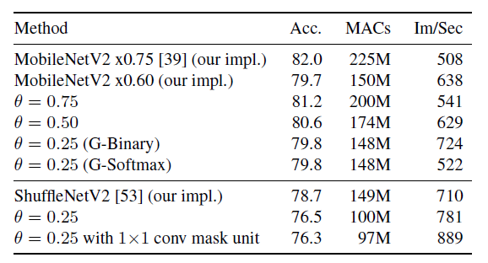
Faster Inference
Inference time of dynamic convolutions using Food-101 dataset
ϴ : Computational budget hyperpamater
Ex) ϴ=0.7 -> compute on average 70% FLOPS in layers
MACs : Computational costs
54
Notes:
MobileNet에서는 세타를 줄이니까 처리량이 늘어났다.
Binary 가 softmax보다 inference 속도가 높았다.
54

Slide 55
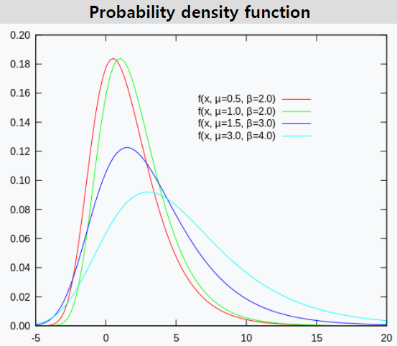
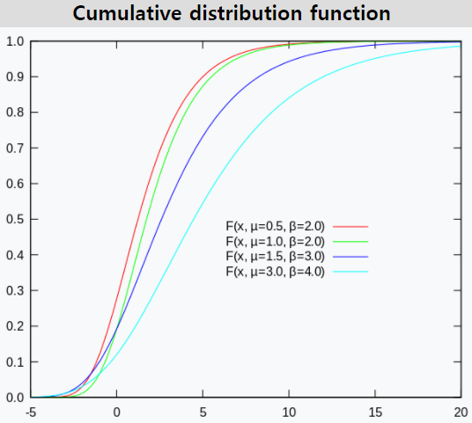
Gumbel Distribution
55
Notes:
55

