Slide 1
CSPNet: A New Backbone that can Enhance Learning Capability of CNN Chien-Yao Wang et. al. Taiwan
Van-Thanh Hoang
thanhhv@islab.ulsan.ac.kr
August 8, 2020

Slide 2
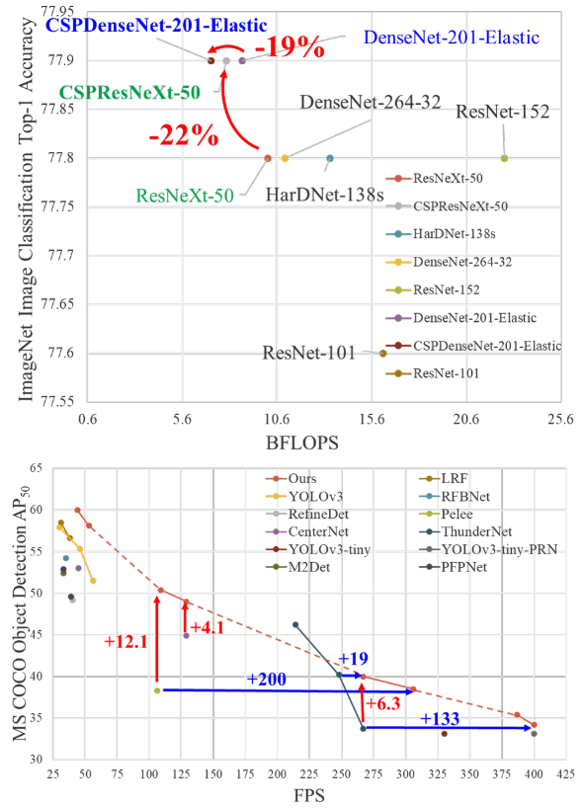
Introduction
Propose Cross Stage Partial Network (CSPNet)
Reduces computations by 20% with equivalent or even superior accuracy on the ImageNet dataset
Significantly outperforms state-of-the-art approaches in terms of AP⁵⁰ on the MS COCO object detection dataset
Easy to implement and general enough to cope with architectures based on ResNet, ResNeXt, and DenseNet

Slide 3
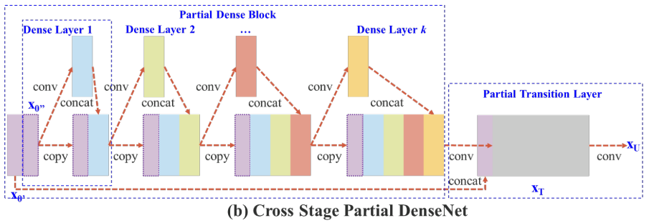
CSPDenseNet

Slide 4
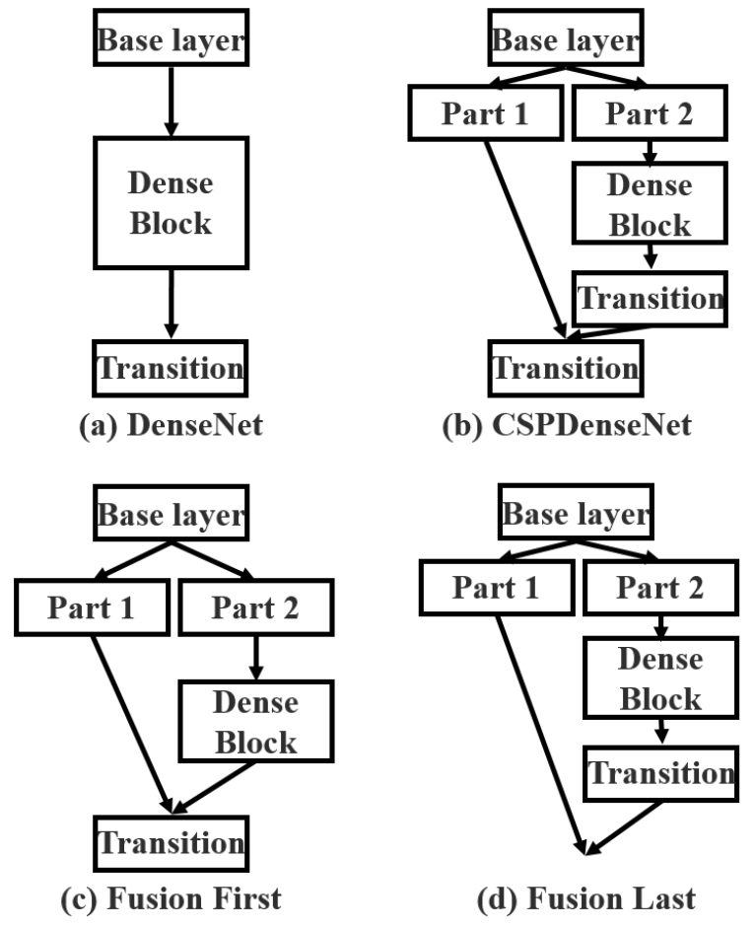
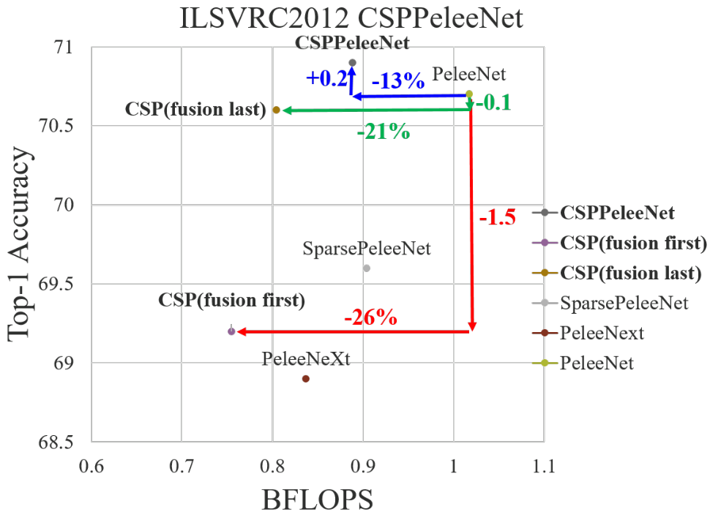
CSPDenseNet
Partial Dense Block
Increase gradient path
Balance computation of each layer
Reduce memory traffic

Slide 5
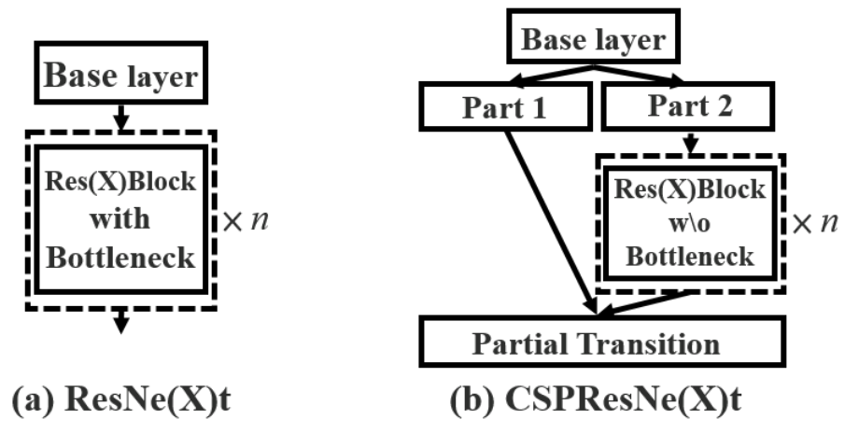
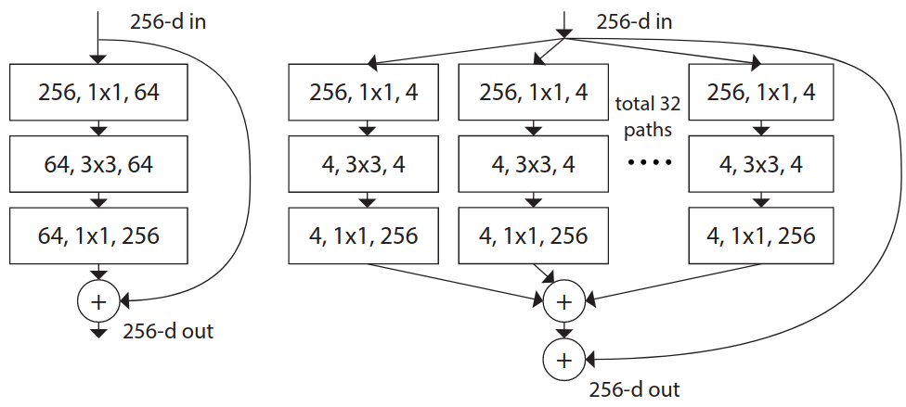
CSPResNe(X)t

Slide 6
Exact Fusion Model

Slide 7
Experiments
Implementation Details
ImageNet for classification with batch size of 128
Coco for object detection with batch size of 64
Implement on Darknet framework
Train on single GPU

Slide 8
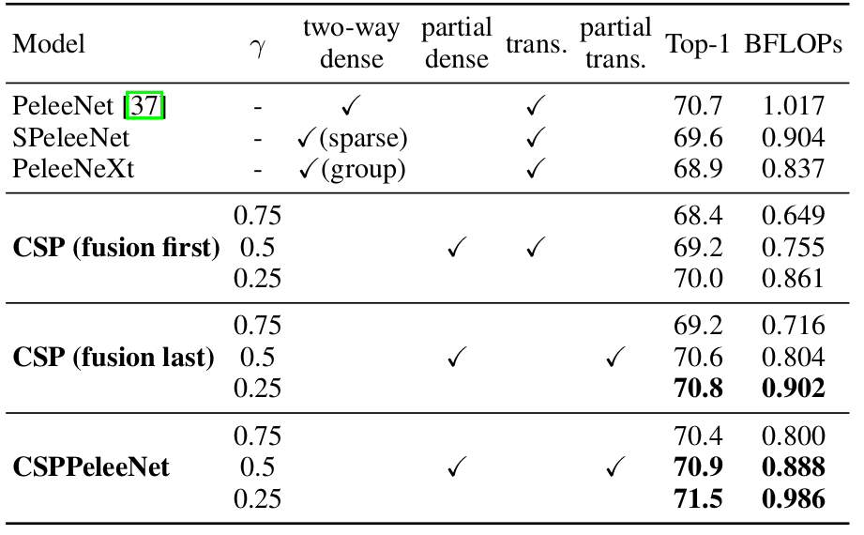
Ablation Experiments
Ablation study of CSPNet on ImageNet

Slide 9
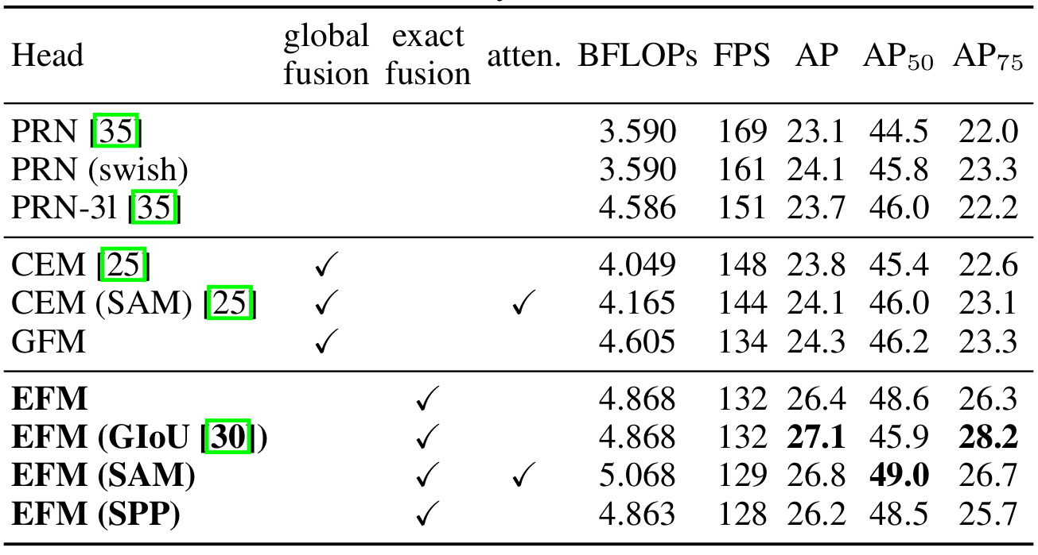
Ablation Experiments
Ablation study of EFM on MS COCO
GIoU can upgrade AP by 0.7%, the AP⁵⁰ is significantly degraded by 2.7%

Slide 10
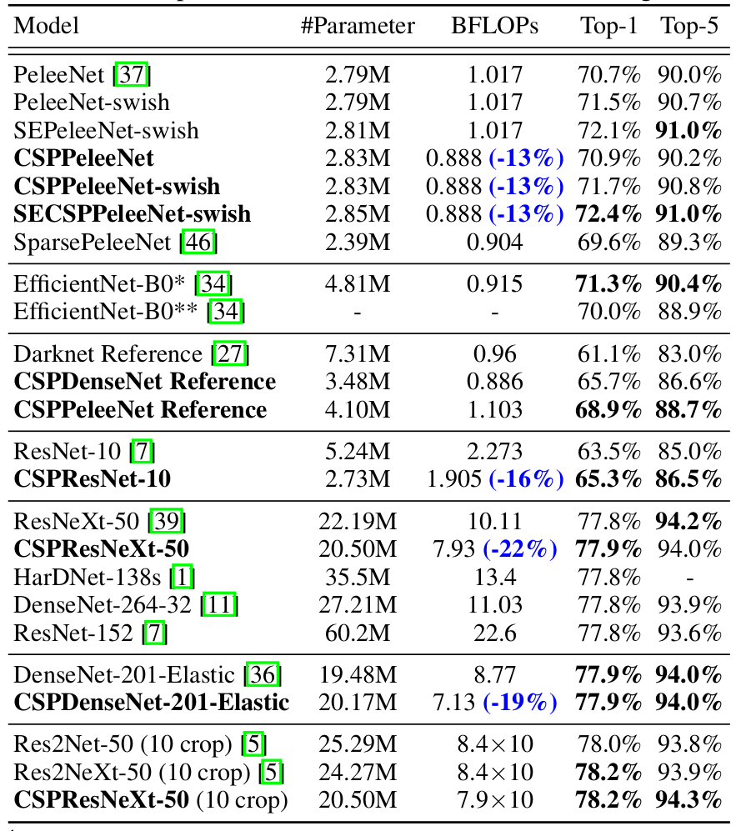
ImageNet Image Classification

Slide 11
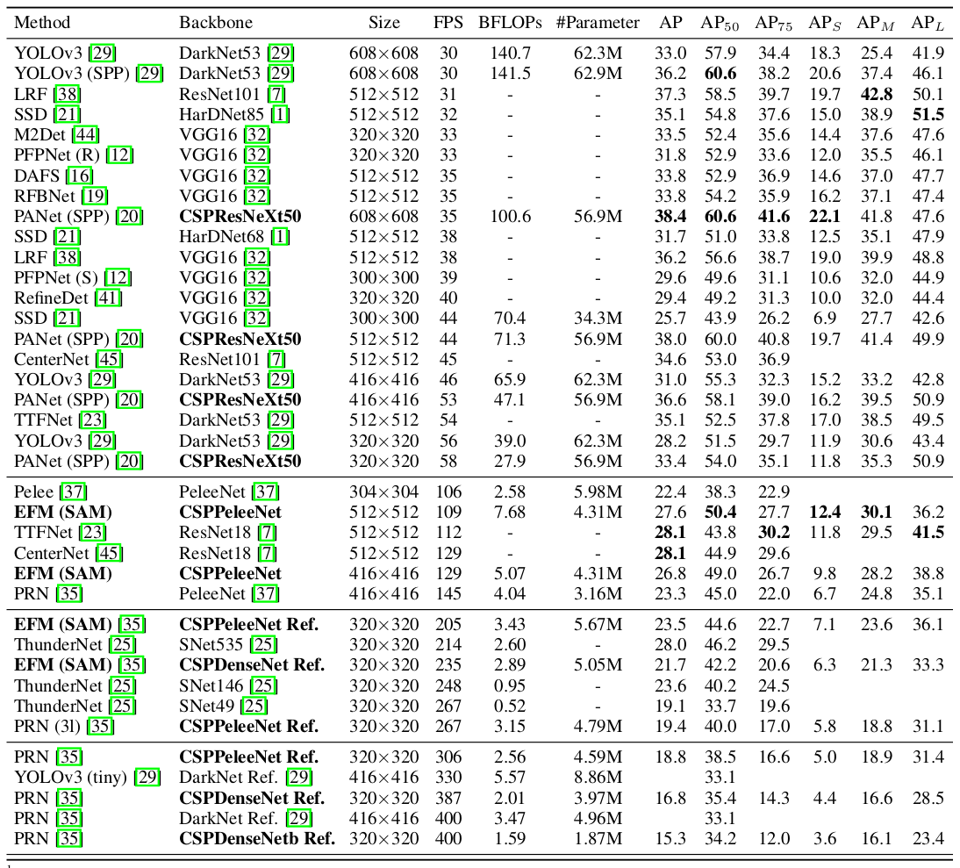
MS COCO Object Detection

Slide 12
Analysis
Computational Bottleneck

Slide 13
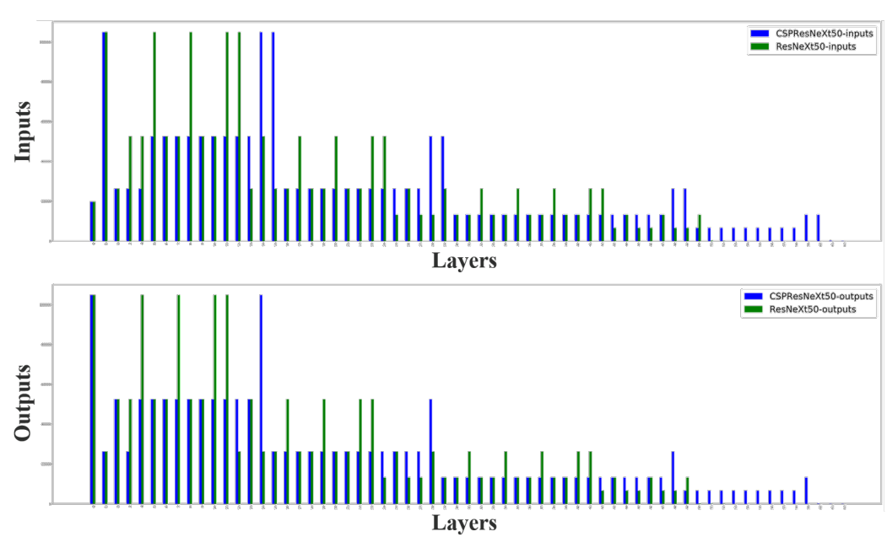
Analysis
Memory Traffic

Slide 14
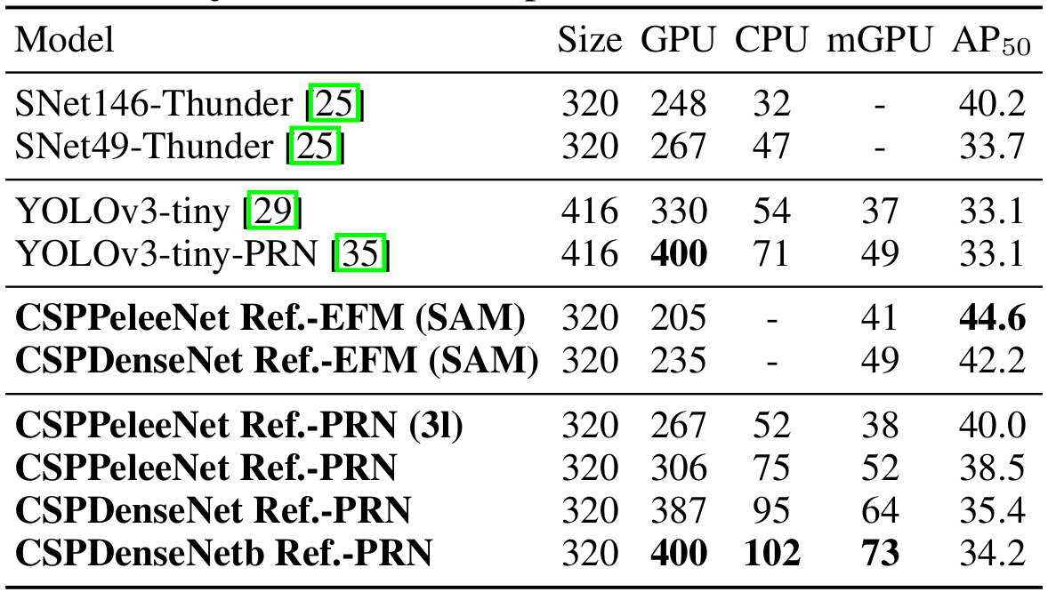
Analysis
Inference Rate

Slide 15
Conclusion
CSPNet
Respect the variability of the gradients by integrating feature maps from the beginning and the end of a network stage
Lack of detailed information of implementation
Comments
Good idea for balance between accuracy and computation cost

Slide 16
Thank you for your attention!

Slide 17
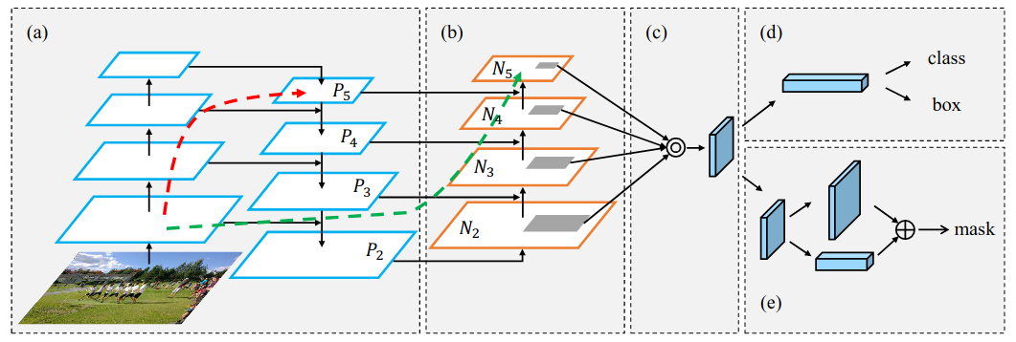
PANet

Slide 18
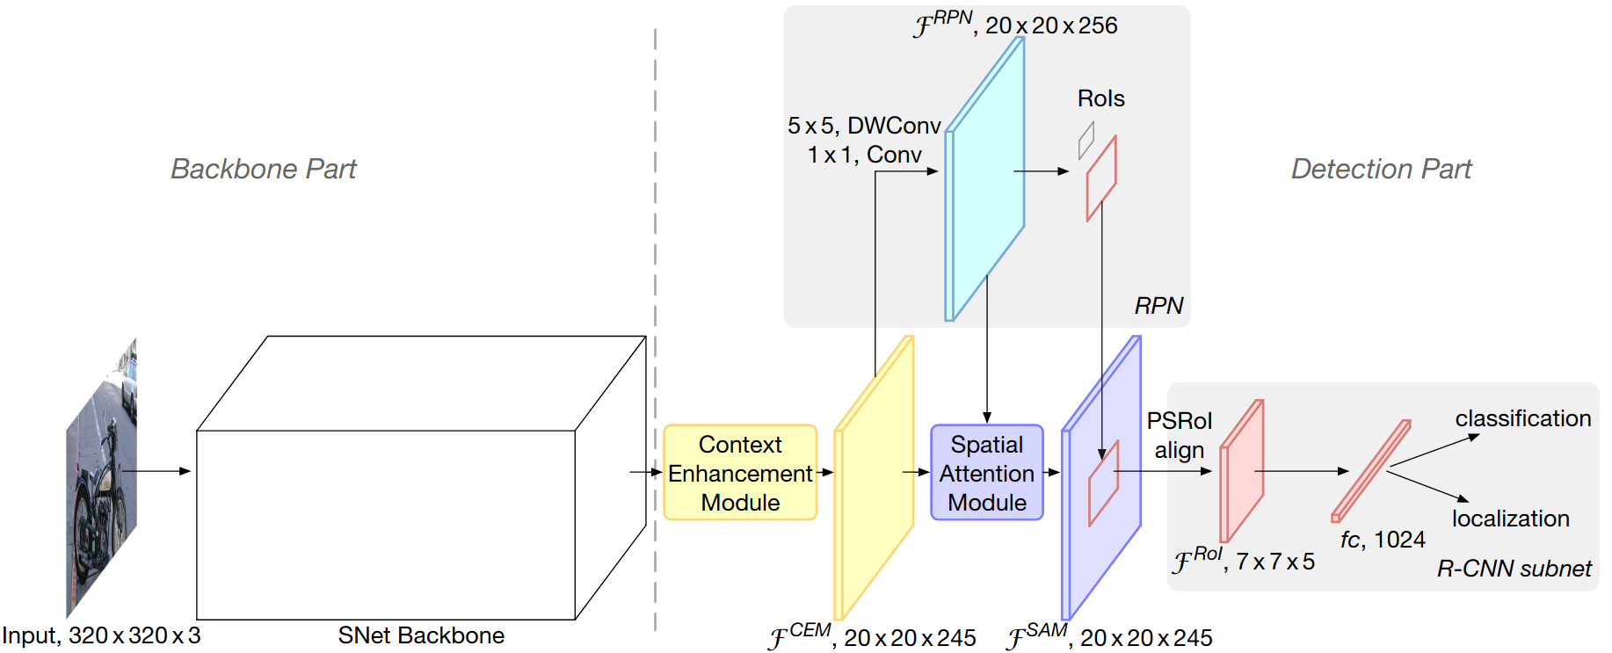
ThunderNet
Overall architecture

Slide 19
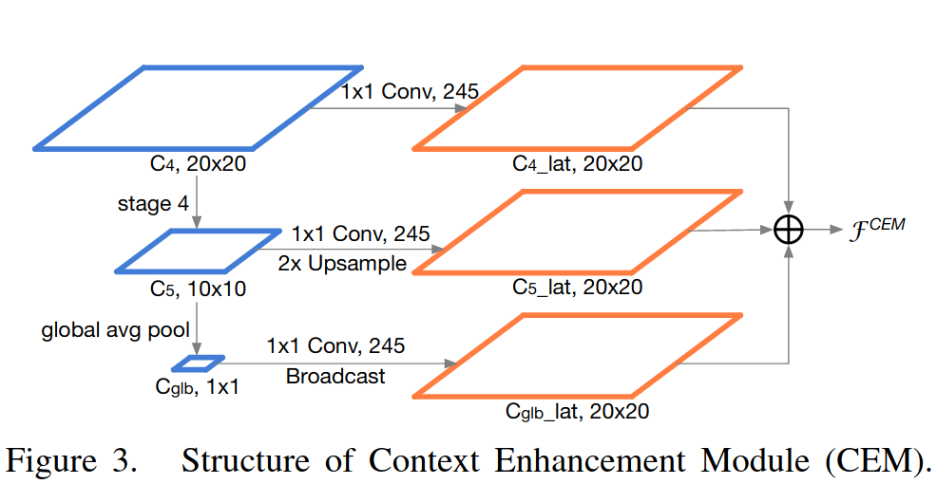
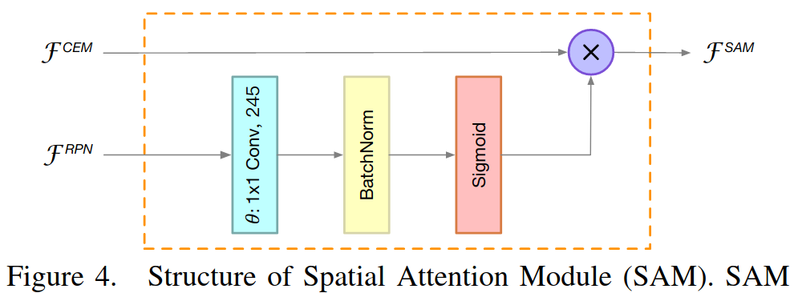
ThunderNet

Slide 20
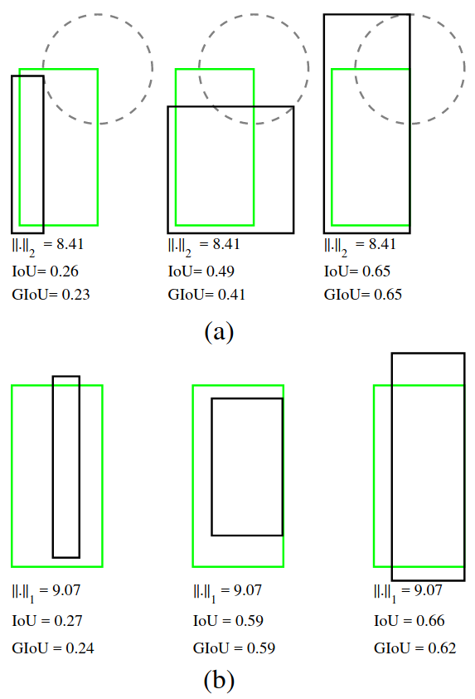
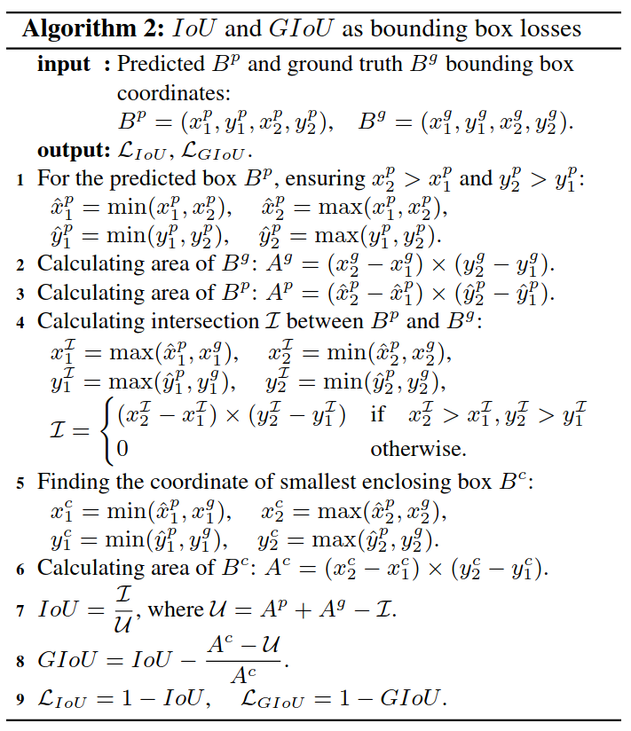
Generalized Intersection over Union

Slide 21
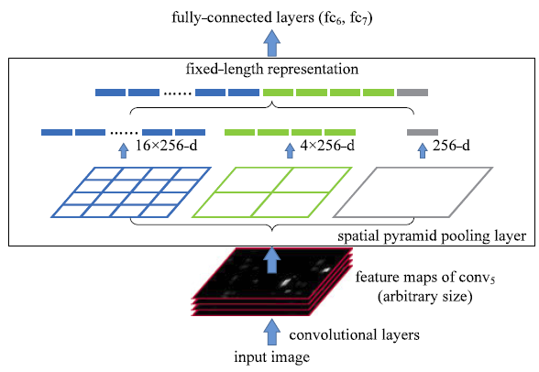
Spatial Pyramid Pooling (SPP)

Slide 22
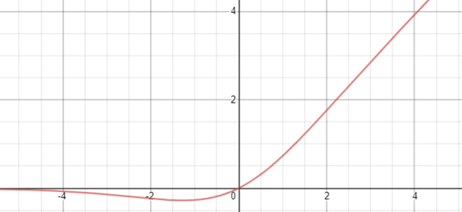
Swish Activation

Slide 23
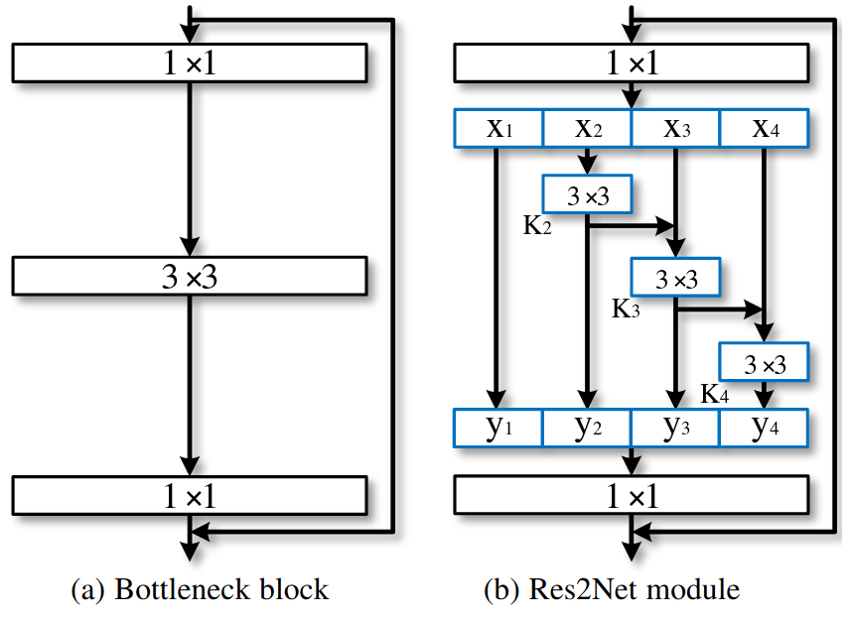
Res2Net

