Slide 1
Tell Me Where I Am: Object-level Scene Context Prediction
Presented by: Lee, Youl-kyeong {yklee@islab.ulsan.ac.kr}
2019/08/16
Xiaotian Qiao, Quanlong Zheng, Ying Cao, Rynson W.H. Lau, “Tell Me Where I Am: Object-level Scene Context Prediction”, City University of Hong Kong, CVPR, 2019

Slide 2
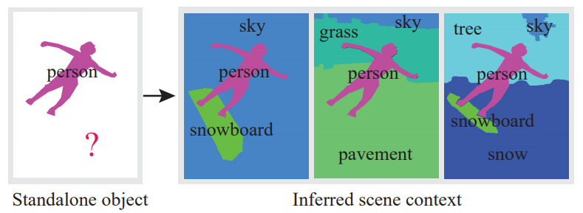
Motivation of works
Contextual information
  Nearby, neighborhood, etc.
Consider an inverse problem of how to hallucinate missing contextual information from standalone objects
Many hints from standalone objects: ex) sports activities with snowboard, sky, grass pavement around objects

Slide 3
Proposed work
Convolutional neural network takes as input the properties(category, shape and position) of standalone objects
To predict an object-level scene layout
Semantics and structure of the scene context where the given objects

Slide 4
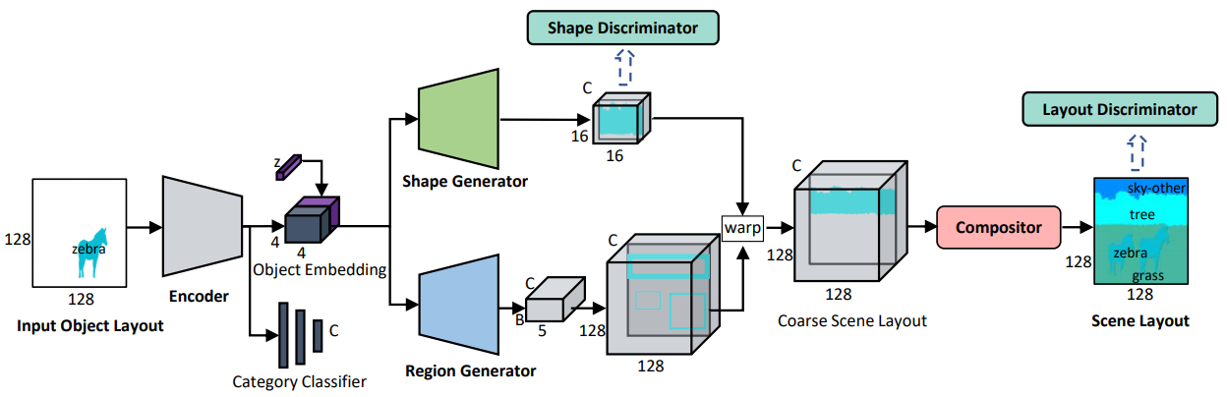

Overview of network architecture

Slide 5
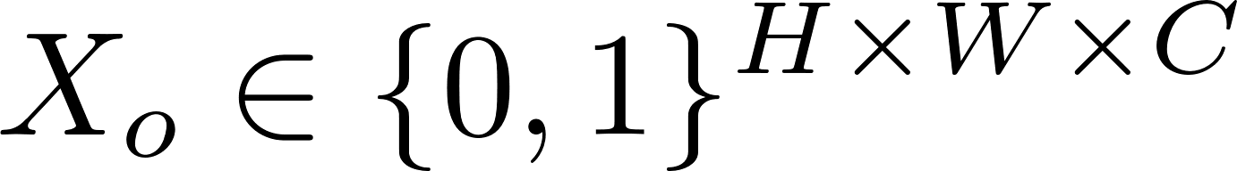


Approach(Inside network)
Scene Context Prediction Network
  Encoder
    input:
    H: height, W: width, C: object category of each pixel
    , category classifier with two fc layer
0 | 1
1 | 0
0 | 1
1 | 0
Encoder
0 | 1
1 | 0
0 | 1
1 | 0

Slide 6
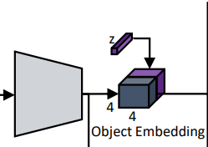
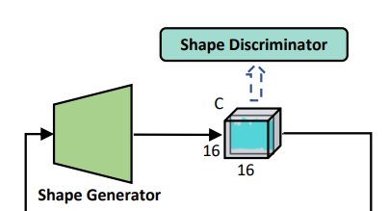
Approach(Inside network)
Scene Context Prediction Network
  Shape Generator
    To increase the diversity, add a noise vector
    Spatial replication and feature channel concatenation = concatenated features F
    Each layer, de-convolution with a stride of 2 followed by batch normalization and ReLU
    last layer: 1x1 convolution followed Sigmoid nonlinearity
Concatenated features F

Slide 7
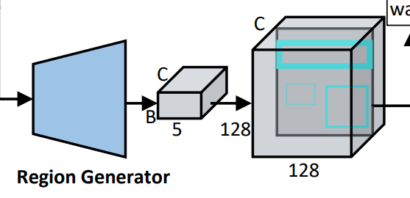
Approach(Inside network)
Scene Context Prediction Network
  Region Generator
    B: Region proposals for each of the C object categories
    Each region contains x, y(center point), w, h of bounding box and confidence score, s
    Confidence score: probability
    Object generator: a set of residual blocks + convolution operation followed by two fc layers to predict the bounding box and confidence s
Concatenated features F

Slide 8
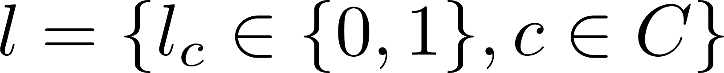
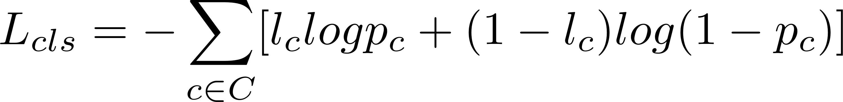
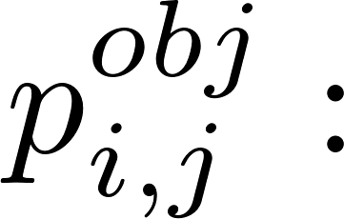
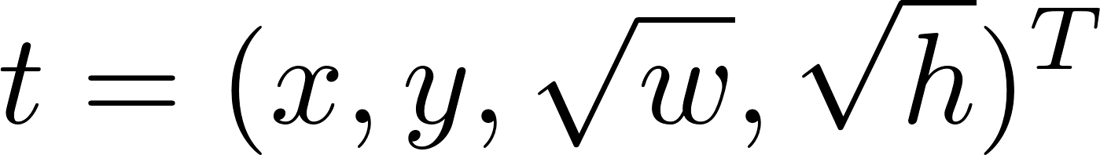

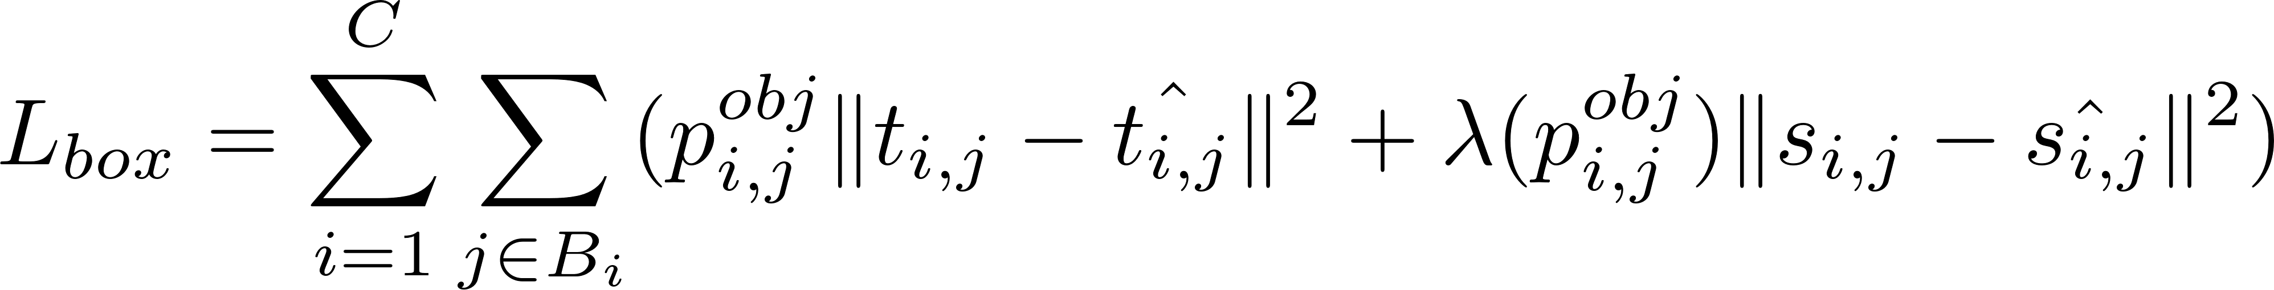
Training
Ground truth object categories of an image
Category classifier
Region generator(bounding box)

Slide 9
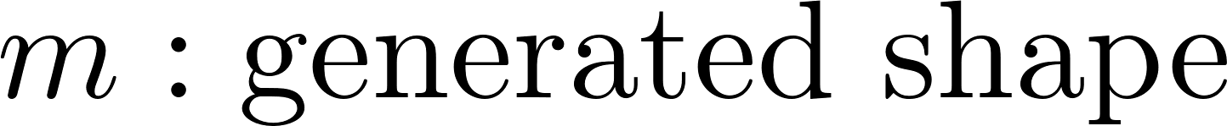
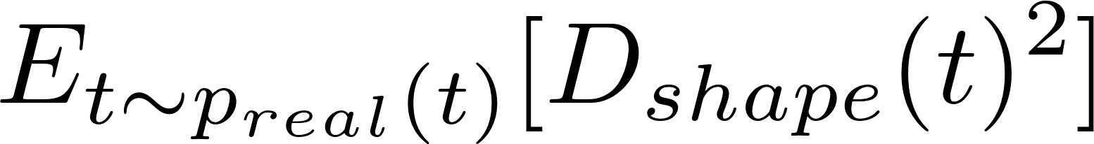
Training
Shape generator
Shape discriminator

Slide 10
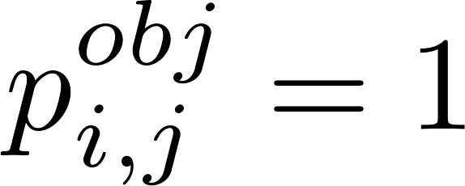
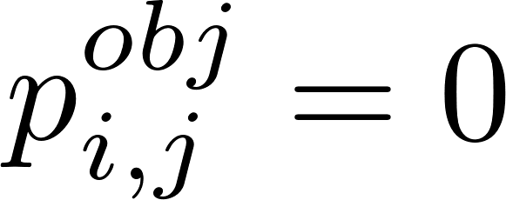
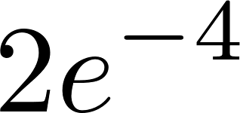
Implementation Details
Input output layout: resized 128x128 by nearest interpolation
Region proposal of category
  Positive = IOU > 0.5
  Negative = IOU < 0.5
Optimizer
  Adam, learning rate:
Batch size: 128

Slide 11
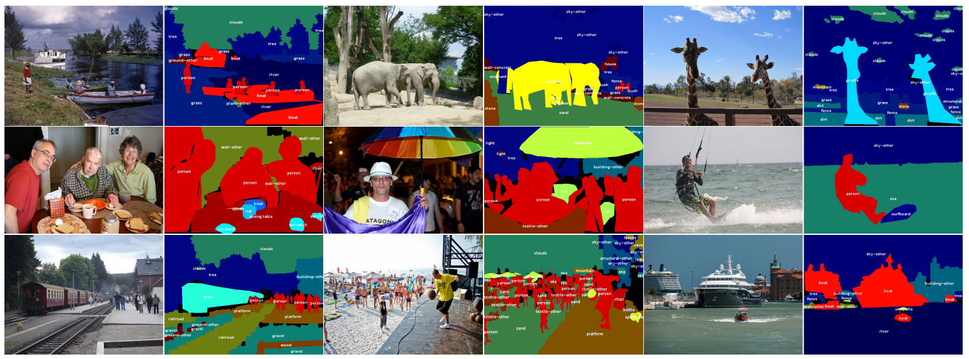
COCO-Stuff dataset
# of classes: 172(80thing, 91 stuff, and 1 class unlabeled)
80 thing: same as COCO dataset
91 stuff: except 80 things, around object, ex) snow, mud, fog, floor, etc.
Unlabeled class:
  A label does not belong to any of the 171 predefined classes
  Annotator cannot infer the label of a pixel

Slide 12
COCO-Stuff dataset
Dataset annotates 40k training and 5k testing images
  Bounding boxes and semantic layouts for both indoor and outdoor scenes
  Including 80 thing categories and 91 thing categories in total
Given the outdoor scene layouts
  Select 2 to 8 objects
  Randomly select one or two objects and remove other regions
  Selected object covers less than 5% of the image, skip the object
Finally,
  Dataset contains 72 object categories(39 thing and 33 stuff) with a total of 52,803 training pairs and 1,934 test pairs.

Slide 13

User studies
Amazon Mechanical Turk
  To evaluate the quality of results:
    Plausibility: how plausible the generated scene layouts are
    Fitness: how well the generated scene layouts fit the given inputs
  Ask AMT workers to judge the generated layouts and GT

Slide 14
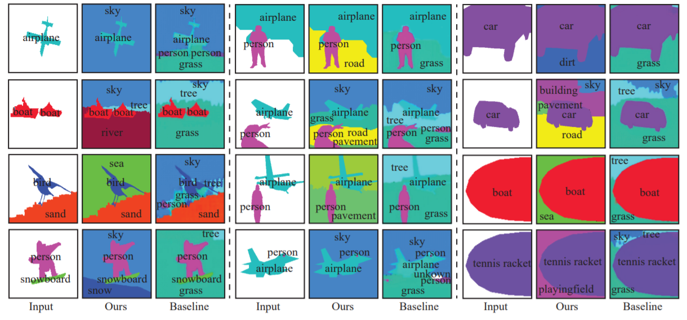
Qualitative results
`

Slide 15
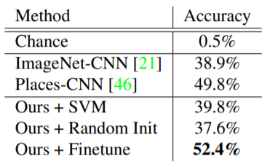
Scene recognition
With SUN dataset(Scene UNderstanding)
220 outdoor scene categories
Discriminator for classification with K-way softmax layer

Slide 16
Conclusion
To address the problem of reasoning about the missing environment from the properties of a few standalone objects
Propose scene context prediction model in an end-to-end

Slide 17
Thank you very much for your attention!

Slide 18
Appendix

Slide 19
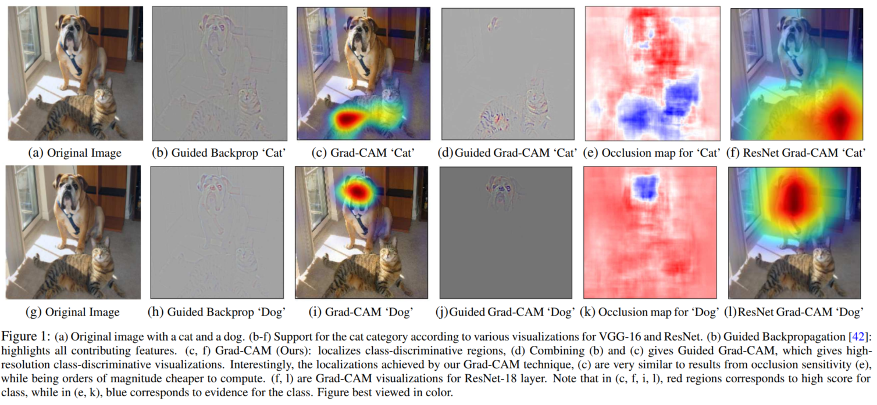
Grad-CAM(1/5)
Based on the fundamental framework of Grad-CAM[3]
  Gradient-weighted Class Activation Mapping
[3]R. R. Selvaraju, M. Cogswell, A. Das, R. Vedantam, D. Parikh, and D. Batra. Grad-cam: Visual explanations from deep networks via gradient-based localization. In ICCV, 2017

Slide 20
Grad-CAM(2/5)
Deeper representations in a CNN capture higher-level visual construct[4,5]
Convolution features naturally retain spatial information which is lost in full-connected layers so we expect the last convolutional layers to have the best compromise between high-level semantics and detailed spatial information
In last layer, look for semantic class-specific information in the image
[4] Y. Bengio, A. Courville, and P. Vincent. Representation learning: A review and new perspectives. IEEE transactions on pattern analysis and machine intelligence, 35(8):1798–1828, 2013
[5] A. Mahendran and A. Vedaldi. Visualizing deep convolutional neural networks using natural pre-images. International Journal of Computer Vision, pages 1–23, 2016

Slide 21
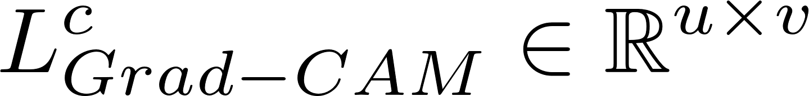


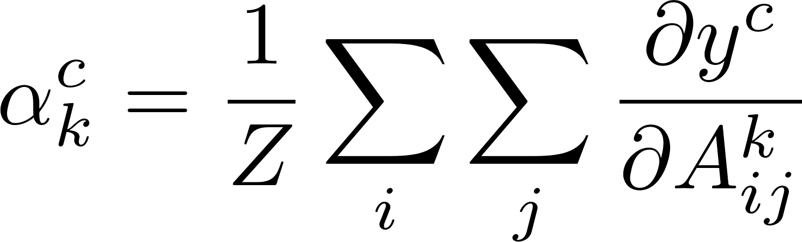
Grad-CAM(3/5)
To obtain the class discriminative localization map
Compute the gradient of the score for class c,
Respect to feature maps of a convolutional layer
Gradients flowing back are global-average pooling to obtain the neuron importance weights
Notes:
L^c, 클래스-차별적인 위치정보맵을 클래스에 대해 구한다. 첫번째로 클래스에 대한 기울기 값을 계산한다. Y^c값이 기울기 값인데 이 정보는 소프트맥스전의 레이어 값이다.
Fc 1000 layer의 값을 14x14, last convoluational layer 에 대한 변화랑

Slide 22
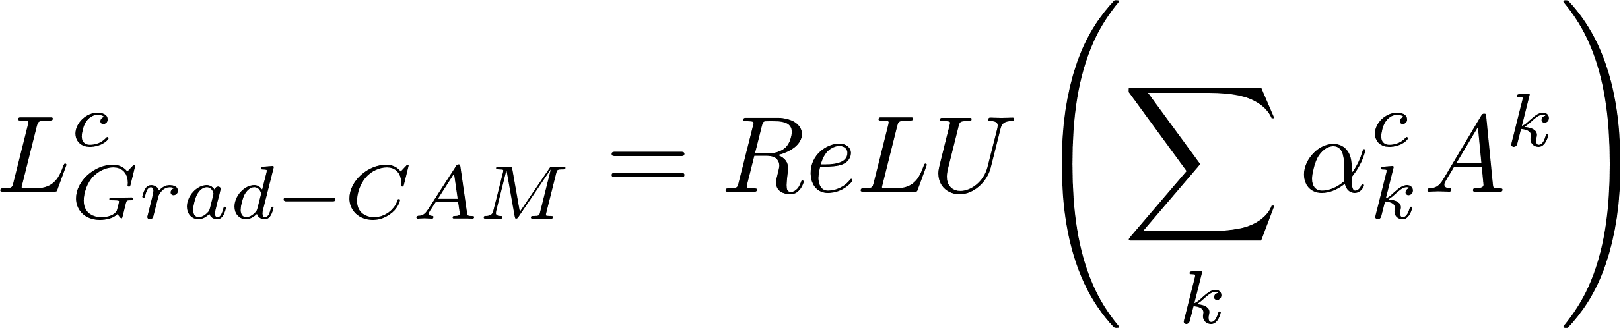

Grad-CAM(4/5)
Weighted combination of forward activation maps and follow it by a ReLU to obtain
Result in coarse heat-map of the same size as the convolutional feature maps(14x14, last convolutional layers of VGG and AlexNet)
Why they use ReLU
  Only interested in the features that have a positive influence on the class of interest
  Pixels whose intensity should be increased in order to increase
  Negative pixels are likely to belong to other categories in the image

Slide 23
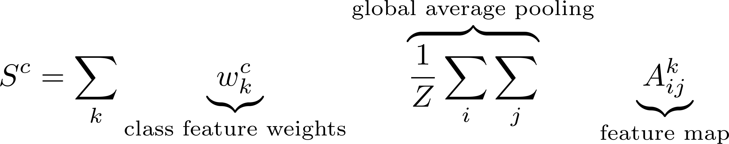

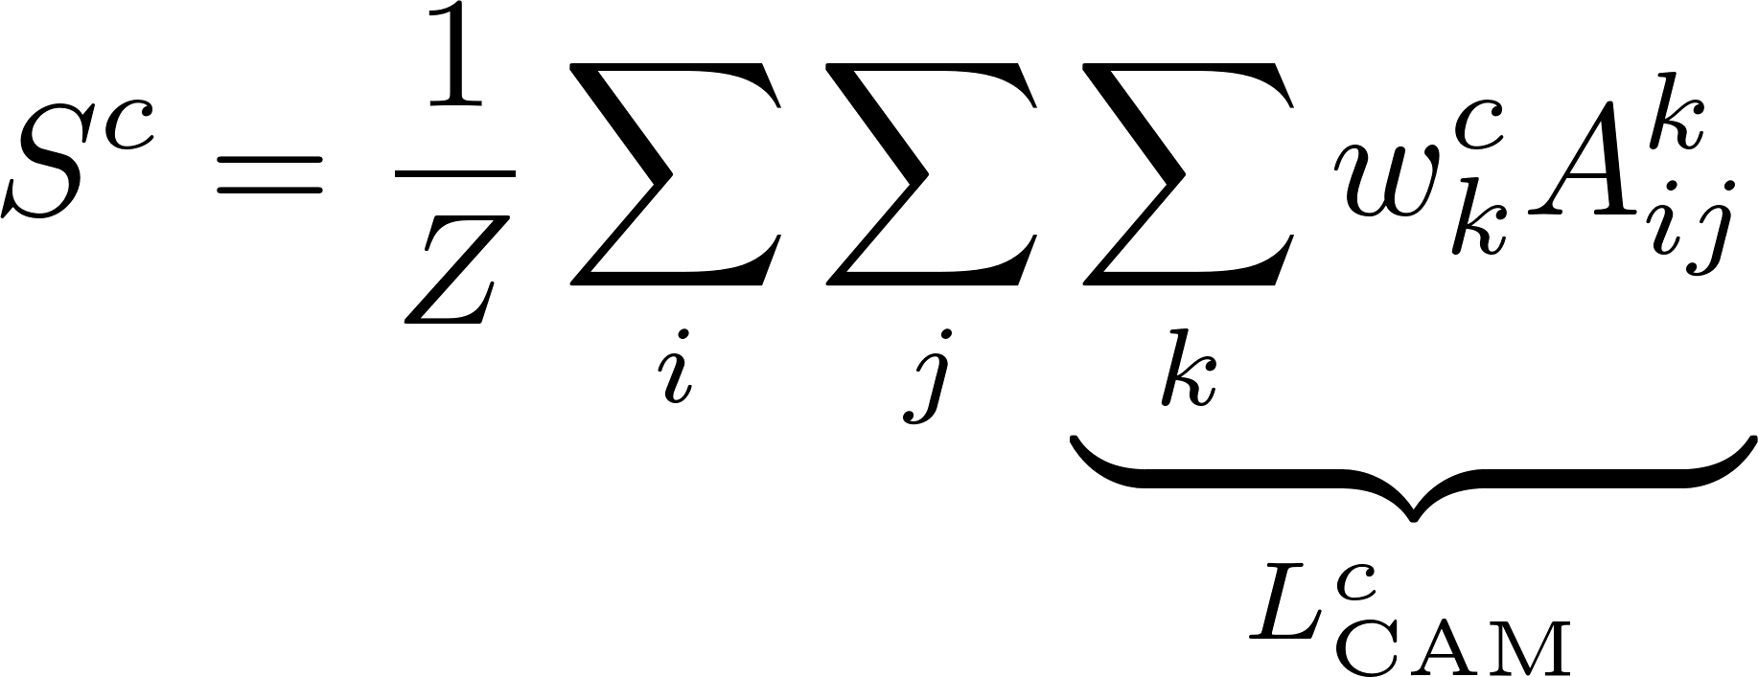
Grad-CAM(5/5)
Prediction Score for class c
Able to interchange the prediction score

Slide 24
Without ReLU, localization maps sometimes highlight more than just the desired class and achieve lower localization performance.

Slide 25
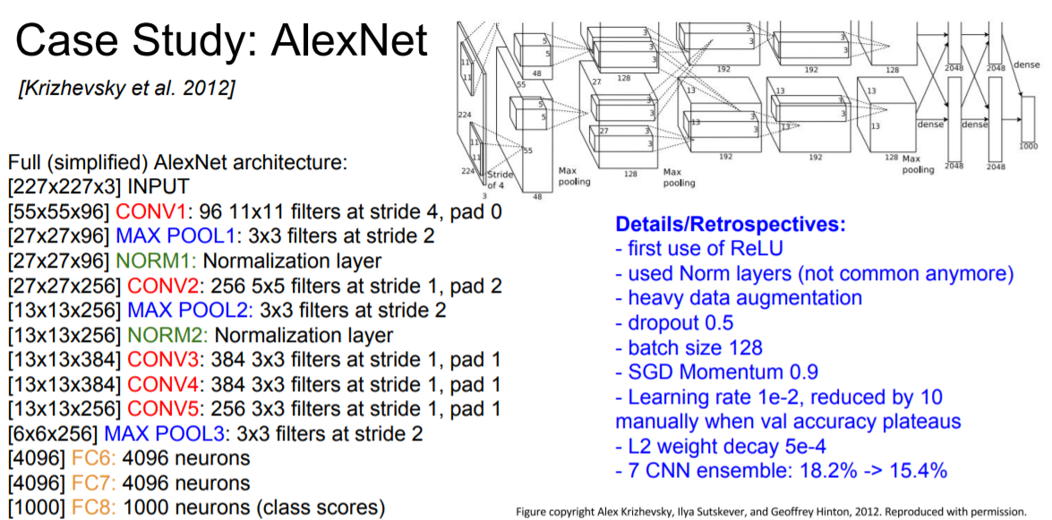
AlexNet Architecture

Slide 26
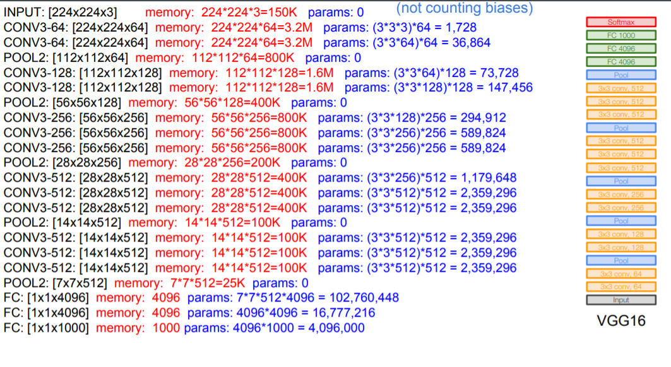
VGG16 Architecture

Slide 27
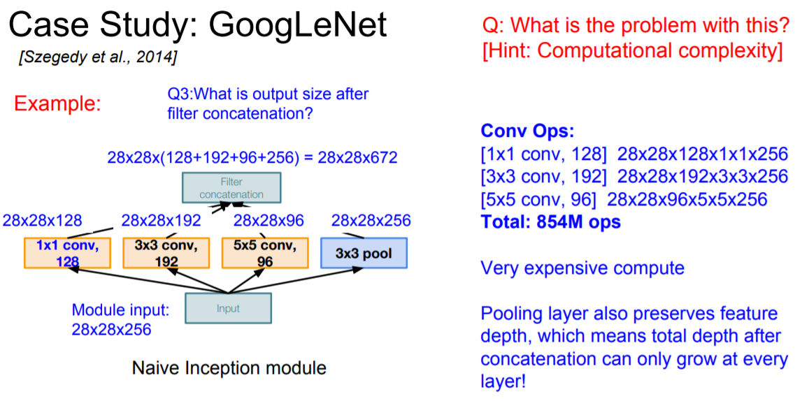
GoogleNet(1/2)

Slide 28
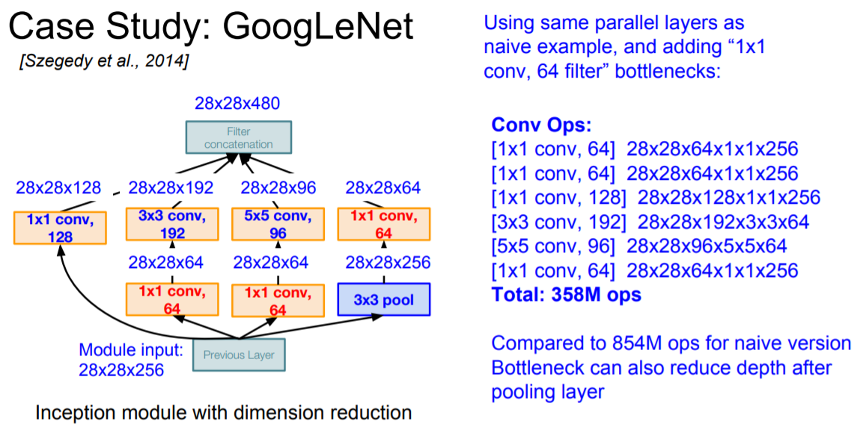
GoogleNet(2/2)

Slide 29
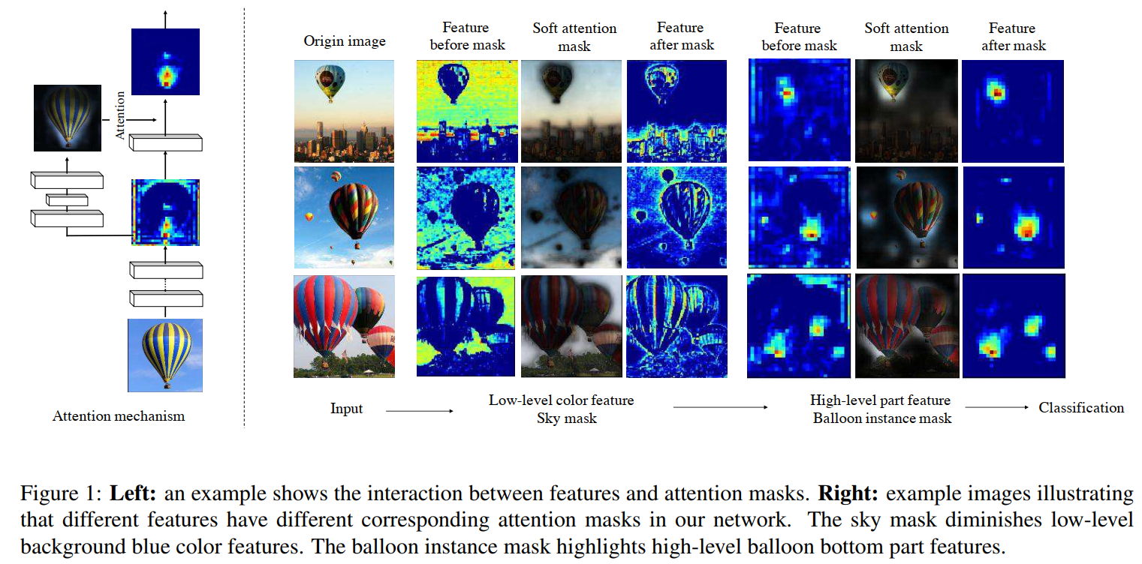
Interaction with feature and attention mask

Slide 30
Network Architecture
Stacking multiple attention modules
Two parts in attention module
  Trunk branch, T(x)
  Mask branch, M(x)
Attention module
  i: all spatial position, c: channel

Slide 31
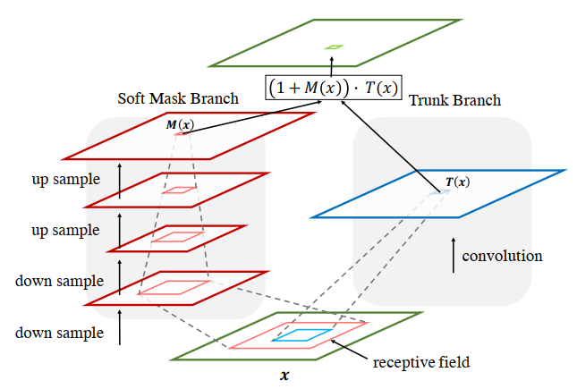
Process of Soft Mask(Attention) & Trunk Branch
Trunk: keep convolution same size with input
Soft mask: generate mask information in top-down and bottom-up process

Slide 32
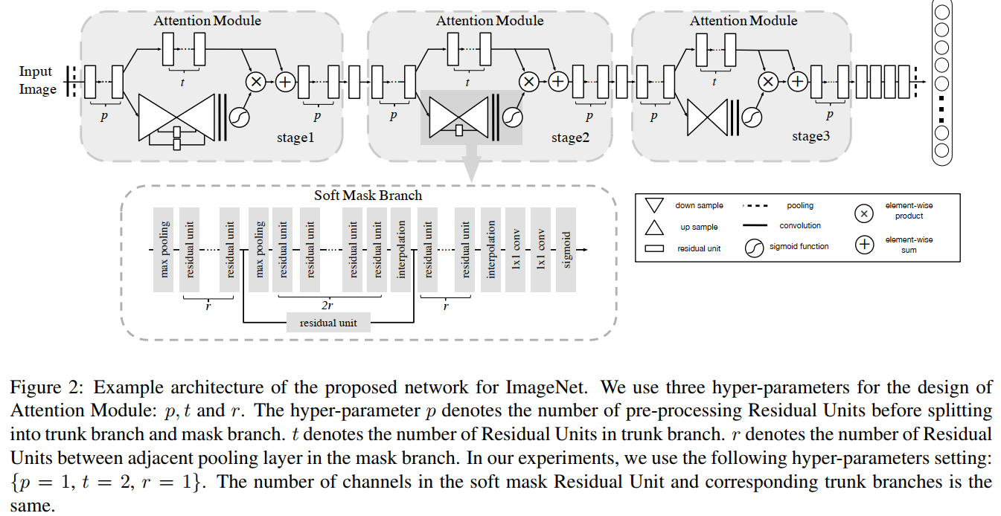

Proposed Architecture

Slide 33
Soft Mask Branch

Slide 34
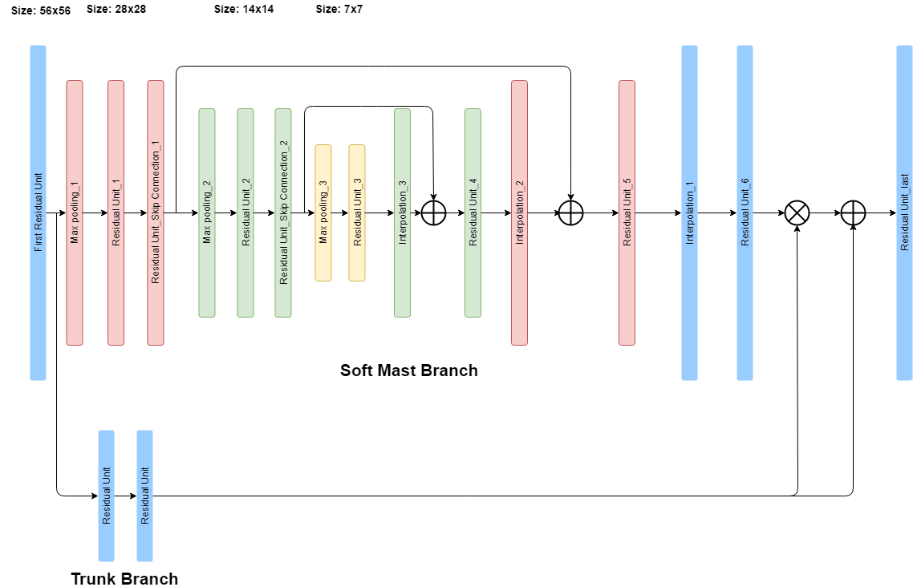
Detail of Soft Mask & Trunk Branch(stage1)

Slide 35
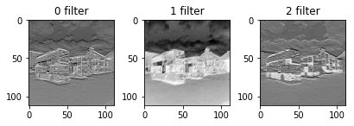
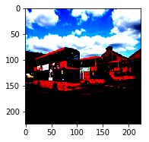

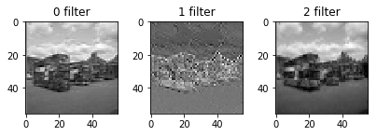


Downsampling(1/2)

Slide 36
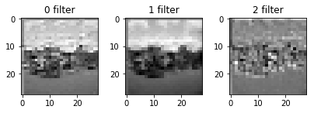

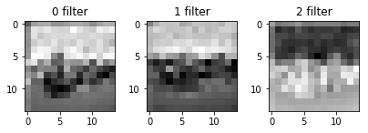

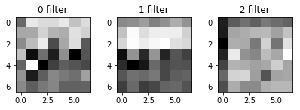
Downsampling(2/2)

Slide 37
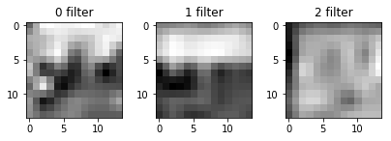

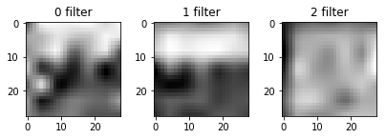

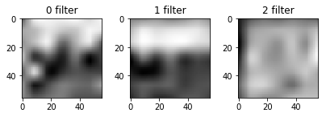
Upsampling(1/2)

Slide 38
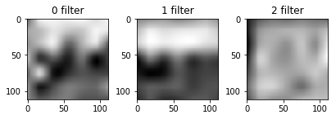

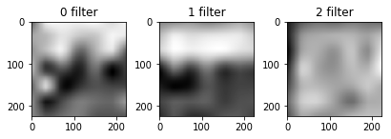

Upsampling(2/2)

Slide 39
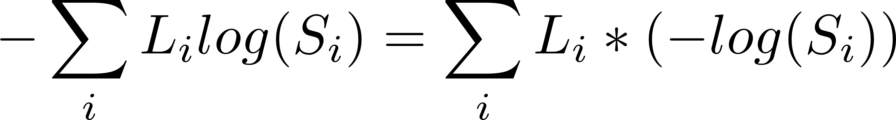

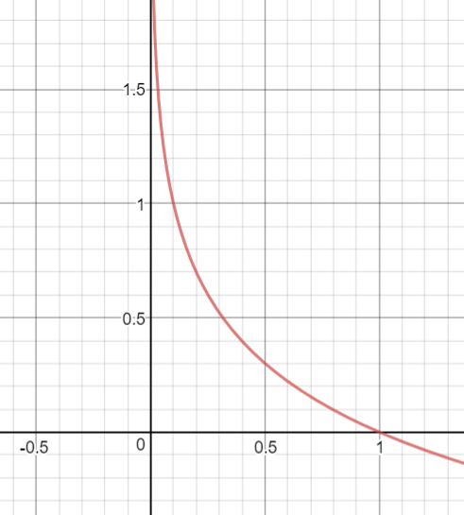
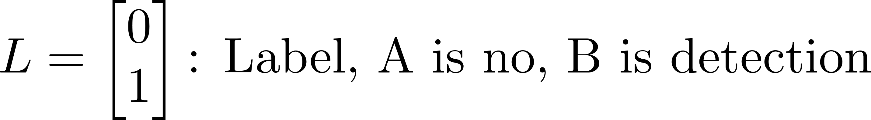
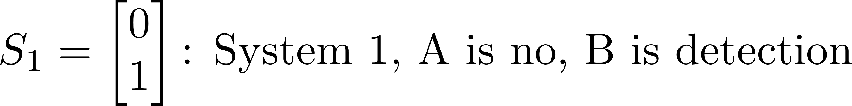
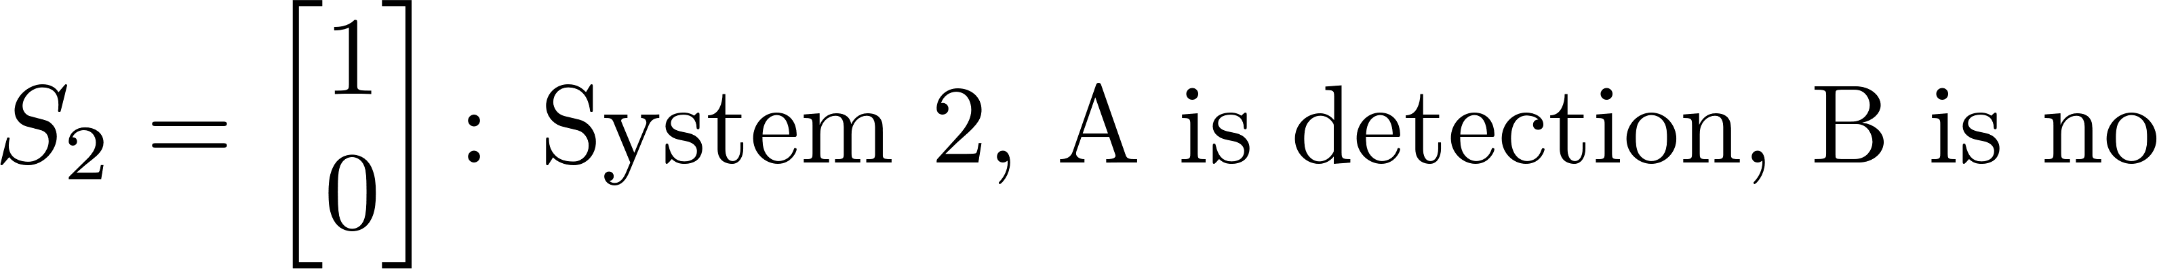
Cross entropy cost
Between the probability distributions p and q
Example
-log(x) graph
Source: https://www.desmos.com/calculator/auubsajefh

Slide 40
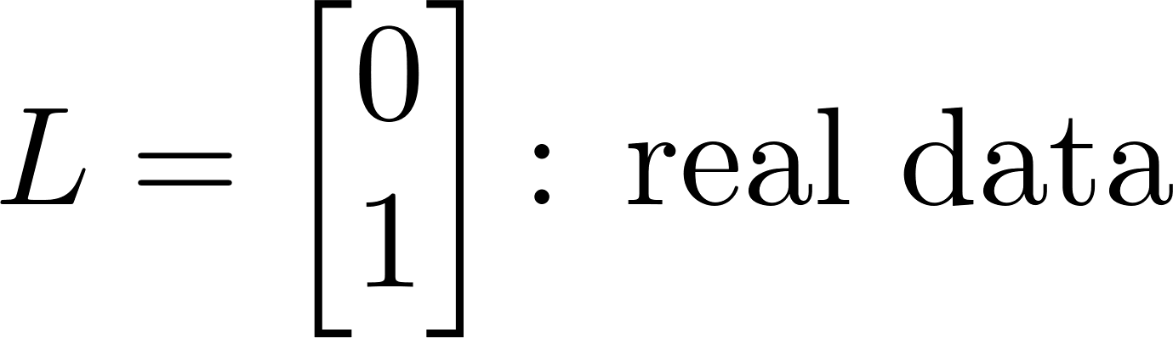
Cross entropy cost
Small cost is the optimal point to the system
Prediction score is denoted by cross entropy
wrong prediction -> high cost, right prediction -> lower cost
Goal of loss function that computes minimum cost for finding the point

Slide 41
RoIPool & RoIAlign
RoIPool: quantized bins + pooling
RoIAlign: continuous + bilinear interpolation + pooling
-> better preserved spatial correspondence
Whole feature map
RoI feature map
RoI

Slide 42

RoIPool
RoIPool: quantized bins + pooling
a) Input activation
Source: https://blog.deepsense.ai/region-of-interest-pooling-explained/

Slide 43
RoIPool
RoIPool: quantized bins + pooling
Region projection and pooling sections
Source: https://blog.deepsense.ai/region-of-interest-pooling-explained/

Slide 44
RoIPool
RoIPool: quantized bins + pooling -> 2x2 max pooling
0.85 | 0.84
0.97 | 0.96
Region projection and pooling sections
Source: https://blog.deepsense.ai/region-of-interest-pooling-explained/

Slide 45
RoIAlign
RoIAlign: continuous + bilinear interpolation + max pooling
Region projection and pooling sections
Source: https://blog.deepsense.ai/region-of-interest-pooling-explained/

Slide 46
RoIAlign
RoIAlign: continuous + bilinear interpolation + max pooling
x
x
x
x
x
x
x
x
x
x
x
x
x
x
x
x
Sampling locations
Source: https://blog.deepsense.ai/region-of-interest-pooling-explained/

Slide 47
RoIAlign
RoIAlign: continuous + bilinear interpolation + max pooling
x
x
x
x
x
x
x
x
x
x
x
x
Max pooling output
x
x
x
x
Sampling locations
Source: https://blog.deepsense.ai/region-of-interest-pooling-explained/

Slide 48
Bilinear Interpolation
Extension of linear interpolation on rectilinear 2D grid
As the intensity value is in linear relationship
What is the red point intensity value?
  Bilinear interpolation can get the intensity
1 |  |  | 3 |  |  | 5
4 |  |  | 6 |  |  | 10
7 |  |  | 9 |  |  | 12
1 | 3 | 5
4 | 6 | 10
7 | 9 | 12
Image x 3

Slide 49


Bilinear Interpolation
Extension of linear interpolation on rectilinear 2D grid
1 |  | P | 3
4 |  | Q | 6
In case of x axis
  P value
  A=1, B=3
  P =(1/3) x A + (2/3) x B = 2.33
  Q value
  C=4, D=6
  Q = (1/3) x 4 + (2/3) x 6 = 5.33
In case of y axis
  P = 2.33, Q = 5.33
  red = (1/3) x P + (2/3) x Q = 4.33
1 |  | P | 3
4 |  | Q | 6

Slide 50
Derive for Back Propagation
Youlkyeong Lee

Slide 51

Structure
Training Input/output
Initial weights
biases

Slide 52

Feed Forward Computation(1/3)

Slide 53
Feed Forward Computation(2/3)

Slide 54


Feed Forward Computation(3/3)
Calculating the total error

Slide 55



Backwards Computation(1/3)
Consider , how much a change in affects the total error
In chain rule

Slide 56



Backwards Computation(1/5)

Slide 57

Backwards Computation(2/5)

Slide 58
Backwards Computation(3/5)

Slide 59
Backwards Computation(4/5)

Slide 60

Backwards Computation(5/5)
To decrease the error, subtract this value from the current weight

Slide 61







First order Markov chains
A sequence of random variables $x_{1},x_{2},…$
$x_{t}$ is the state of the model at time t
Markov assumption:
each state is dependency of only on the previous one
dependency given by a conditional probability
A first-order Markov chain
Nth-order Markov chain:
$$x_{1}$$
$$x_{2}$$
$$x_{3}$$
$$x_{4}$$

Slide 62






Computation of Convolution Image Size

Slide 63

VGG-16 Structure

Slide 64

VGG-16 Structure
Number of layers:
weight layers(conv layers + fully connected layers),
no count max pooling

Slide 65
RoIPool & RoIAlign
RoIPool: quantized bins + pooling
RoIAlign: continuous + bilinear interpolation + pooling
-> better preserved spatial correspondence
Whole feature map
RoI feature map
RoI

Slide 66
RoIPool
RoIPool: quantized bins + pooling
a) Input activation
Source: https://blog.deepsense.ai/region-of-interest-pooling-explained/

Slide 67
RoIPool
RoIPool: quantized bins + pooling
Region projection and pooling sections
Source: https://blog.deepsense.ai/region-of-interest-pooling-explained/

Slide 68
RoIPool
RoIPool: quantized bins + pooling -> 2x2 max pooling
0.85 | 0.84
0.97 | 0.96
Region projection and pooling sections
Source: https://blog.deepsense.ai/region-of-interest-pooling-explained/

Slide 69
RoIAlign
RoIAlign: continuous + bilinear interpolation + max pooling
Region projection and pooling sections
Source: https://blog.deepsense.ai/region-of-interest-pooling-explained/

Slide 70
RoIAlign
RoIAlign: continuous + bilinear interpolation + max pooling
x
x
x
x
x
x
x
x
x
x
x
x
x
x
x
x
Sampling locations
Source: https://blog.deepsense.ai/region-of-interest-pooling-explained/

Slide 71
RoIAlign
RoIAlign: continuous + bilinear interpolation + max pooling
x
x
x
x
x
x
x
x
x
x
x
x
x
x
x
x
Sampling locations
Source: https://blog.deepsense.ai/region-of-interest-pooling-explained/

Slide 72
RoIAlign
RoIAlign: continuous + bilinear interpolation + max pooling
x
x
x
x
x
x
x
x
x
x
x
x
Max pooling output
x
x
x
x
Sampling locations
Source: https://blog.deepsense.ai/region-of-interest-pooling-explained/

Slide 73
Fully Convolutional Network
Previous pixel-level classification
  Generate local window
  Object classify within window
  Center point of window = class
  Problem: limitation search in local information and computation
FCN
  Use CNN architecture
  Global computation
  Pixel-level classification
  Classify at each pixel

Slide 74


FCN architecture
1/2
1/4
1/8
1/16
1/32
Source: https://youtu.be/UdZnhZrM2vQ

Slide 75


FCN Result
Source: Jonathan Long, Evan Shelhamer, Trevor Darrell, “Fully Convolutional Networks for Semantic Segmentation”, TPAMI, Vol. 39, Issue 4, 2016

Slide 76
Experiments
Hyperparameter : suing existing Faster R-CNN
Backbone architectures: ResNet50, ResNet101, FPN(Feature Pyramid Networks)
Input image: resized into 800px for its shorter size
GPU: 8 GPU @2 images on training
Training time: 32 hours(ResNet50-FPN), 44 Hours (ResNet101-FPN), not end-to-end training
Testing time (ResNet101-FPN): 105ms per image on an Nvidia Tesla M40 GPU(plus 15ms CPU time resizing the outputs to the original resolution)
Dataset: MS COCO(80k train, 35k val, 5k test)
YOLOv2, SSD->GeForce GTX Titan X(3073 cores, 12Gb)
Mask R-CNN->Nvidia Tesla M40(3072 cores, 12Gb)

Slide 77


Result

Slide 78

Result
Compare with Faster R-CNN in COCO dataset

Slide 79


Result
Mask R-CNN in Cityscapes dataset

Slide 80


Result
Human Pose Estimation

Slide 81

Selective Search
Selective Search by Hierarchical grouping
  Create initial regions
  Greedy algorithm to iteratively group regions
    Similarities between all neighbouring regions
    Group together with two similar regions
    Calculate new similarities between resulting region and its neighbors
  Repeat the process of grouping the most similar regions until the whole image becomes a single region

Slide 82


Hierarchical Grouping Results

Slide 83

R-CNN Architecture
Takes an input image
Extracts around 2000 bottom-up region proposals(by selective search)
Computes features for each proposal using a large convolutional network
Classifies each region using class-specific linear SVMs
R-CNN, object detection system overview
Source: Ross Girshick, Jeff Donahue, Trevor Darrell, Jitendra Malik, “Region-based Convolutional Networks for Accurate Object Detection and Segmentation”, PAMI, Vol 38, Issue 1, 2015

Slide 84

R-CNN Architecture
Regional Proposal + CNN
Regional Proposal by Selective search
Compute the CNN at each proposal region(many computation)
Improve the detection accuracy by bounding box regression
Problem
  Slow test
    13s/image in GPU
    53s/image in CPU
  Learning process complex
    84 hours in GPU
R-CNN architecture
Source: https://jamiekang.github.io/2017/05/28/faster-r-cnn/

Slide 85

Fast R-CNN
Initial RoI by Selective search
CNN for whole image
After CNN, RoI apply with feature map
Different from R-CNN that is no convolution computation at each RoI
Fast R-CNN Architecture
Source: https://jamiekang.github.io/2017/05/28/faster-r-cnn/

Slide 86


Faster R-CNN
Region Proposal Networks
  No use selective search
  RoIpooling, classifier and bounding box regressor
Source: https://jamiekang.github.io/2017/05/28/faster-r-cnn/

Slide 87
Faster R-CNN
Region Proposal Networks
  K proposals are parameterized relative to k reference boxes, which are called anchor
  K=9( 3 scales(128, 256, 512) and 3 aspect ratio(1:1, 1:2, 2:1))
  Image resize: PASAL VOC 2007(500x375) -> 1000x600
  2k scores(there is object in bounding box or not)
  4k coordinates: x, y(top-left), H, W
Source: https://jamiekang.github.io/2017/05/28/faster-r-cnn/

Slide 88

R-CNN vs Fast vs Faster R-CNN
Source: https://www.youtube.com/watch?v=v5bFVbQvFRk

Slide 89

Bounding Box Predictions
By sliding the kernel, it is a convolution process with ground truth
Some of kernels are matched with ground truth
How much match kernel with ground truth
Sliding kernel
Source: https://www.google.co.kr/search?q=udacity+dataset&source=lnms&tbm=isch&sa=X&ved=0ahUKEwjFitKu8-jaAhVElZQKHY0QCjUQ_AUICigB&biw=1474&bih=750#imgrc=Fi2QqVQZN63kMM: , UDACITY dataset

Slide 90
Datasets
MS COCO: Microsoft COCO: Common Objects in Context
  Object segmentation
  Recognition in context
  Superpixel stuff segmentation
  330K images
  1.5 million object instances
  80 object categories
  91 stuff categories
  5 captions per image
  250,000 people with keypoints

Slide 91
PASCAL VOC
PASCAL VOC project
  Pattern Analysis, Statistical Modelling and Computational Learning(PASCAL),
  VOC(Visual Object Classes)
  Provides standardized image data sets for object class recognition
  Provides a common set of tools for accessing the data sets and annotations
  Enables evaluation and comparison of different methods
  Ran challenges evaluating performance on object class recognition (from 2005-2012, now finished)
Organizers
  Mark Everingham (University of Leeds)
  Luc van Gool (ETHZ, Zurich)
  Chris Williams (University of Edinburgh)
  John Winn (Microsoft Research Cambridge)
  Andrew Zisserman (University of Oxford)

Slide 92
PASCAL VOC 2007/2012
Classes: 20
  Person(1): person
  Animal(6): bird, cat, cow, dog, horse, sheep
  Vehicle(7): aeroplane, bicycle, boat, bus, car, motorbike, train
  Indoor(8): bottle, chair, dining, table, potted, plant, sofa, tv/monitor
Train/validation/test
  9,963image containing 24,640 annotated objects
Classes: 20
Train/validation/test
  11,530 images containing 27,450 RoI annotated objects and 6,929 segmentations

Slide 93
CITYSCAPES
Semantic Understanding of Urban Street Scenes
Labs: Daimler AG R&D, Max Planck Institute for Informatics, TU Darmstadt Visual Inference Group, Germany
Volume
  2048x1024 pixels
  5,000 annotated images with fine annotations
    https://www.cityscapes-dataset.com/examples/#fine-annotations
  20,000 annotated images with coarse annotations
    https://www.cityscapes-dataset.com/examples/#coarse-annotations
Metadata
  Preceding and trailing video frames. Each annotated image is the 20th image from a 30 frame video snippets
  Corresponding right stereo views
  GPS coordinates
  Ego-motion data from vehicle odometry
  Outside temperature from vehicle sensor
Benchmark suite and evaluation server
  Pixel-level semantic labeling
  Instance-level semantic labeling

Slide 94
CITYSCAPES
Features
  Annotations
    Semantic
    Instance-wise
    Dense pixel annotations
30 classes
  Flat: road, sidewalk, parking, rail track
  Human: person, rider
  Vehicle: car, truck, bus, on rails, motorcycle, bicycle, caravan, trailer
  Construction: building, wall, fence, guard rail, bridge, tunnel
  Object, pole, pole group, traffic sign, traffic light
  Nature: vegetation, terrain
  Sky: sky
Diversity
  50cities
  Several months(spring, summer, fall)
  Daytime
  Good/medium weather conditions
  Manually selected frames
    Large number of dynamic objects
    Varying scene layout
    Varying background

