Slide 1
Spatiotemporal GMM for Background Subtraction with Superpixel Hierarchy
Mingliang Chen, Xing Wei, Qingxiong Yang, Qing Li, Gang Wang, and Ming-Hsuan Yang
IEEE Transactions on Pattern Analysis and Machine Intelligence, Vol. 40, No. 6, June 2018
Presented by: Yang Yu {yuyang@islab.ulsan.ac.kr}
Sep. 15, 2018

Slide 2
Overview
Background subtraction using hierarchical superpixel segmentation, spanning trees and optical ﬂow.
Generate superpixel segmentation trees using a number of Gaussian Mixture Models (GMMs).
Use M-smoother to enhance spatial consistency on spanning trees and estimate optical ﬂow to extend M-smoother to temporal domain.

Slide 3
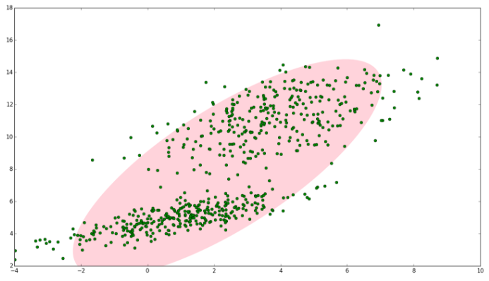
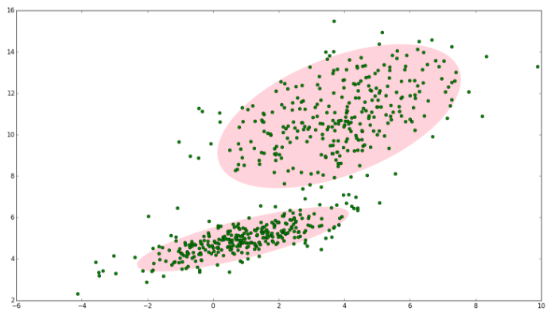
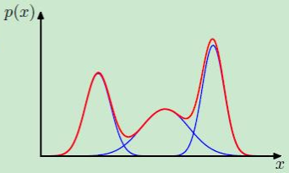
Gaussian Mixture Background Model
Model pixel intensity value by a mixture of Gaussians.
Probability of observing a pixel.
Gaussian probability density function
Mean value and covariance matrix of the kth Gaussian.
Each pixel is described by K different Gaussian distributions.

Slide 4
Spatially-Consistent Background Modeling
Each pixel in GMM is processed independently and less robust to noise.
For sudden and frequent intensity changes---add incorporate region cues in spatially-consistent background model.

Slide 5
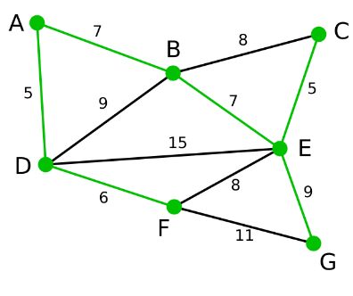
Minimum Spanning Tree
Assume connected pixels with similar pixel values have similar background estimates.
Similarity between two pixels is deﬁned based on minimax path
Undirected graph pixels and edges
Each minimax path identiﬁes a region boundary without high contrast and does not cross the boundary of any thin-structured homogeneous object.
Each minimax path can be efﬁciently extracted using a minimum spanning tree.
Greedy algorithm - minimum spanning tree
Pixel is node,
Adjacent edge weight is pixel value difference

Slide 6
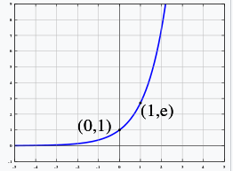
Minimum Spanning Tree
Reﬁned background estimate 0.1
Minimax path ﬁltered with M-smoother to handle outliers
weighted median ﬁlter
or is image where pixel value at pixel q is or
Weighted aggregation results
Signiﬁcantly reduce noisy effect.

Slide 7
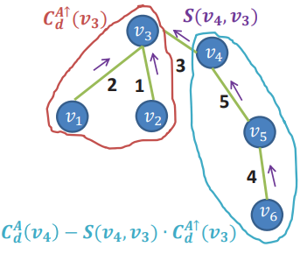
Linear Time Solution
Computational load of M-smoother lies in weighted aggregation
Recursive matching cost aggregation method
denotes the parent of node p
8-bit gray-scale images
T1 and T2 denote the two lookup tables

Slide 8
Temporally-Consistent Background Modeling
Use optical flow.
Extend to temporal domain
Similarity measurement. Obtained directly from optical ﬂow
motion vector
Simplify
Recursive approximate
Spatiotemporally-consistent background model

Slide 9
Superpixel Hierarchy
Hierarchical superpixel segmentations--background motion.
Segmented superpixels are organized by a spanning tree
Image --graph where weights are dynamically adjusted to extract superpixels
, Gaussian mixture model is V
GMMs within a superpixel are merged into a single GMM
Background estimate obtained for superpixel P.
Number of superpixels is iteratively reduced by half. 10
--mean color of superpixel at s th scale.
Initial and ﬁnal background estimates
10
Robust for dynamic appearance changes.

Slide 10
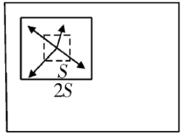
Superpixel Set
Simple linear iterativeclustering (SLIC) algorithm is used to segment video sequence to obtain a superpixel set .
Pixels of similar characteristics are aggregated to form a more representative large "element". Dimensionality reduction.
Seed Pixel Initialization. SLIC uses a simple clustering (greedy) algorithm. At initial moment, center of each cluster is equally divided into the original image. Number of superpixels can also be determined by these central points.
At each iteration, the seed pixels merge the surrounding pixels to form a superpixel.

Slide 11
Experimental results (1/6)
Spatiotemporal background subtraction with a superpixel hierarchy.
(a) Stuttgart Artiﬁcial Background Subtraction (SABS) dataset.
(b)-(f) GMM, spatially-consistent and spatiotemporally-consistent background model without and with a superpixel hierarchy.

Slide 12
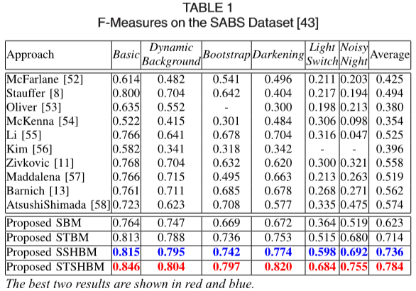
Experimental results (2/6)
Evaluation on the SABS Dataset
Six image sets with diverse scene changes.

Slide 13
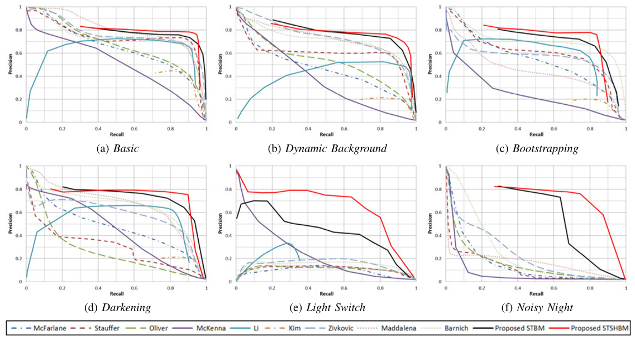
Experimental results (3/6)
Precision-recall curves with different challenging factors
Region-based methods are less robust to dynamic background.
Pixellevel background models are not robust to the sudden illumination changes and sensor noise.
Model background changes with superpixel hierarchies..

Slide 14
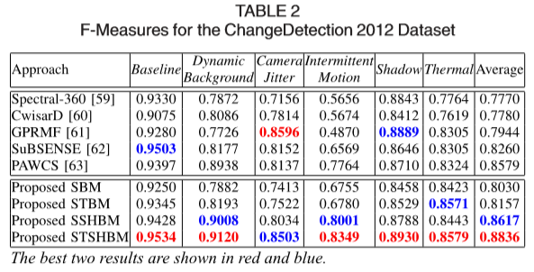
Experimental results (4/6)
Evaluation on the ChangeDetection 2012 Dataset.

Slide 15
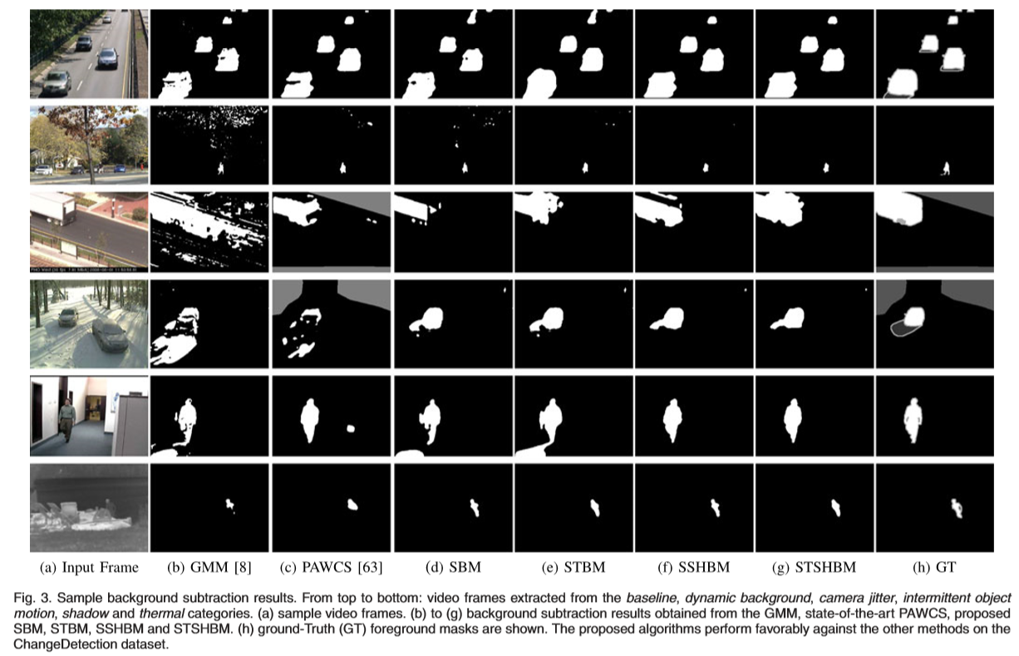
Experimental results (5/6)
ChangeDetection Dataset.
.

Slide 16
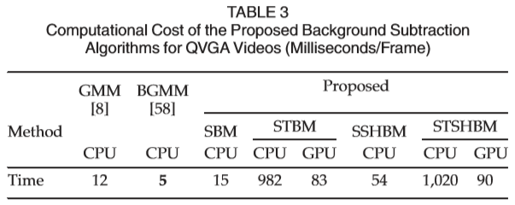
Experimental results (6/6)
Computational Cost.
2.3 GHz Intel Core i7 CPU and 4 GB memory.
Main additional computational cost of SSHBM is hierarchical GMM and M-smoother.
Optical ﬂow.

Slide 17
Conclusion
Pixel-based background models process each pixel independently and efﬁciently--not robust to noise due to sudden illumination changes.
Region-based background models can better describe scene changes--less robust to frequent appearance variations.
Effective and efﬁcient background subtraction models based on hierarchical superpixel and robust estimator to exploit the strength of two approaches.

Slide 18
Thank you for attention!

