Slide 1
Real-Time Vehicle Make and Model Recognition Based on a Bag of SURF Features
Abdul Jabbar Siddiqui, Abdelhamid Mammeri, and Azzedine Boukerche
IEEE Transactions on Intelligent Transportation Systems, Vol. 17, No. 11, November 2016
Presented by: Yang Yu {yuyang@islab.ulsan.ac.kr}
Nov. 26, 2016

Slide 2
Overview
Real-time automated vehicle make and model recognition (VMMR) based on a bag of speeded-up robust features (BoSURF).
Use SURF features of front- or rear-facing images and retain the dominant characteristic features (codewords) in adictionary.
Single dictionary, modular dictionary. SURF features to BoSURF histograms
Single multiclass SVM and an ensemble of multiclass SVM based on attribute bagging.

Slide 3
Application of VMMR
Automated vehicular surveillance: parking lots of public spaces (e.g., malls, stadiums or airports).
Search for a speciﬁc vehicle type, make, or model.
VMMR systems based on license plates can fail due to ambiguity, forgery, damage, or license-plate duplication.

Slide 4
Challenges
Toyota Altis, Toyota Camry, Nissan Xtrail: three classes Multiplicity: displays different shapes.
Ambiguity: different companies --comparable shapes.
Intramake ambiguity: same company --comparable shape or appearance.

Slide 5
Contributions
Speed: 7 fps, accuracy: 95%
(1) VMMR based on BoSURF, dominant dictionary;
(2) Single-Dictionary, Modular-Dictionary : multiplicity and ambiguity problems of VMMR.
(3) Optimal dictionary sizes.
(4) Single Multi-Class SVM Classiﬁer (SVM) and Attribute Bagging based Ensemble of SVM Classiﬁers (AB-SVM),
Inter-class differences (to solve inter-make and intra-make ambiguity)
Intra-class similarities (to solve multiplicity)
(5) random training-testing dataset splits of NTOU-MMR Dataset

Slide 6
Vehicle make and model recognition
Real-time automated vehicle make and model recognition (VMMR) based on a bag of speeded-up robust features (BoSURF).
Architecture of VMMR systems..
MMR module of VMMR system

Slide 7
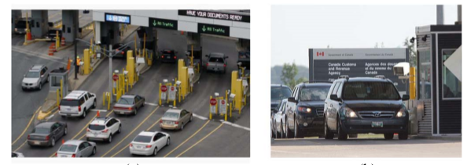
VMMR
Vehicle detection.
Features extraction and global features representation .
Classiﬁcation approaches.
VMMR targeted environment: gates of a cross-border checkpoint.

Slide 8
Dataset description
Speed up to 65 km/h for the oncoming vehicles.
2,846 images for training, and 3,793 images for testing. The total numberof classes is 29.
Different viewing angle: −20◦ to 20◦
Daytime and night-time, and under weather conditions.
Occluded by irrelevant objects

Slide 9
BOSURF-MMR
BoSURF approach for VMMR
Extract SURF features from training samples of all classes and retain the dominant ones in a “bag” or dictionary: Bag-of-SURF (BoSURF).
64-dimensional SURF. Dictionary represent vehicles’ images as BoSURF histograms

Slide 10
Offline Dictionary Building
Extract their SURF features.
The dominant features (codewords) are retained in a “bag” or dictionary
I: set of training images of class i .
Each j-th image in , SURF features.
Single-dictionary(SD) building, modular dictionary(MD) building.

Slide 11
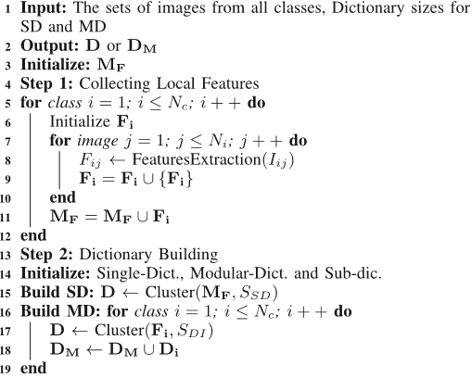
Offline Dictionary Building
: p-th SURF feature in image-j
: number of SURF features extracted from j-th image of class i.
Pool of features

Slide 12
Single Dictionary
SD(denoted by D), Kmeans++ clustering
Group training features into a number of clusters of similar patterns.
Cluster centers are the selected dominant features that make up dictionary, and are referred to as codewords
The number of clusters (or codewords) determines overall dictionary size

Slide 13
Modular Dictionary
Main dictionary (denoted by DM) by combining individual dictionaries of each class.
Each Di is the individual dictionary of class i,
Size of the Dictionary
Affects processing speed, discriminative capacity and generalizability of the built dictionary

Slide 14
BoSURF features representations
Use the dictionary D or DM to embed given images’ local features into global BoSURF representations through Features Quantization
BoSURF features: Histogram . of votes to the dictionary codewords
BoSURF histogram
dist(a,b) is the euclidean distance
fpji is the pth SURF feature and pji is the numberof SURF features extracted from the image Ij.

Slide 15
Classification
Single Multi-Class SVM Classiﬁer (SVM)
Based on BoSURF histogram, binary classiﬁers in multi-class SVM vote to predicted class.
Ensemble of Multi-Class SVM Classiﬁers Based on Attribute Bagging (AB-SVM)
Ensemble of individual multi-class classiﬁers --train different random feature subspaces---avoid over-ﬁtting
Create random feature subspaces, each comprising of 5 attributes.
Set of randomly chosen attribute indices for an feature subspace
BoSURF feature vector is sub-sampled into subsets based on respective set of attribute indices.
Use majority-voting to combine outputs to produce ﬁnal prediction.

Slide 16
Experiment
(1) Ofﬂine dictionary building (used for features quantization),
(2) BoSURF features generation
(3) Classiﬁcation, which involves classiﬁer training and testing.
Repeatedly randomly partition the original dataset to form different training and testing splits for each class.
Speed:speeds of the SD- and MD-based BoSURF approaches with SVM are 7.5 fps and 6.99 fps
Accuracy: correct classiﬁcation rates are 94.84% and 93.7%
Dictionary Training Time: MD is signiﬁcantly less than SD

Slide 17
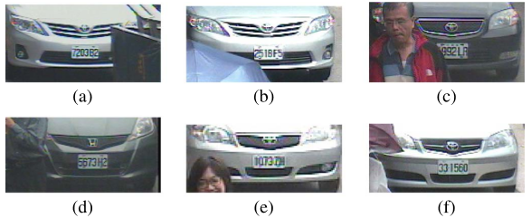
Experiment
Some challenging cases of vehicles under occlusion

Slide 18
Conclusion
Real-time automated vehicle make and model recognition (VMMR) based on Bag-of-SURF features
Two Dictionary Building: multiplicity and ambiguity
Optimal dictionary sizes for both dictionaries;
Two multi-class classiﬁcation: accurate and efﬁcient make-model prediction:
Single SVM
Attribute Bagging based Ensemble of SVMs (AB-SVM)
Random training-testing splits of the NTOU-MMR Dataset
Future work
Enhance BoSURF-VMMR approaches by exploring dictionary pruning methods.
Build a comprehensive VMMR dataset

Slide 19
SURF
Speeded up robust features (SURF)
In scale space to find extreme points (position, scale, direction)
Neighborhood gradients histogram peak- direction
Local feature detector. Use square-shaped filters as an approximation of Gaussian smoothing.
Be evaluated quickly using the integral image

Slide 20
SURF
Use a blob detector based on the Hessian matrix to find points of interest.
The determinant of Hessian matrix is used as a measure of local change around the point. Points are chosen where this determinant is maximal.
Cale-space representation and location of points of interest
Scale spaces in SURF are implemented by applying box filters of different sizes. Up-scaling the filter size rather than iteratively reducing the image size.

Slide 21
SIFT
SIFT: In scale space to find extreme points (position, scale, direction)
Neighborhood gradients histogram peak- direction
Direction- 4*4*8 HOG feature
Dense SIFT: in 16*16 patch--each position SIFT features
Match: Histogram intersection operation.

Slide 22
Thank you for attention!

