Slide 1
Manhattan-world Stereo
Y. Furukawa, B. Curless, S. M. Seitz, and R. Szeliski
2009 IEEE Conference on Computer Vision and Pattern Recognition (CVPR), pp. 1422 – 1429, 2009.
Dongwook Seo
seodonguk@islab.ulsan.ac.kr
Jan. 10, 2015

Slide 2
Introduction
Multi-view stereo (MVS) approach
Using properties of architectural scenes
Focusing on the problem of recovering depth maps
Manhattan-world assumption
Advantages of proposed approach (within the constrained space of Manhattan-world scenes)
It is remarkably robust to lack of texture, and able to model flat painted walls.
It produces remarkably clean, simple models as outputs.
Steps of the proposed algorithm
Identifying dominant orientations in the scene
Recovering a depth map for each image by assigning one of the candidate planes to each pixel in the image

Slide 3
Reconstruction pipeline

Slide 4
Hypothesis planes
Solve for per-pixel disparity or depth values
Restrict the search space to a set of axis-aligned hypothesis planes
Seek to assign one of these plane labels to each pixel in the image
Identifying hypothesis planes
MVS preprocessing
Extracting dominant axes
Generating hypothesis planes

Slide 5
MVS preprocessing (1/2)
Patch-based MVS software (PMVS) [11]
To recover oriented points
Output: set of oriented points $\left\{P_{i}\right\}$
For each point $P_{i}$
3D location $P_{i}$
Surface normal $N_{i}$
Set of visible images $V_{i}$
Photometric consistency score (normalized cross correlation) $C\left(P_{i}\right)∈[−1, 1]$
PMVS
To recover only points observed in at least three views
Initial photometric consistency threshold to 0.95
To remove points in nearly textureless regions
Project each point $P_{i}$ into its visible images $V_{i}$
Compute the standard deviation of images intensities inside a 7 x 7 window around the projected point (threshold $τ=3$ for intensities in the range $\left[0, 255\right]$

Slide 6
MVS preprocessing (2/2)
Some parameters
Depending on a measure of the 3D sampling rate $R$ implied by the input images
MVS point $P_{i}$ and one of its visible views $I∈V_{i}$
Compute diameter of a sphere centered at $P_{i}$
Weight this diameter by the do product between the normal $N_{i}$ and view direction to arrive at a foreshortened diameter
$R$: the average foreshortened diameter of all points projected into all their visible views

Slide 7
Extracting dominant axes
Under the Manhattan-world assumption
Scene structure → picewise-axis-aligned-planar
Estimation of the axes
Using the normal estimates $N_{i}$ recovered by PMVS (See [8, 15, 21] for similar approaches.)
Compute a histogram of normal directions over a unit hemisphere, subdivided into 1000 bins.
Set first dominant axis $\vec{d_{1}}$ to the average of the normal within the largest bin.
Find the largest bin within the band of bins that are in the range 80 to 100 degrees away from $\vec{d_{1}}$ and set the second dominant axis $\vec{d_{2}}$ to the average normal within that bin.
Find the largest bin in the region that is in the range 80 to 100 degrees away from both $\vec{d_{1}}$ and $\vec{d_{2}}$ and set the third dominant axis $\vec{d_{3}}$ to the average normal within that bin.
- Axes are within 2 degrees of perpendicular to each other

Slide 8
Generating hypothesis planes
Generating axis-aligned candidate planes to be used as hypotheses in the MRF optimization
Given point $P_{i}$
A plane with normal equal to axis direction $\vec{d_{k}}$ and passing through $P_{i}$ has an offset $\vec{d_{k}}∙P_{i}$. (the plane equation is $\vec{d_{k}}∙X$ = $\vec{d_{k}}∙P_{i}$.)
For each axis direction $\vec{d_{k}}$
Compute the set of offsets $\left\{\vec{d_{k}}∙P_{i}\right\}$
Perform a 1D mean shift clustering [7] to extract clusters and peaks
Generation of candidate planes
At the offsets of the peaks
Removal of clusters
Less than 50 samples
Bandwidth $σ$ of the mean shift algorithm
Control how many clusters
For each plane
Including both the plane hypothesis with surface normal pointing along its corresponding dominant axis, and the same geometric plane with normal facing in the opposite direction

Slide 9
Reconstruction
For given set of plane hypotheses
Recover a depth map for image $I_{t}$ (referred to as a target image) by assigning one of the plane hypotheses to each pixel
MRF and graph cuts
Energy function

Slide 10
Data term (1/5)
Measuring visibility conflicts between a plane hypothesis at a pixel and all of the points $\left\{P_{i}\right\}$ reconstructed by PMVS
Notational preliminaries
$X_{p}^{l}$: the 3D point reconstructed for pixel $p$ when $H^{l}$ is assigned to $p$. (the intersection between a viewing ray passing through $p$ and the hypothesis plane $H^{l}$.)
$\hat{π_{j}}(p)$: the projection of a point $p$ into image $I_{j}$, rounded to the nearest pixel coordinate in $I_{j}$
Depth difference between two points $P$ and $Q$ observed in image $I_{j}$ with optical center $O_{j}$
The signed distance of $Q$ from the plane passing through $P$ with normal pointing from $P$ to $O_{j}$.
Positive values: $Q$ is closer than $P$ is to $O_{j}$.

Slide 11
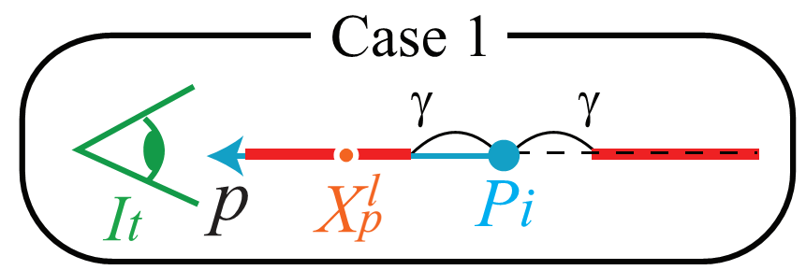
Data term (2/5)
Visibility conflict with an MVS point $P_{i}$
Case 1. If $P_{i}$ is visible in image $I_{t}$, the hypothesized point $X_{p}^{l}$ should not be in front of $P_{i}$ and should not be behind $P_{i}$.
For each $P_{i}$ with $I_{t}∈V_{i}$ and $\hat{π_{i}}\left(P_{i}\right)=p$
$h_{p}$ to be in conflict with $P_{i}$
$γ$: parameter that determines the width of the no-conflict region along the ray to $P_{i}$ (set to be 10R in this paper)

Slide 12
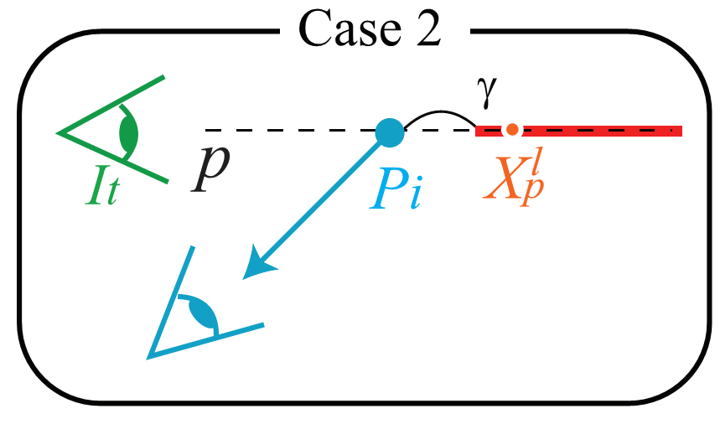
Data term (3/5)
Case 2. If $P_{i}$ is not visible in image $I_{t}$, $X_{p}^{l}$ should not be behind $P_{i}$.
For each $P_{i}$ with $I_{t}∉V_{i}$ and $\hat{π_{i}}\left(P_{i}\right)=p$
$h_{p}$ to be in conflict with $P_{i}$

Slide 13
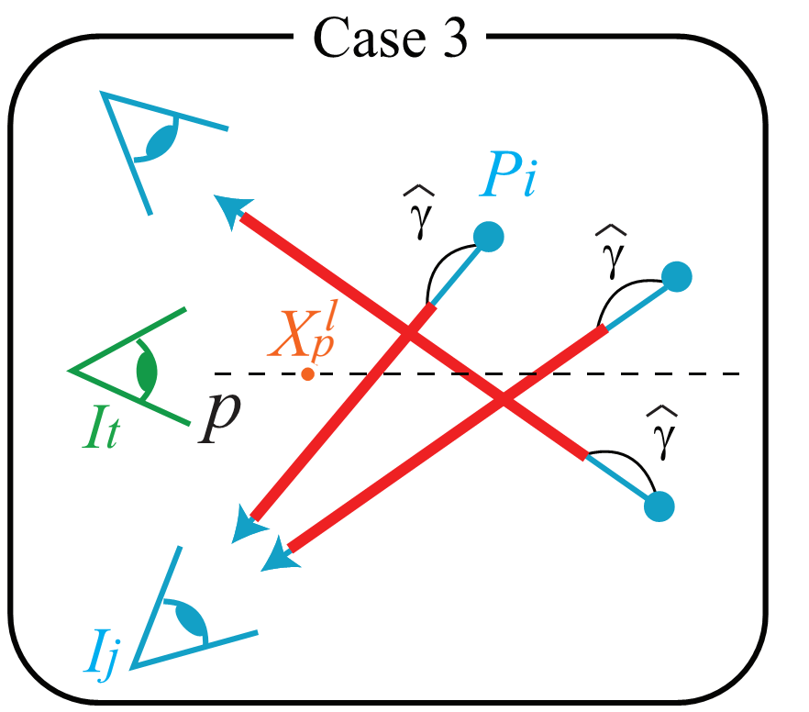
Data term (4/5)
Case 3. For any view $I_{j}$ that sees $P_{i}$, not including the target view, the space in front of $P_{i}$ on the line of sight to $I_{j}$ should be empty.
For each $P_{i}$ and for each view $I_{j}∈V_{i}$, $I_{j}≠I_{t}$ and $\hat{π_{j}}\left(P_{i}\right)=\hat{π_{j}}\left(X_{p}^{l}\right)$
$h_{p}$ to be in conflict with $P_{i}$
$N_{h_{p}}$: the normal to the plane corresponding to $h_{p}$
$r_{j}\left(P_{i}\right)$: the normalized viewing ray direction from $I_{j}$ to $P_{i}$

Slide 14
Data term (5/5)
Contribution of $P_{i}$ to the data term
$C\left(P_{i}\right)$: the photometric consistency score of $P_{i}$ reported by PMVS
Data term for $h_{p}$

Slide 15
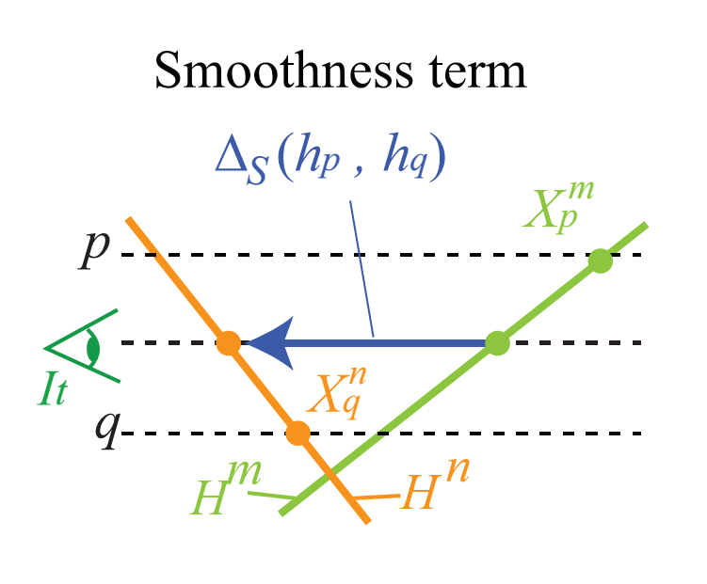
Smoothness term (1/5)
Measuring the penalty of assigning a hypothesis $H^{n}$ to pixel $q$, and a hypothesis $H^{m}$ to pixel $p$

Slide 16
Smoothness term (2/5)
Plane consistency
Plane consistency $∆_{s}\left(h_{p},h_{q}\right)$
By extrapolating the hypothesis planes corresponding to $h_{p}$ and $h_{q}$ and measuring their disagreement along the line of sight between $p$ and $q$
The unsigned distance between candidate planes measured along the viewing ray that passes through the midpoint between $p$ and $q$
Large value of plane consistency
Inconsistent neighboring planes

Slide 17
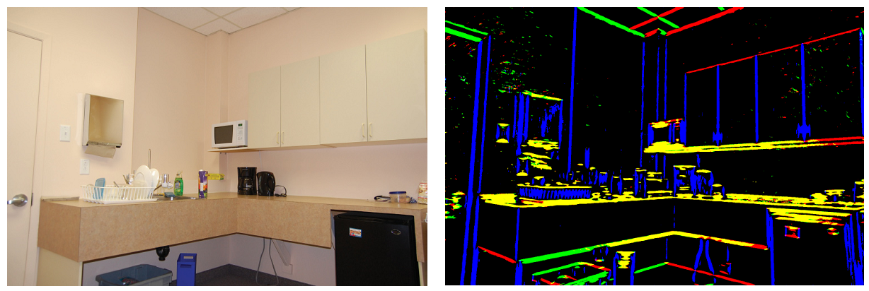
Smoothness term (3/5)
Exploiting dominant lines
Junction of two dominant planes in a Manhattan-world scene
Line is aligned with one of the vanishing points.
=> Structural constraints on depth map
Input image
Extracted dominant lines

Slide 18
Smoothness term (4/5)
Identifying dominant lines
Given an image $I$
Projection of all dominant lines parallel to dominant direction $\vec{d_{k}}$ pass through vanishing point $v_{k}$
The projection of dominant line observed at $p$
Passing through $p$ and $v_{k}$
The strength of and edge along $\vec{l_{k}}$
$\vec{l_{k}^{⊥}}$: the direction perpendicular to $\vec{l_{k}}$
$∇_{\vec{l_{k}}}I\left(p′\right)$ and $∇_{\vec{l_{k}^{⊥}}}I\left(p′\right)$: the directional derivatives along $\vec{l_{k}}$ and $\vec{l_{k}^{⊥}}$
$w\left(p\right)$: rectangular window centered at $p$ with axes along $\vec{l_{k}}$ and $\vec{l_{k}^{⊥}}$
$e_{k}\left(p\right)$: the aggregate edge orientation (or the tangent of that orientation) in a neighborhood around $p$

Slide 19
Smoothness term (5/5)
To allow for orientation discontinuities
Smoothness term between two pixels
To optimize the MRF
$α$-expansion algorithm to minimize the energy

Slide 20
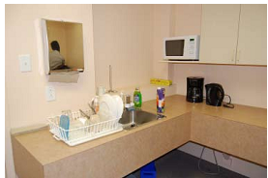
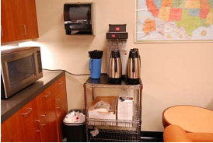
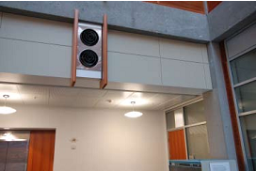
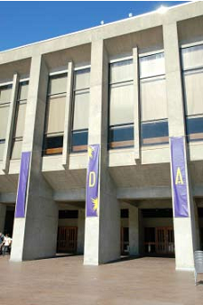
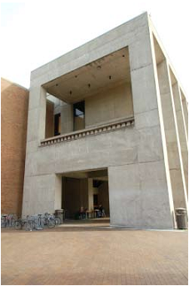
Experimental results (1/5)
Five real datasets
Camera parameters for each dataset
Using publicly available structure-from-motion (SfM) software [18]

Slide 21
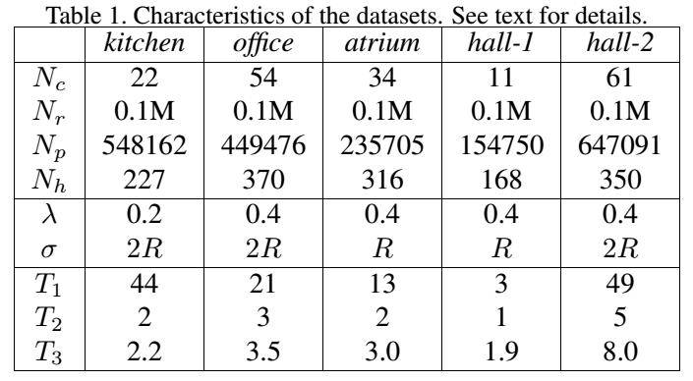
Experimental results (2/5)
$N_{c}$: the number of input photographs
$N_{r}$: the resolution of the input images in pixels
$N_{p}$: the number of reconstructed oriented points
$N_{h}$: the number of extracted plane hypotheses for all three directions
$λ$: scalar weight associated with the smoothness term
$σ$: the mean shift bandwidth, set to either R or 2R based on the overall size of the structure
$T_{1}$: the time to run PMVS (minutes)
$T_{2}$: the time for both the hypothesis generation step and the edge map construction (minutes)
$T_{3}$: the running time of the depth map reconstruction process for a single target image

Slide 22
Experimental results (3/5)

Slide 23
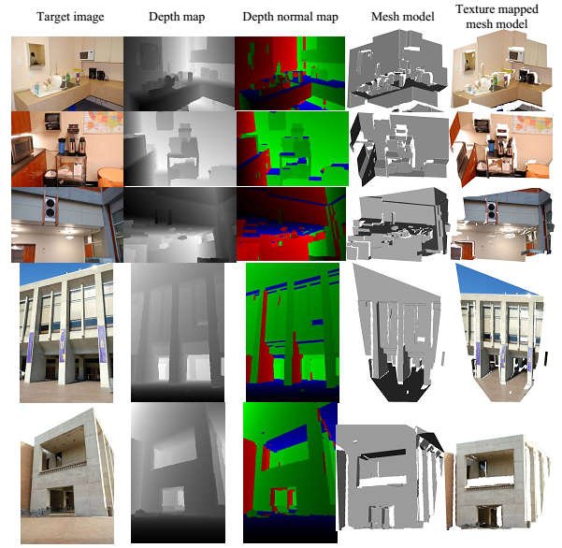
Experimental results (4/5)

Slide 24
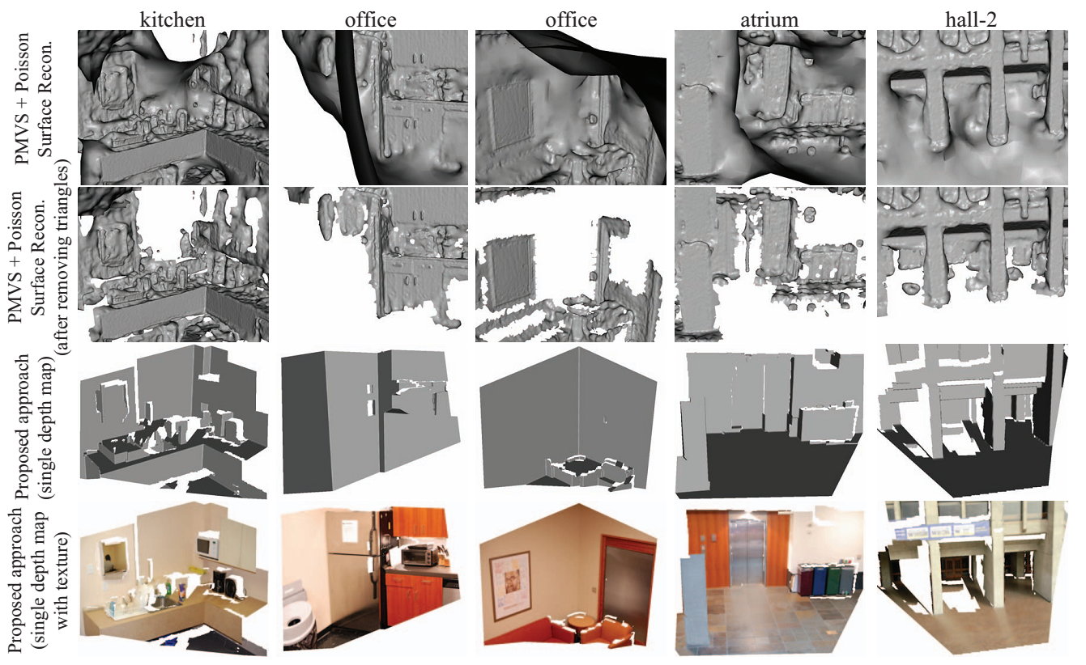
Experimental results (5/5)

Slide 25
Conclusion
The 3D reconstruction of architectural scenes based on Manhattan-world assumption
Produce remarkably clean and simple models
Perform well even in texture-poor areas of the scene
Future work
Merging depth maps into large scenes

Slide 26
References
[4] Y. Boykov and V. Kolmogorov. An experimental comparison of min-cut/max-flow algorithms for energy minimization in vision. PAMI, 26:1124–1137, 2004.
[5] Y. Boykov, O. Veksler, and R. Zabih. Fast approximate energy minimization via graph cuts. PAMI, 23(11):1222–1239, 2001.
[7] D. Comaniciu and P. Meer. Mean shift: A robust approach toward feature space analysis. PAMI, 24(5):603–619, 2002.
[13] V. Kolmogorov and R. Zabih. What energy functions can be minimized via graph cuts? PAMI, 26(2):147–159, 2004.

