Slide 1
Real-Time 6D Stereo Visual Odometry with Non-Overlapping Fields of View Tim Kazik, Laurent Kneip, Janosch Nikolic, Marc Pollefeys and Roland Siegwart IEEE Conference Computer Vision and Pattern Recognition, 2012
Presenter: Van-Dung Hoang
dungvanhoang@islab.ulsan.ac.kr
June 15, 2013

Slide 2
Content
Goal
System overview
Transformation constraint
Multi-frame window process
Fusion of two odometry
Feedback into individual camera frame
Experiment
Conclusion

Slide 3
Goal
Estimation absolute motion using stereo camera with non-overlapping fields of views.
Application: indoor environment.
http://www.youtube.com/watch?v=Yl3DbBUdnUw

Slide 4
Related work
Metric motion estimation of multiple non-overlapping camera:
Multiple individual camera:
B. Clipp, J.-H. Kim, J.-M. Frahm, M. Pollefeys, and R. Hartley. Robust 6DOF Motion Estimation for Non-Overlapping, Multi-Camera Systems. IEEE Workshop on Applications of Computer Vision, 2008.
J. Kim, H. Li, and R. Hartley. Motion Estimation for Non-overlapping Multi-camera Rigs: Linear Algebraic and L∞ Geometric Solutions. IEEE Transactions on PAMI, 2010
Multiple cameras as generalized camera model.
H. Li, R. Hartley, and J. Kim. A Linear Approach to Motion Estimation using Generalized Camera Models. IEEE Conference on CVPR, 2008
E. Mouragnon, M. Lhuillier, M. Dhome, F. Dekeyser, and P. Sayd. Generic and Real-Time Structure from Motion Using Local Bundle Adjustment. Image and Vision Computing, 2009

Slide 5
System overview
Trigger
Camera left
Camera right
Visual odometry
Visual odometry
T_{L}
T_{R}
T'_{L}
T'_{R}
Estimate metric scale λ, μ
Fusion
6D motion

Slide 6
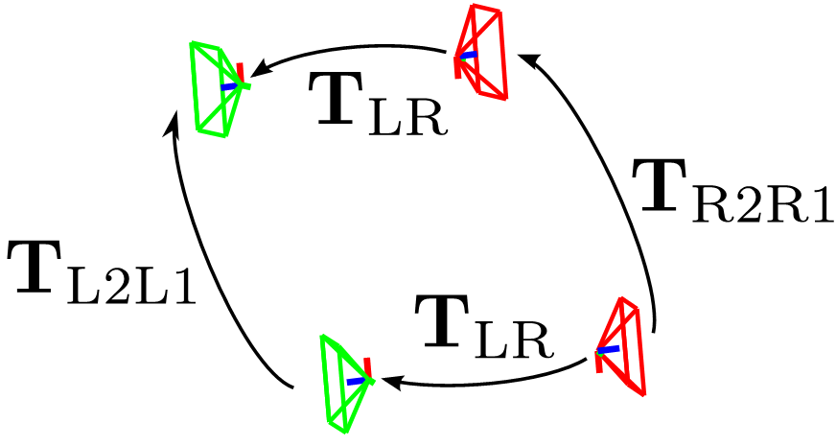
Transformation constraint
t2
Where:
T_{L2L1}: transformation of left camera position at t₁ to left camera position at t₂;
T_{R2R1}: transformation of right camera position at t₁ to right camera position at t₂;
T_{LR:} transformation of right camera position to left camera position
T_{LR} is computed by “hand-eye” calibration.
t1

Slide 7
Transformation constraint
Expanded equation:
μ, λ: scale factors translation metric for right and left camera.
=>
=>
Discovering the metric scales

Slide 8
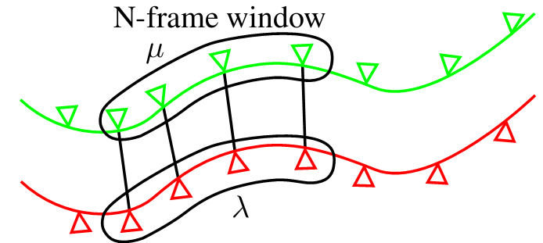
Multi-frame window process
In order to improve accuracy
=> computing scales based on several consecutive frame.
Assumption the scales are locally constant.
From frame 1->2
From frame 2->3
From frame (n-1)->n

Slide 9
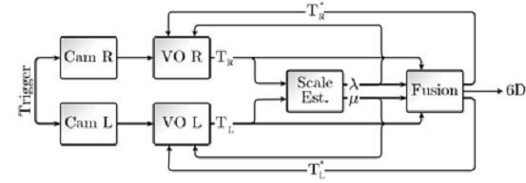
Fusion of two odometry
Estimate the motion in individual camera.
Compute corresponding motion covariance
Estimate the motion of common coordinate system
The result is feedback into individual camera frame

Slide 10
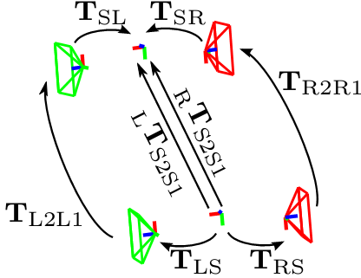
Expressing motion in common frame
Transformation of right camera:
Transformation of left camera:
Where: q: quaternion rotation representation.
R: rotation matrix.
t: translation.

Slide 11
Covariance
Measurement the uncertainty of the estimated incremental motion of the cameras => computing covariance of motion parameters based on projection error:
Where:
C stands for Left or Right camera.
P : projection function.
X_{i} : 3D world point.
x_{i}: : 2D image point.

Slide 12
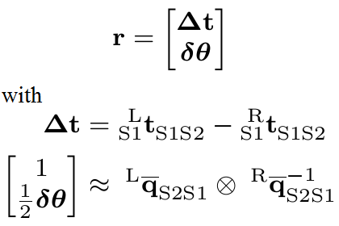
Fusion two motion estimation
Computing residual of motion
Computing weight matrix for correction
Correction value
Fusion:

Slide 13
Feedback into individual camera frame
Motion estimate result after fusion:
=> The optimal translation and rotation of each camera are inferred from the fused motion result.
with C is representative for left or right camera.

Slide 14
Experiments
System setup
Stereo cameras with 150ºFOV
Cameras system is calibration by “eyes-hand”.
Camera triggering unit: to synchronize images capture.
Vicon motion capture system: to validate of motion estimation.
CPU core i7 2.8Ghz, 4GB RAM

Slide 15
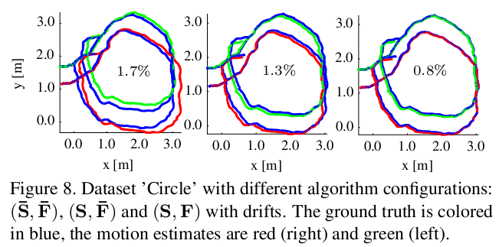
Experiments
Data collected in circular trajectory.
Monocular VO in each camera without scale estimation or fusion step.
VO with scale estimation but not fusion.
VO with scale estimation and fusion.
Notes:
S: scale. F: fusion.

Slide 16
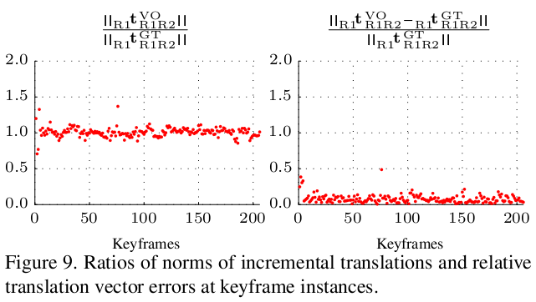
Experiments
Evaluation the ratio of the incremental translation from estimated and ground truth.

Slide 17
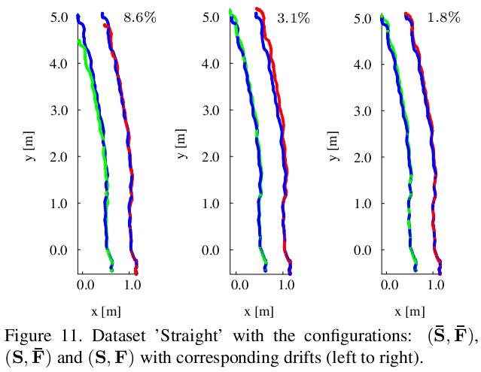
Experiments
Data collected in straight motion and little rotation.
Monocular VO in each camera without scale estimation or fusion step.
VO with scale estimation but not fusion.
VO with scale estimation and fusion.

Slide 18
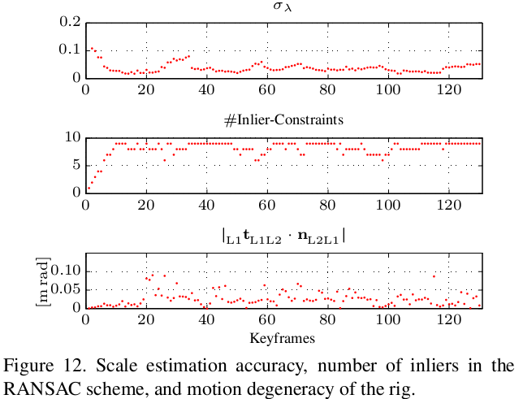
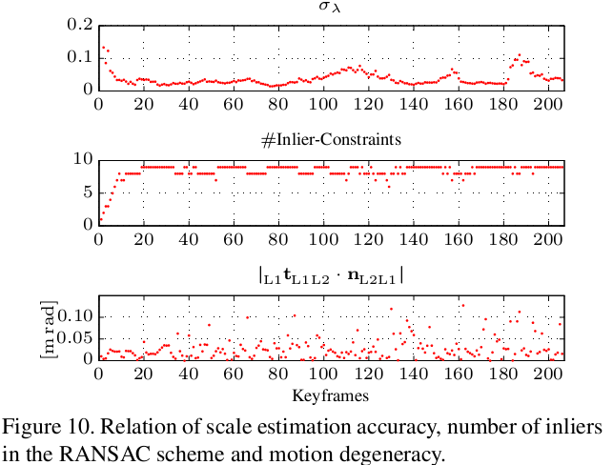
Experiments
Evaluation on standard deviation of the scale estimation, number of inliers in the RANSAC scheme, and motion degeneracy (planar motion, almost no rotation,..)
Circular motion
Straight motion and little rotation

Slide 19
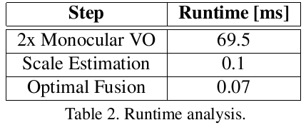
Experiments
Comparison on the norm of ratio the incremental translation from estimated and ground truth.
Time consuming
[4] B. Clipp, J.-H. Kim, J.-M. Frahm, M. Pollefeys, and R. Hart-ley. Robust 6DOF Motion Estimation for Non-Overlapping, Multi-Camera Systems. IEEE Workshop on Applications of Computer Vision 2008, pages 1–8,

Slide 20
Conclusion
Proposed the method for estimating metric 6DOF motion of stereo non-overlapping FOV.
Application indoor environment.
Advantages:
Lager FOV due to avoid common view of two camera.
Suitable for parallel process.
Disadvantages:
Short term tracking landmark => unsuitable for back confirm and correct error.
Low accuracy in the straight motion.

Slide 21
Thank you for attention!

Slide 22
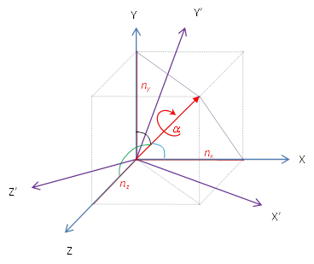
Quaternion and rotation matrix
Rotation matrix:

Slide 23
Quaternion vs. Euler angle
Convert quaternion to Euler angle (Tait–Bryan rotation)
Convert Euler angle to quaternion

Slide 24
Quaternion product
q₁ ⊗q₂ =(s₁s₂-v'₁v₂, s₁v₂+ s₂v₁+v₁×v₂)
Where:
q₁=(s₁,v₁)
q₂=(s₂,v₂)
s_{i}: scalar (real) component for quaternion
v_{i}: vector (imaginary) components for quaternion
⊗: quaternion product
× : cross product

Slide 25
Covariance of motion
The covariance of the motion parameters
Covariance matrix
Where: σ² is the estimated variance of the residual.
t and rpy represent the translation and Euler angles
Covariance matrix rewrite in quaternion
where R_{BI} consists of rotation matrices along its diagonal

Slide 26
Jacobian Matrix
F Jacobian matrix of motion function f(X,u)
=>

Slide 27
EKF Process
Formulation:
State transition
Observation
Predict:
Predicted state estimate
Predict covariance estimate
Update:
Measurement residual:
Residual covariance:
Kalman gain:
Update state estimate:
Update covariance estimate :
Noise: w=[x_{w} ,y_{w} ,θ_{w}]^{T}
Covariance matrix Q=E[ww^{T}]
Noise: v=[x_{v} ,y_{v} ]^{T}
Covariance matrix R=E[vv^{T}]

