Slide 1
Silhouette Segmentation in Multiple Views
Wonwoo Lee, Woontack Woo, and Edmond Boyer
PAMI, VOL. 33, NO. 7, JULY 2011
Donguk Seo
seodonguk@islab.ulsan.ac.kr
2012.10.13
Notes:
안녕하십니까? 오늘 제가 발표할 논문은 다중 시점에 실루엣 세그멘테이션에 관한 내용입니다. 이 논문은 2011년 PAMI에 게재된 논문입니다.

Slide 2
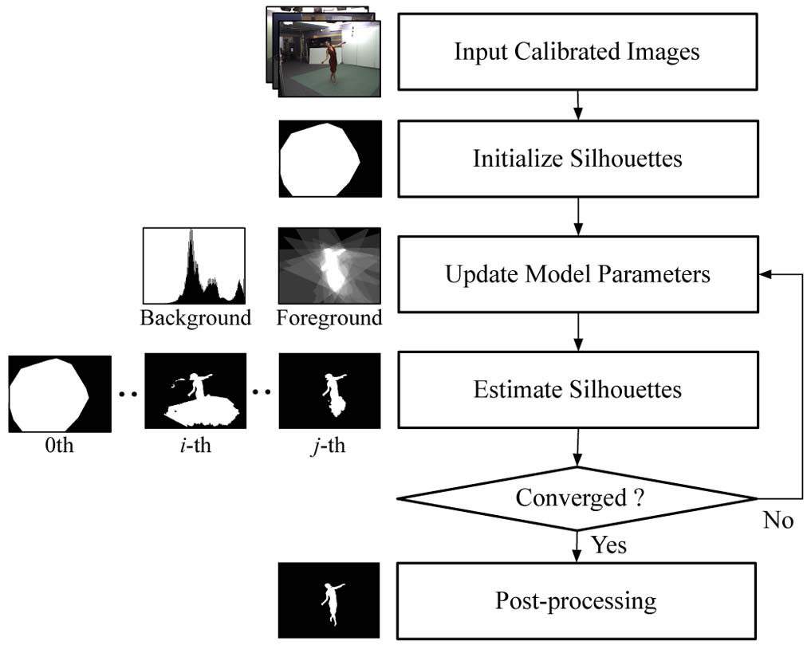
Introduction
Extraction of consistent foreground regions from multi views without a priori knowledge of the background
Two assumptions for proposed method
The region of interest appears entirely in all images.
Background colors are consistent in each image.
<Approach outline>
Notes:
이 논문에서는 배경에 대한 사전 지식 없이 다중 시점으로부터 전경 영역을 추출하는 것이 주 내용입니다. 제안된 방법에 대해 두 가지 가정을 두고 있습니다. 하나는 관심 영역은 모든 영상들에 걸쳐 나타난다. 두 번째는 배경 색은 각 이미지에서 일관성을 가지고 있다는 것이다. 제안된 방법에 대한 개요는 다음 그림과 같습니다. 입력 영상은 교정이 된 영상을 사용하고 초기 실루엣을 구하고 모델에 대한 파라미터에 대한 업데이트를 한 뒤 실루엣을 예측한다. 업데이트 과정과 실루엣 예측 과정을 실루엣을 얻을 때까지 반복하여 결과를 얻는다.

Slide 3
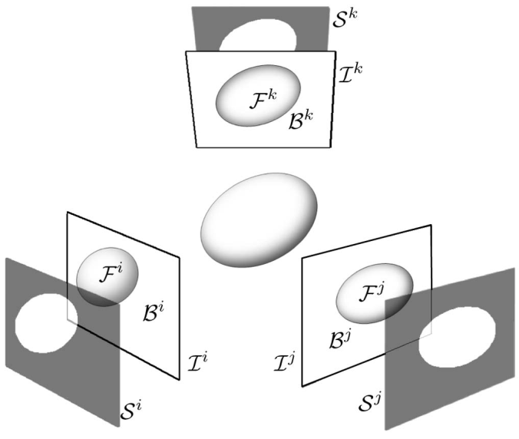
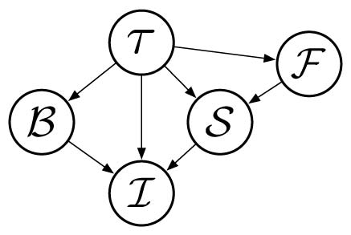
Probabilistic model
Variables and their dependencies
$I$: a color image map
$S$: a binary silhouette map
$τ$: the prior knowledge about the model
$F$: the foreground occupancy
$B$: the background colors
$i$: $i$th image
$x$: a pixel located at $x=(u,v)$ in an image
$I_{x}^{i}$: the color value of the pixel $x$ in the $i$th image
<Dependency graph of the image $I$
(Bayesian network)>
<The variables in different views>
Notes:
다중 시점에 실루엣을 검출하기 위해 확률적 모델을 사용한다. 그림에서 보는 거와 같이 이미지는 2차원에서 배경 지식과 3차원 전경 occlusion으로 이루어진다. 실루엣에 대한 사전 모델은 한 이미지에서 픽셀과 다른 이미지들 픽셀 사이의 의존성을 가진다. 변수들과 변수들 사이의 관계는 다음 그림과 같습니다. I는 컬러 영상, S는 이진 실루엣, $τ$는 모델에 대한 사전 지식, F는 전경, B는 배경을 나타낸다. $i$는 $i$번째 시점을 의미하며 $x$는 영상에서 픽셀 위치를 나타낸다. 따라서 $I_{x}^{i}$는 $i$번째 시점의 영상에서 픽셀 $x$의 컬러 값을 나타낸다.

Slide 4
Joint probability
The joint probability of all the variables
$Pr\left(τ\right)$, $Pr\left(F|τ\right)$, and $Pr\left(B|τ\right)$: the prior probabilities of the scene, the foreground, and the background (uniform distribution)
$Pr\left(S|F,τ\right)$: the silhouette likelihood that determines how likely is a silhouette given the foreground shape. (spatial consistency)
$Pr\left(I|B,S,τ\right)$: the image likelihood term that models the relationship between the image observation. (colors and the background information)
Independent of background colors and foreground shape
(1)
Notes:
앞에서 설명한 Bayesian network로 부터 확률을 계산한다. 확률은 식 (1)과 같은 Joint probability로 나타낼 수 있다. 배경과 전경에 대한 사전 조건이 없으므로 사전 확률은 uniform distribution으로 가정한다. 실루엣 우도는 공간적 일관성으로 나타낼 수 있다. 이미지 우도는 컬러와 배경 정보로 나타낼 수 있다.배경 컬러와 전경 형태는 독립이기때문에 실루엣과 이미지 우도는 다음과 같이 product 형태로 나타낼 수 있다.

Slide 5
Spatial consistency term(1/4)
$Pr\left(S|F,τ\right)$: the probability of a silhouette S knowing the foreground shape F
A spatial consistency term
To evaluate the silhouette consistency between viewpoints
Using the silhouette calibration ratio
The definition of silhouette set
Using a visual hull which is the maximal volume consistent with all silhouettes
Notes:
실루엣은 전경 형태가 투영된 이미지 영역이다. 따라서 spatial consistency 형태는 다음과 같이 바꿀 수 있다. 시점들 사이의 실루엣 일관성을 평가하기 위해 실루엣 calibration ratio를 사용한다.

Slide 6
Spatial consistency term(2/4)
<The silhouette consistencies of pixels in image $i$>
Notes:
이 그림은 이미지 $i$에서 픽셀들의 실루엣 일관성을 보여준다. 밝은 픽셀은 높은 일관성을

Slide 7
Spatial consistency term(3/4)
The silhouette calibration ratio $C_{x}$ at pixel $x$
A discrete measure based on the intersections between the viewing ray at $x$ and the viewing cones from other viewpoints
$R_{x}$: a normal distribution
$C^{m}$: the highest consistency value
$C^{m}=N−1$, $N$: the number of views
$c$: a normalization factor
$σ$: controls how $C_{x}$ influences the silhouette consistency term
Using a value of 0.7 for $σ$
(2)

Slide 8
Spatial consistency term(4/4)
Spatial consistency term at given pixel location $x$
$P_{b}$: a uniform distribution
The silhouette information at that pixel $S_{x}^{i}$
0: background
1: foreground
(3)

Slide 9
Image likelihood term
The image likelihood term $Pr\left(I_{x}^{i}|B^{i},S_{x}^{i},τ \right)$
Similarity between a pixel color $I_{x}^{i}$ and the background information (the background color model at that location)
$H_{B}$: the statistical model of the background colors
k-component Gaussian mixture model(GMM)
$N\left(x|m_{k},Σ_{k}\right)$ : the normal distribution with mean vector $m_{k}$ and covariance matrix $Σ_{k}$
$P_{f}$: controls the threshold between foreground and background assignments and ranges from 0 to 1 (uniform distribution)
(4)
(5)
Notes:
이미지 우도는 $I_{x}^{i}$의 픽셀 컬러와 배경 정보 사이의 유사성에 의해 결정된다.

Slide 10
Inference of the silhouettes
The probability of the silhouette at pixel $I_{x}^{i}$
(6)
Notes:
실루엣의 확률은 다음과 같이 결정 할 수 있다.

Slide 11
Iterative silhouette estimation
Two assumptions
Any foreground element has an appearance different from the background in most images so that color segmentation positively detects the element in most images.
The region of interest appears entirely in all of the images considered.
Iterative opitmization
Silhouettes are estimated using foreground and background models. (spatial and color consistencies)
These model are updated with the new silhouettes.

Slide 12
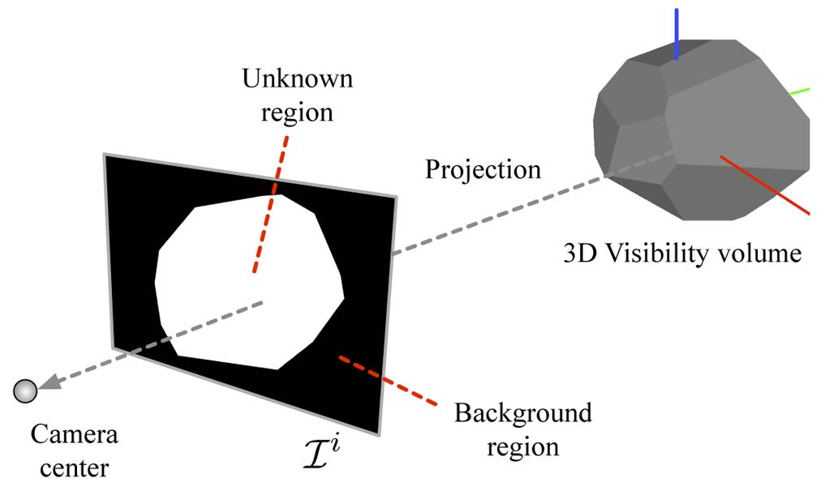
Initialization
Foreground scene: observed by all cameras
Belongs to the 3D space region that is visible from all cameras
The background
color model

Slide 13
Iterative optimization via Graph cut(1/2)
Iteration
Estimate each silhouette $S^{i}$ using (6) with the current background models $B^{i}$ and the other current silhouettes $S^{j≠i}$.
Update each $B^{i}$ with pixels outside the current $S^{i}$.
For the first step
To decide for the pixel labeling into foreground or background in each image (from equation (6))
Graph-based approaches which account for additional spatial coherence in the image

Slide 14
Iterative optimization via Graph cut(2/2)
Minimization of energy of the pixel assignment $S^{i}$ in image $i$
$E_{d}$: the data term that measures how good pixel label $S_{x}^{i}=0,1$ is with respect to the image observation.
$E_{s}$: the smoothness term that favors consistent labeling in homogeneous region
$N^{i}$: the set or neighboring pixel pairs in image $i$ based on 8-connectivity
$D\left(\right)$: the euclidean distance
(7)

Slide 15
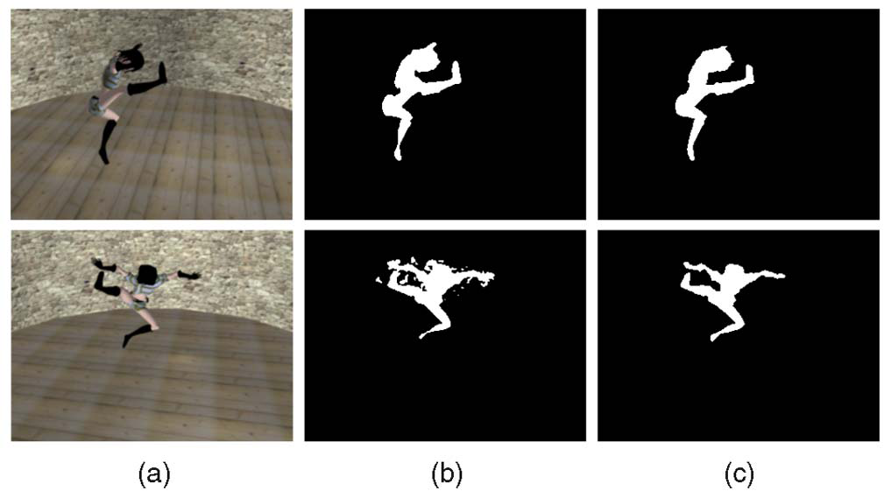
Silhouette refinement
$H_{F}$: color model for foreground
$H_{B}$: Gaussian Mixture Model (GMM)
(8)
Input image. (b) Silhouette after the iterative optimization
(c) Silhouette after refinements

Slide 16
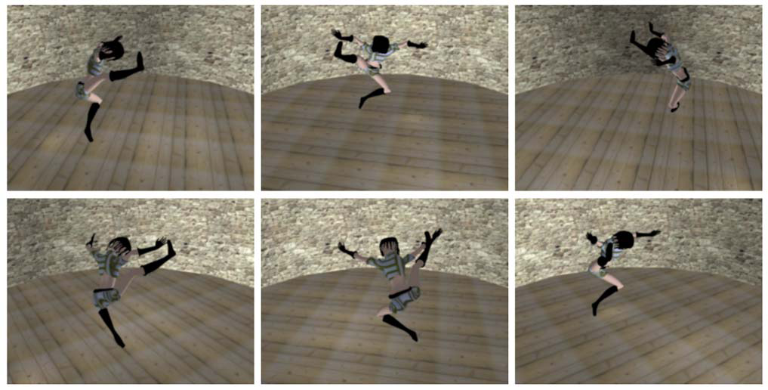
Experimental results
Synthetic data
Kung-fu girl data set:
http://www.mpi-inf.mpg.de/departments/irg3/kungfu/

Slide 17
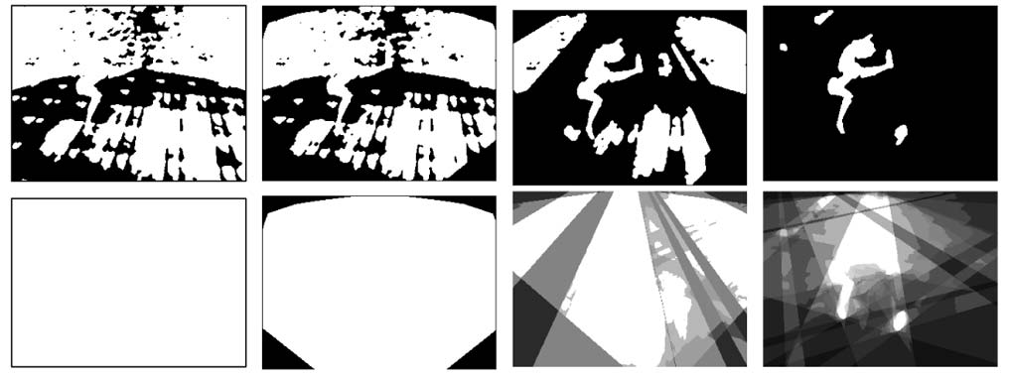
Kung-fu girl data (1/2)
Segmentation results with different numbers of views (top row) accounting for spatial consistencies (bottom row)
Only using background color consistency
One view
Two views
four views
Six views

Slide 18
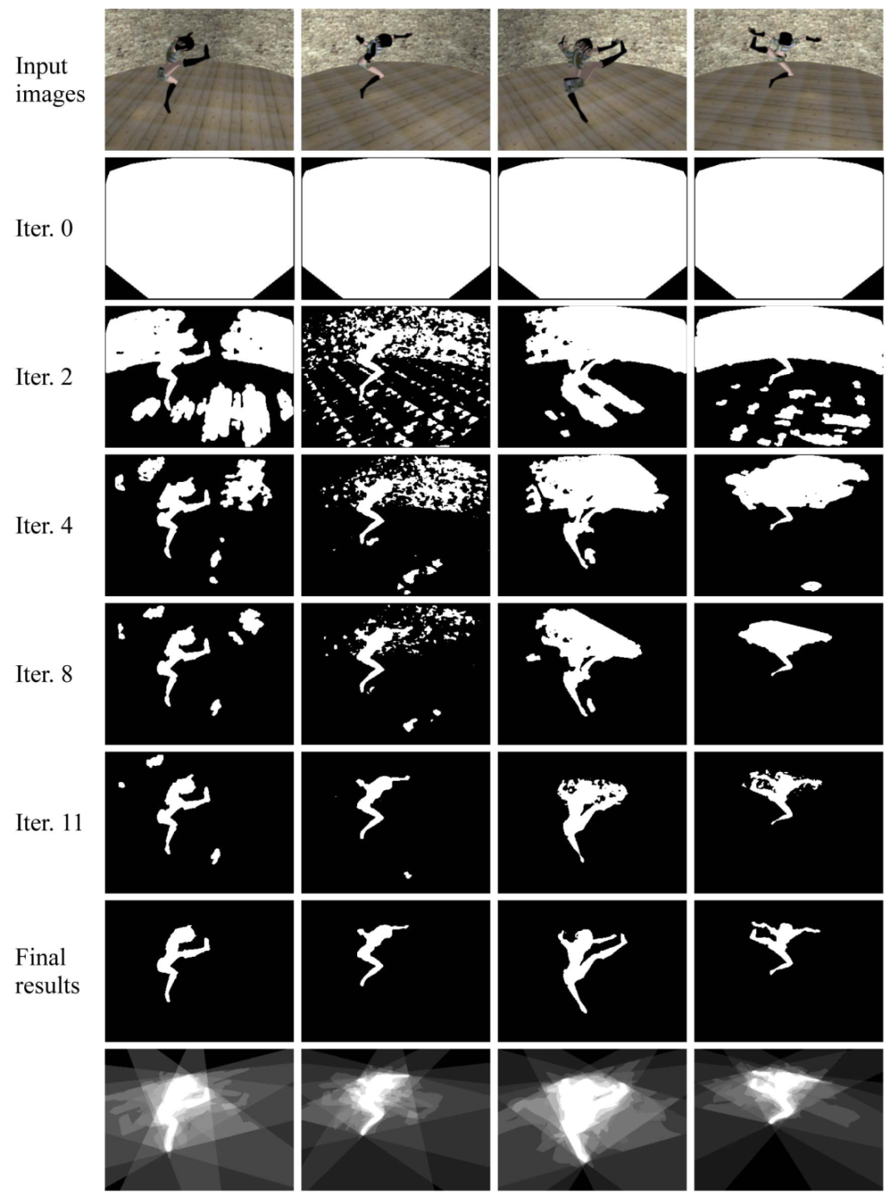
Kung-fu girl data (2/2)
Proposed method

Slide 19
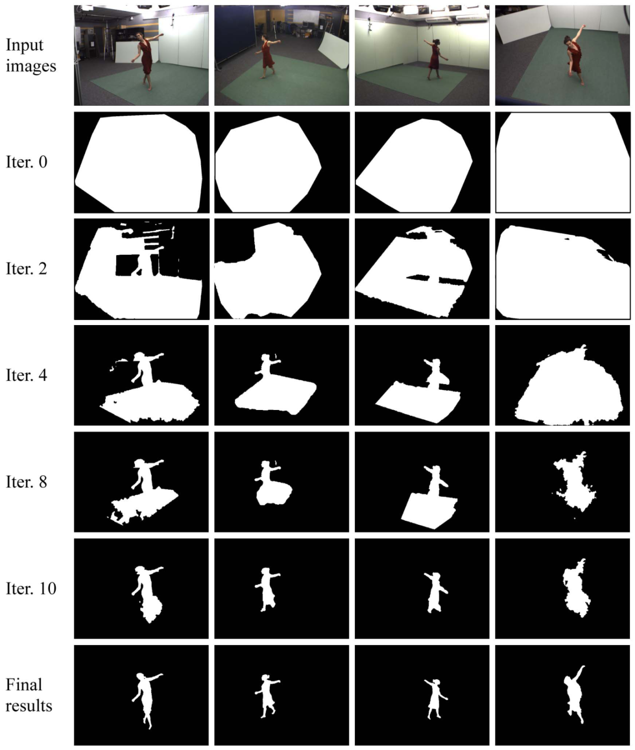
Real data(1/7)
Basic calibration
GPU-based SIFT
<Segmentation results with the Dancer data (eight views) >

Slide 20
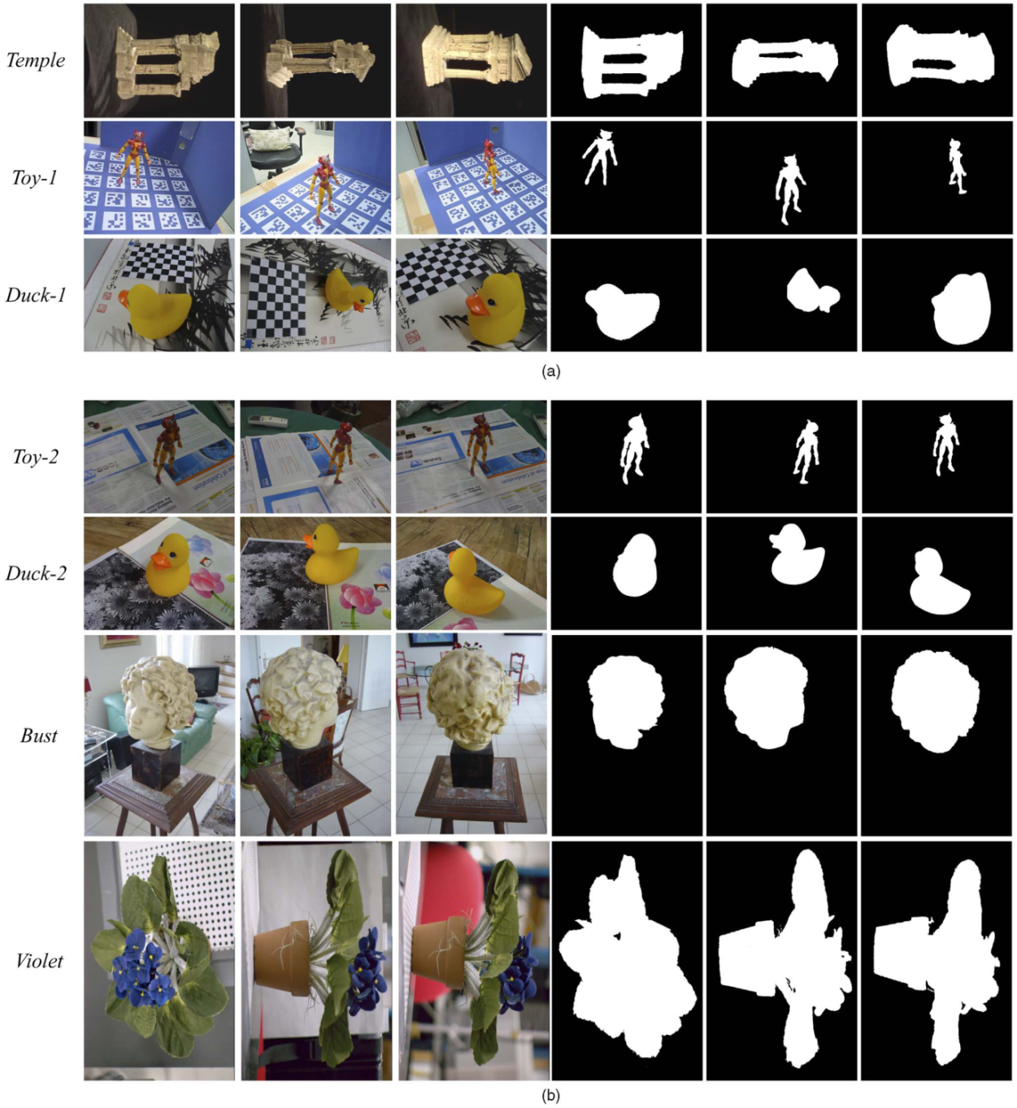
Real data(2/7)
(10 views)
(12 views)
(5 views)
(12 views)
(8 views)
(6 views)
(8 views)
<Segmentation results with single-object scenes>

Slide 21
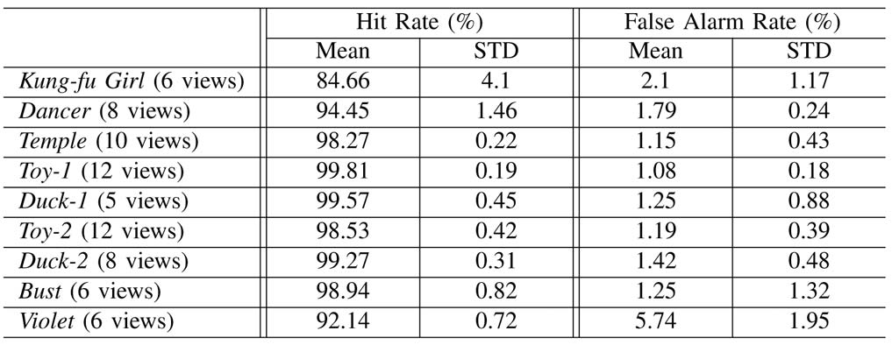
Real data(3/7)
Quantitative evaluation
$N\left(∙\right)$: the number of pixels in a set
$W_{a}^{b}$: the label set a pixel (a: the labeling F or B, b: the ground truth label)
(9)
Table 1. Silhouette extraction performance measurements

Slide 22
Real data(4/7)
(a) Only one object is spatially consistent. (6 views)
(b) All three objects are spatially consistent. (6 views)

Slide 23
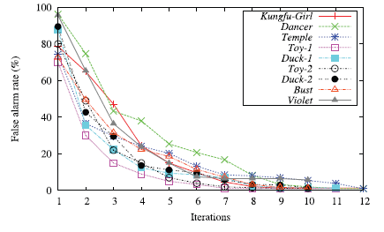
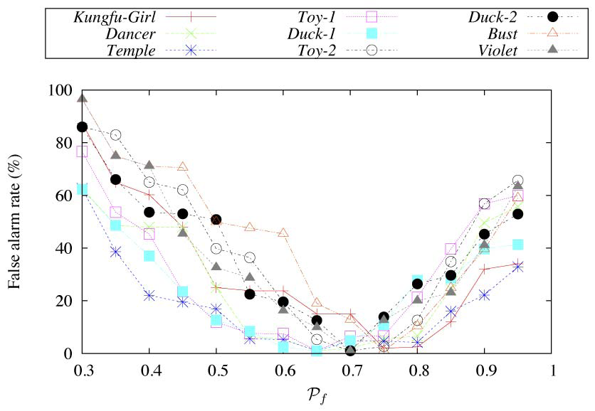
Real data(5/7)
<Convergence of the extracted silhouettes: the average false alarm rates at each iteration>
<Silhouette extraction with different $P_{f}$>

Slide 24
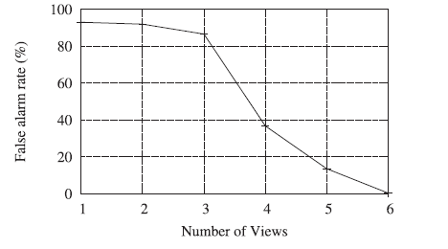
Real data(6/7)
<Silhouette extraction for a different number of views>

Slide 25
Real data(7/7)
<Silhouette extraction in the presence of noise>

Slide 26
Conclusions
A novel method for extracting spatially consistent silhouettes of foreground objects from several viewpoints
Using spatial consistency and color consistency constraints in order to identify silhouettes with unknown backgrounds
The assumption
Foreground objects are seen by all images and they present color differences with the background regions.

Slide 27
Thank you!!!

Slide 28
Silhouette calibration ratio
The silhouette calibration ratio
$w_{i}^{r}$: an interval along ray $r$ where image $i$ contributes
$m$ rays and $n$ images
$N\left(\right)$: the number of image contributing inside that interval

Slide 29
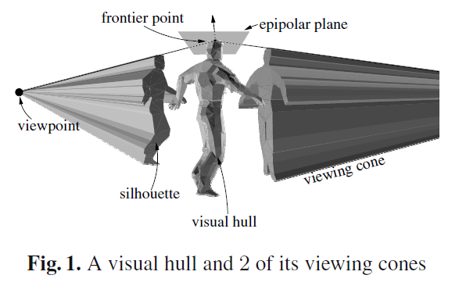
Visual hull

Slide 30
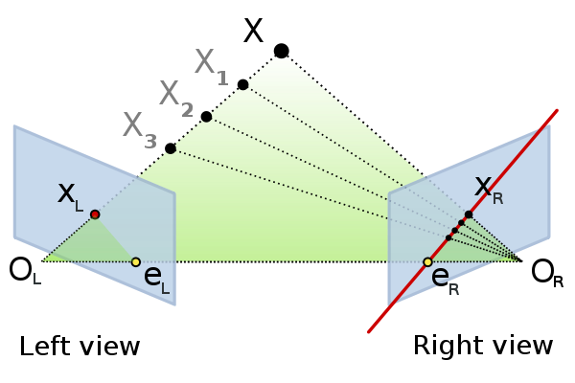
Epipolar geometry
3D point
Epipolar plane
Center of projection
of camera
Projection of
point X
Epipole
Epipolar
line

