Slide 1
FAST HUMAN DETECTING USING A CASCADE OF HISTOGRAM OF ORIENTED GRADIENTS
Qiang Zhu, Shai Avidan, Mei-Chen Yeh, and Kwang- Ting Cheng
In: Computer vision and Pattern Recognition-CVPR’2006
Presenter: Hoang, Van Dung
dungvanhoang@islab.ulsan.ac.kr
April 28, 2012

Slide 2
Outline
Histogram of Oriented Gradients (HOG)
  Method
  Variable size block
  “Integral image” method
Training classification
Experiments
Conclusions.

Slide 3
Introduction
Paper ^{(*)} showed that the system is powerful enough to classify humans by use HOG feature. However, it has high computational cost.
This paper try to speed up above method by using AdaBoost, and HOG feature. However, if using original HOG (fix size blocks) is not informative enough to classify at high accuracy.
=> This paper proposed HOG computing with variable size block.
*Dalal, N and Triggs, B.. Histograms of Oriented Gradients for Human Detection. In Proceedings of the IEEE Conference on Computer Vision and Pattern Recognition, Vol. II, pp. 886-893 (2005).

Slide 4
Histogram of Oriented Gradients
Gradient computation
Orientation binning
Descriptor blocks
Block normalization
Gradient computation
  G_{x}=I⊗[-1 0 1]
  G_{y}=I⊗[-1 0 1]^{T}
  Magnitude
  Angle
G
G_{y}
α
G_{x}
G_{x}
G_{y}

Slide 5
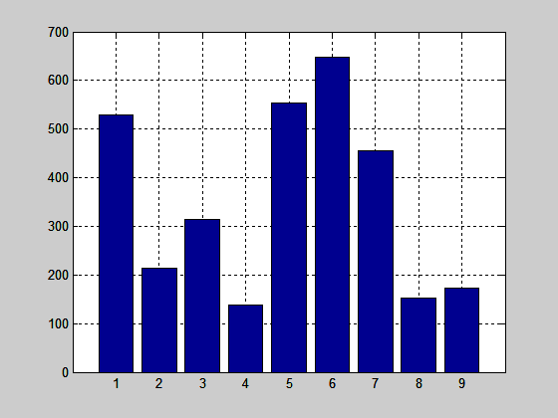
Computing HOG within a Region
Computing histogram of gradient based on orientation
(Using unsigned of orientation (0-180⁰) and 9 bins)
Magnitude
  Angle

Slide 6
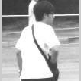
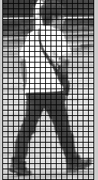
Computed HOG
Calculation histogram of orientation gradient within cells, blocks.
Accumulation features to construct HOG feature vector.
F is the vector feature of image, f ^{i} is the vector feature of i^{th}-block
and normalizing.

Slide 7
Variable-size Blocks
Different with original HOG feature, this paper don’t fix size of block. The block size rangers from 12x12 to 128x64 with restrictive ratio between block width and height is (1:1), (1:2), and (2:1).
  Original HOG: 105 block (3,780 features).
  This paper: 5,031 block (181,116 features).

Slide 8
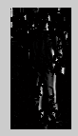
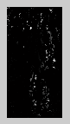
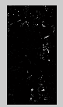
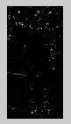
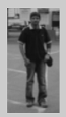
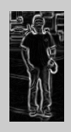
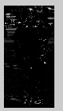
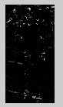
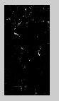
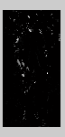
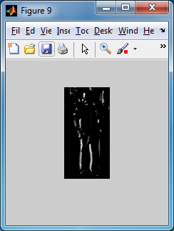
Discretize Gradients into Bins
Discretization each pixel’s gradient magnitude into 9 bins based on their orientation.
1th bin layer (1º₋20º)
2th bin layer (21º₋40º)
Computing gradient
9th bin layer (161º-180º)

Slide 9
“Integral Image” Method
Using “Integral image” method for rapid compute HOG
There are two steps to calculate sum of gradients with in a region .
  Creation the SAT table.
  Calculation a histogram bin of gradient within a region (x,y,w,h) based on SAT
  S(x,y,w,h)= SAT(x+w-1,y+h-1)-SAT(x-1,y+h-1)
  SAT(x+w-1,y-1)+SAT(x-1,y-1)
SAT(x,y)
SAT(x-1,y-1)
SAT(x+w-1,y-1)
SAT(x-1,y+h-1)
SAT(x+w-1,y+h-1)
=> HOG within cell(x,y,w,h), we compute S(x,y,w,y) of 9 bin layers, respectively.

Slide 10


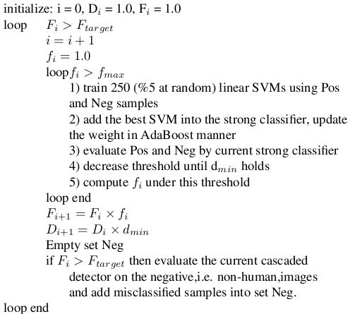

Training the Cascade
Chose one block that is best classification

Slide 11
Training the Cascade
Each a cascade consists several weak classifiers
Each weak classifier used one block.
The number weak classifiers of each cascade depend on the training process
After “loop f_{i}>f_{max}”, if F_{i}> F_{target} is not satisfied, resampling by put false positive sample (from evaluate test) into negative samples for next iteration.

Slide 12
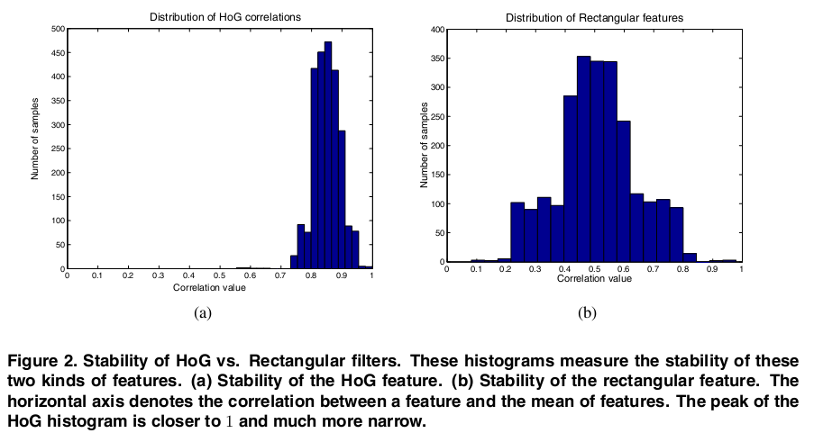
Experiments

Slide 13
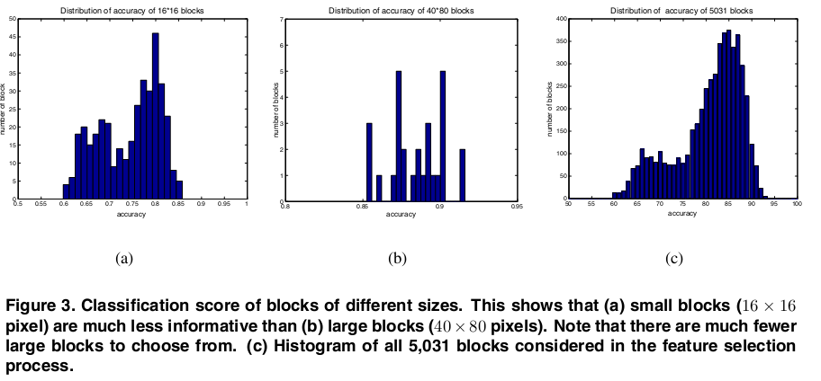
Experiments

Slide 14
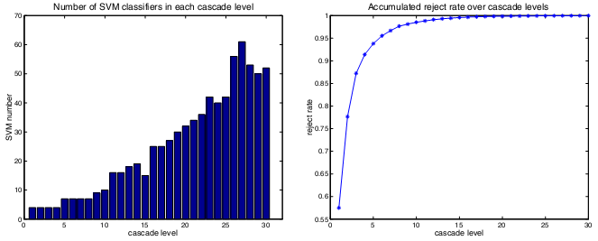
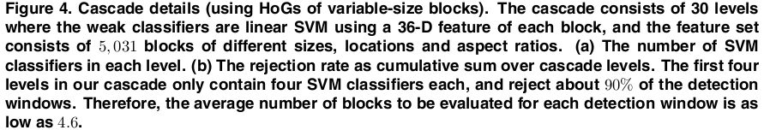
Experiments

Slide 15
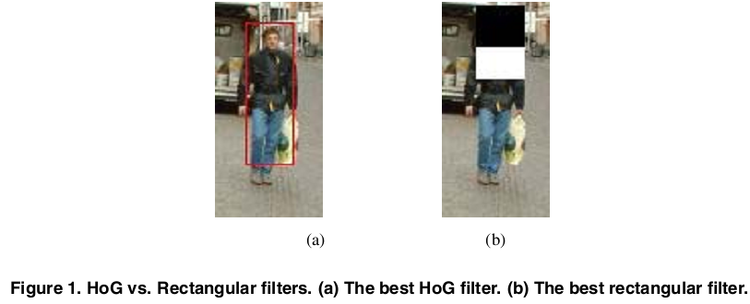
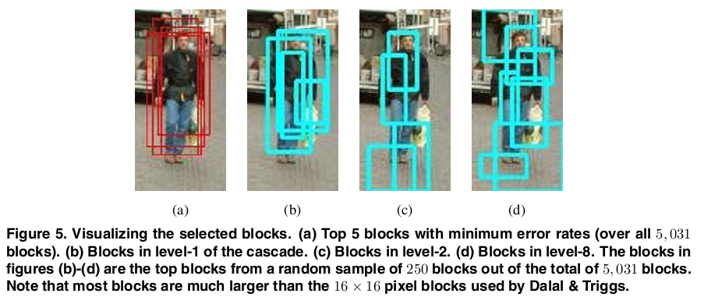
Experiments

Slide 16
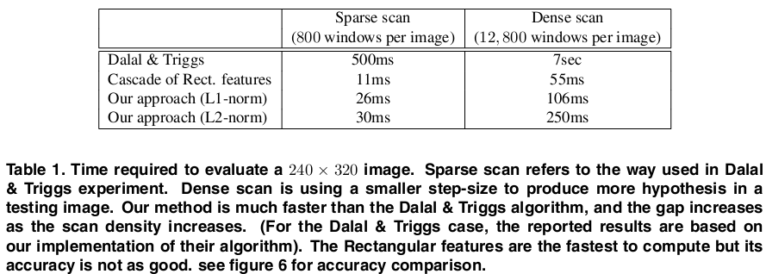
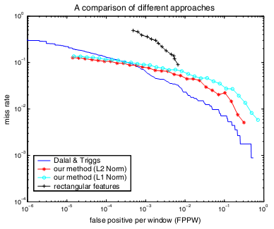
Experiments
Figure 6. Comparing the Dalal & Triggs algorithm, a Rectangular filter detector and our cascade of the HoG method. Our method (using either L1 or L2 norms) is comparable to the Dalal & Triggs method, especially when the FPPW goes down.

Slide 17
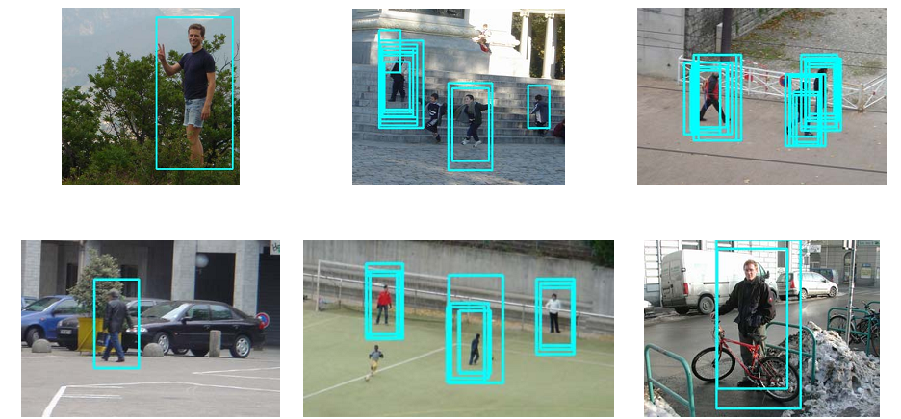
Experiments

Slide 18
Conclusions
This system used AdaBoost that is up to 70X faster than previous method (Dalal&Triggs).
Using multiple sizes block in order to accumulate more features that rich for training and classification.
Using “integral image” method that rapid compute features.

Slide 19
Thank YOU for listening!

Slide 20
x₁= (x₁₁ x₁₂ x₁₃ …. x_{1m})
x₂= (x₂₁ x₂₂ x₂₃ …. x_{2m})
x₃= (x₃₁ x₃₂ x₃₃ …. x_{3m})
x₄= (x₄₁ x₄₂ x₄₃ …. x_{4m})
…………..
x_{n}= (x_{n1} x_{n2} x_{n3} …. x_{nm})
mean
m= (m₁ m₂ m₃ …… m_{m})

Slide 21
Using all features that accumulated from sample image.
Using only the best features that were selected by training.

