Slide 1
Recognizing Human actions from Still Images with Latent Poses Authors: Weilong Yang, Yang Wang, and Greg Mori Simon Fraser University, Burnaby, BC, Canada In: IEEE Conference Computer Vision and Pattern Recognition (CVPR), 2010
Presenter: Hoang, Van Dung
dungvanhoang@islab.ulsan.ac.kr
November 05, 2011

Slide 2
Outlines
Introduction
Pose presentation
Model formulation
Part appearance potential
Pairwise potential
Root location potential
Global action potential
Learning and inference
Inference
Learning
Experiments
Conclusion

Slide 3
Introduction
The main goal of this paper is inferential the action label from still images.
The information about actions label of an image comes from the pose. For example the configurations of body parts of human in the image. However, not all body parts are equally important for differentiating actions.
The challenge is how to learn a system that is aware of the importance of different body parts. So it can try to differentiate on some parts for pose estimation.

Slide 4
Introduction (cont.)
Schema performance
Image
Body parts classification
Pose
estimation
Action detection
Running

Slide 5
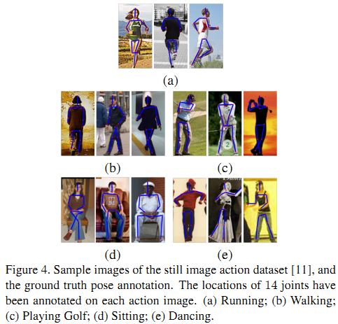
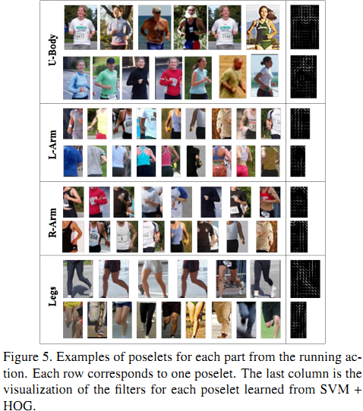
Pose representation
Authors use the notation of “poselet” to refer to a set of patches not only with similar pose configuration, but also from the same action class.
Building annotation the joint positions of human body parts in the 2D image space.
From the pose annotation, collect a set of patches with similar pose configuration.
Based on the intuition that action-specific parts to select poselets per action.

Slide 6
Pose representation (cont.)
In order to detect the presence of poselets, authors used the standard SVM and HOG feature for training classifier for each poselet.
Create samples:
The positive samples are patches from each poselet cluster.
The negative samples are randomly selected from images which have the different action label to the positive samples.

Slide 7
Model formulation
Assumptions:
Image (I) only contains one person in the middle of the image.
Y is the action label of the person, L is the pose of person.
Where:
L=(l₀,l₁,...l_{κ-1}), κ is the number of the parts
l_{i}=(x_{i},y_{i},z_{i}) is configuration of the i-th part, where (x_{i},y_{i}) indicates the (x,y) locations of the i-th in image.
z_{i}∈Ζ_{i} is index of the chosen poselet for the i-th part. Ζ_{i} denote the poselet set corresponding to the part i.

Slide 8
Model formulation (cont.)
Using an undirected graph G=(V,E) to constrain the configuration of the pose L.
Where:
A vertex j∈V, represent j-th part
An edge (j,k) ∈E
Represent connected part l_{j} and l_{k}
Upper body
0
Left-arm
2
3
Right-arm
1
Legs

Slide 9
Model formulation (cont.)
Giving a set of N training samples {(I^{(n)},L^{(n)},Y^{(n)}), n=1..N}
Learning a discriminative function H: I xY →R over an image I and its class label Y, and H is parameterized by Θ.
Testing can predict the class label Y* of input image I as
Where H is formed:
ψ(I, L, Y) is a feature vector depending on I, L, and Y

Slide 10
Model formulation (cont.)
Θ^{T}ψ(I,L,Y) is defined as
Parameters Θ are the concatenation of the parameters in all the factors. That is Θ ={α_{j}: j ∈ V} ∪ {β_{j,k}:(j, k) ∈ E} ∪ {γ}
Part appearance potential
Root location potential
Global action potential
Pairwise potential

Slide 11
Model formulation (cont.)
Part appearance potential
Where:
f(I(l_{j})) denote the feature vector extracted from the patch defined by l_{j}.
α_{jab} represents a template for the j-th part, if the action label is a and the chosen poselet for the j-th part is b.
$$1k\left(X\right)=\left\{\begin{aligned}1 if X=k \\ 0 otherwise\end{aligned}\right.$$

Slide 12
Model formulation (cont.)
Pairwise potential
Where
bin(l_{j}- l_{k}) is a feature vector that bins the relative location of the j-th and k-th part according to the (x, y) component of l_{j} and l_{k}.
$βjka$ is a model parameter that favors certain relative bins for the j-th and k-th part for the action class label a.

Slide 13
Model formulation (cont.)
Root location potential
Where:
bin(l₀) is vector according to the root part.
η_{a} is favors certain bins for the location of the root part for the action label a.

Slide 14
Model formulation (cont.)
Global action potential
Where
f(I) is a feature vector extracted from the whole image I
γ_{a} is a template for the action class a.

Slide 15
Inference
Given test image I, predict the action label Y* of I according to equation
Where
Try to find best pose

Slide 16
Learning
Training the model parameters Θ from training samples set {I^{n}, L^{n}, Y^{n}}, n=1...N.
Learning Θ using SVM formulation as follows:
Where
C is the trade-off parameter in SVM
ξ^{n} is the slack variable for the n-the training sample.

Slide 17
Experiments
Dataset: 2458 original images, consists 5 action categories: running, walking, playing golf, sitting, and dancing.
Making samples set from this set, and by mirror image.
Then manually annotate the pose with 14 joint on the human body on the all image in dataset.
For training stage, creating 90 poselets in total from the training set.

Slide 18
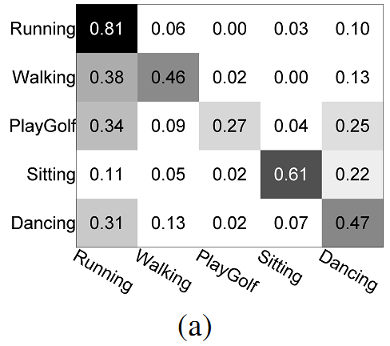
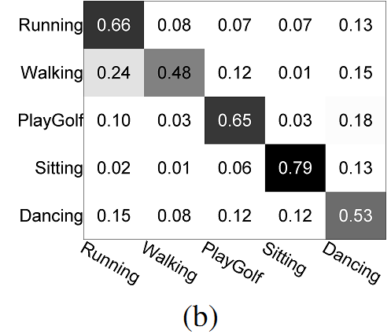
Experiments (cont.)
Comparing this approach with a multi classification SVM with HOG descriptors

Slide 19
Experiments (cont.)
Summarizing the comparison between this method and baseline method on the same test data.

Slide 20
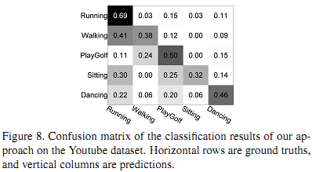
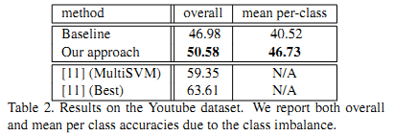
Experiments (cont.)
Testing on Youtube video dataset.

Slide 21
Experiments (cont.)
Visualization of Latent Pose

Slide 22
Conclusion
Presenting a model that integrates pose estimation and action recognition. Based on the latent pose estimation to solve action recognition.
The experimental results demonstrate that based on inferring the latent pose, we can improve the final action recognition result.

Slide 23
Conclusion
My aim: Developing the camera surveillance system for monitor smoker in public places. However, it detection smoking action via estimation the history of action on video.

Slide 24
Thank YOU for Attentions!

